Slide 1

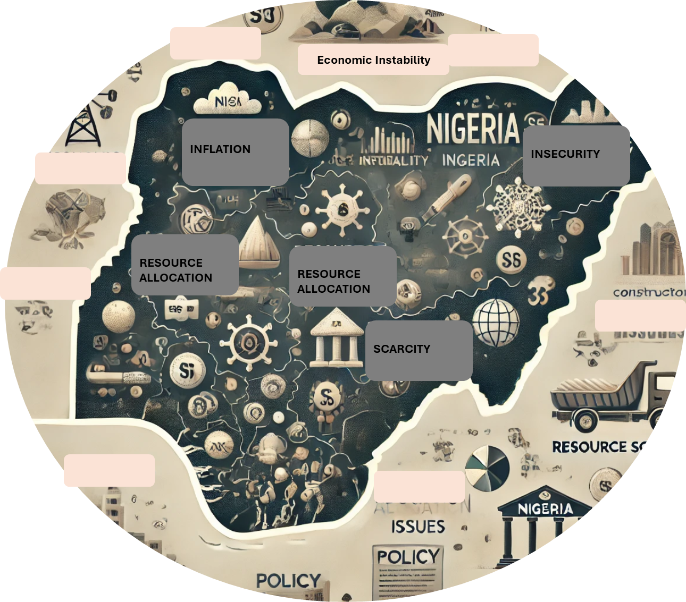
Addressing the Challenges and Limitations Facing Quantity Surveying in Nigeria’s Volatile Economy
By: QS Ogochukwu Osubor (FNIQS, RQS)

Slide 2

Content
Introduction
Identified Challenges and Recommendations
Benefits of Addressing the Challenges
Demerits of not Addressing the Challenges
Conclusion

Slide 3
Introduction
The QSRBN is the regulatory body responsible for advancing and regulating quantity surveying practice in Nigeria.
The NIQS plays a crucial role in qualifying and certifying, helping the quantity surveying profession navigate economic instability by providing guidance, upholding standards, and advocating for the profession.
Nigeria has a history of economic instability, marked by inflation, currency devaluation, unemployment, and rising costs of goods and services. This creates a challenging environment for quantity surveying. These challenges include:
  Competence and proficiency
  Galloping Inflation

Slide 4
Introduction
  Lack of public awareness of the profession's role
  Unhealthy rivalry from other professions
  Unemployment
  Corruption
  Unethical practices
  Limited proficiency in new technologies
  Insecurity
  Need for improved regulatory enforcement
Objective: This presentation identifies key challenges and provides actionable solutions to strengthen the quantity surveying profession in Nigeria’s volatile economy

Slide 5

Competence and Proficiency
?
Declining Admission Standards: Lower entry scores by JAMB have impacted the quality of candidates entering Quantity Surveying programs.
Limited Accreditation: Only 14 universities and 12 polytechnics are accredited to offer QS programs, out of 39 universities and 49 polytechnics listed.

Slide 6
Competence and Proficiency
Need for Updated Curriculum
Competence Exams & Professional Development
Continuous Professional Assessment
Automation as a Requirement
Collaboration urged between NIQS, QSRBN, NUC, and NBTE to develop a curriculum aligned with industry demands.
QSRBN accreditation exercise should rather take the form of a continuous assessment.
Exams like the Test of Professional Competence should reflect essential skills, including computer proficiency
Make automation of practice and operations a part of the requirements for accreditation & practice license

Slide 7

Galloping Inflation
Inflation Challenges: Rising inflation disrupts accurate cost predictions, affecting budgets, funding, and project timelines.
Volatility in Construction Costs: Prices for materials like cement and steel are unstable, with cement prices increasing from N4,600 to N15,500 per 50kg bag within months in 2024. listed.

Slide 8
Galloping Inflation
Adopt Cost Control Strategies
Avoid “Cheap Builds”
Adopting alternative construction techniques and reliance on locally sourced materials.
Qs should focus on life-cycle costing to ensure long-term value rather than opting for low-cost, short-term solutions.
State the basic prices, report regular trends of price increase and prepare cost control measures.
The practice of providing/publishing monthly or quarterly market prices of materials should be upheld.
Re-scoping, re-scaling and phased completion strategies can be adopted as alternative to project abandonment

Slide 9

Lack of Awareness and Recognition
Public Awareness Deficit: The title “Quantity Surveyor" lacks public recognition. Qs are often underrecognized in the society. Their roles are misunderstood and frequently mistaken for that of land surveyors.
Misinterpretation of “Value for Money”: The core role of a Qs is to ensure cost-effective, value-driven project outcomes. However, this is frequently misinterpreted as “building cheaply,” diminishing the profession’s perceived importance.

Slide 10
Lack of Awareness and Recognition
Clarifying Professional Identity
Professional Advocacy and Public Education
Expanding Scope and Specialization
Showcasing Value Through Case Studies
Emphasis on Ethics and Professional Standards:
Addressing Skill Gaps

Slide 11

Unhealthy Rivalry from Other Professions
QS
Others
Professional Overlap: Fields such as engineering and industrial installations often claim that they can manage cost-related tasks independently, seeing the quantity surveyor’s role as an intrusion.

Slide 12
Unhealthy Rivalry from Other Professions
Differentiation Through Specialized Skills
Specialization by QS Firms
Enhanced Training
Mediation by Professional Bodies
Press for outlaw of BEME
Quantity surveyors should develop unique competencies, such as using network-based bills of quantities that integrate cost, quality, and time for project optimization.
Quantity surveying firms are encouraged to specialize in fields like engineering, power installations, and oil & gas to enhance their relevance.
Expanding the QS curriculum to include engineering knowledge can better prepare quantity surveyors for roles in specialized fields

Slide 13
Unemployment
Diversify into other areas of specialization for example Arbitration, heavy engineering cost management
High Unemployment Rates
Increase monitoring to prevent unethical practices and promote professionalism.
Skill Gap
Strengthen QS Academy, Network and Build Connections
Limited Local Opportunities

Slide 14

Professional Ethics and Lack of Supervision
Need for Stronger Oversight: QSRBN’s impact is limited in enforcing standards and monitoring activities, especially regarding member welfare and ethical practices.
Participation Gaps: Many registered quantity surveyors fail to remain actively involved or fulfill obligations like paying dues, continuing practice without oversight.

Slide 15
Professional Ethics and Lack of Supervision
Establish monitoring teams at local, state, and national levels to ensure compliance
Enforce disciplinary actions visibly to uphold standards and accountability
Decentralize board operations to enhance accessibility and administrative efficiency.
Promote Professional Integrity

Slide 16

Technology Adoption
Embrace Digital Skills: Quantity surveyors should adopt IT skills, e-technology, and basic knowledge of Building Information Modeling (BIM) to stay competitive
High Unemployment Rates
BIM and Global Digitization: Mastery of BIM software is essential as the industry moves towards digital solutions for project management and cost control
Increase monitoring to prevent unethical practices and promote professionalism.
Cost Savings with Virtual Platforms: Virtual meetings (e.g., Microsoft Teams, Zoom) reduce the need for large office spaces, annual rent, travel, and stationery costs
Cost Savings with Virtual Platforms and Remote collaboration
Strengthen QS Academy, Network and Build Connections
Strengthen QS Academy, Network and Build Connections
Limited Local Opportunities

Slide 17
Production of Substandard Goods
Reduced quality, adulteration, and substandard goods increase in volatile economies.
Advocacy for Standard Enforcement:

Slide 18
Budget Constraint
Active participation of NIQS and QSRBN from the inception of the budgeting process is key
Limited Budget
Political Influence on budgeting
Late Involvement of QS in projects
Establishing connections between professionals and politicians could strengthen the role of quantity surveyors in policy-making
Increase monitoring to prevent unethical practices and promote professionalism.
Public Procurement Act: Recognizing quantity surveyors in the Public Procurement Act would enhance their influence on public projects
Public Procurement Act: Recognizing quantity surveyors in the Public Procurement Act would enhance their influence on public projects

Slide 19
Benefits of Addressing the Challenges
While it is believed that challenges are a part of life and growth, it can make a firm or organization when positively addressed, and mar when not properly addressed. The benefits of addressing challenges include:
  Goals are defined and progress leading to achievement is gained
  Abortive time and energy saved
  Build confidence – when you find a solution to a problem, especially a difficult one, you gain and increase confidence in your ability to face and overcome future challenges

Slide 20
Benefits of Addressing the Challenges
  Resilience – the ability to bounce back from difficult situations, providing opportunity to learn and adapt.
  Professional development prospects
  Helps to learn and grow – it is argued that failure can provide valuable lessons and insights that can lead to personal and professional growth
  Helps in finding innovative solutions to difficulties.

Slide 21
Demerits of not Addressing the Challenges
Failure to address challenges have their consequences as well and may include the following:
  Stagnation – growth and development become impossible
  Fear – challenges unattended grow and become more difficult
  Build up defence mechanism to avoid situations
  Miss opportunities to build resilience, learn new skills and achieve goals.

Slide 22
Conclusion
Despite economic volatility, Nigeria's quantity surveying profession can thrive with strategic actions and commitment.
Key Actions for Progress:
  Strengthen training programs to ensure relevant skills.
  Enforce industry standards and ethical practices.
  Engage in political advocacy for legal recognition.
  Expand expertise in areas like value engineering and cost management.
  Foster collaboration with other professional bodies.
  Require post-project cost analyses to highlight the value of quantity surveying.

Slide 23

Path Forward
With commitment, transparency, and consistent public engagement, the future of Quantity Surveying in Nigeria is promising.
Thank you for your attention!

