Slide 1
Quantity Surveying Consolidation and Financial Innovation: Mergers, Acquisitions and Financial Models for Mega Practices a paper presented at the niqs annual general meeting, gardencity 2024
Samuel Ekung

Slide 2
AGENDA for engagement
QS as a professional service/practice
Consolidation
Drivers of consolidation
Form of consolidations
Consolidation strategies
Financial Innovations
Financial modelling
Conclusion

Slide 3
services sector in review
Nature of service industry
Firms creating value by providing services using specialized skills and expertise.
Key resources and nature of service
The employees of the business,
Services are patterned to projects and programmes.
Examples
QS, Law, accounting, management, design and architecture, engineering, advertising
Market size
$7.06 trillion by 2025 based on capitalized growth rate of 7%.

Slide 4
Future outlook for the sector
The sector in the New Normal will be driven by:
consolidation.
Increasing specilisation,
Innovation,
Commodity pricing: the American story,
Decreasing profit
Scarcity of skilled labour (Deloitte Report 2020)

Slide 5
Types of practice& their kpi
Professional practice could be:
The embedded practices
Part of the larger or another organisation, serving the internal needs of another practice (business) or representing a unit of that organization.
Key performance indicator is satisfaction of the internal stakeholders.
Independent practice
operates as a stand-alone promoting only their line of services to the client directly.
Key performance indicator is satisfaction of the external stakeholders.

Slide 6
Key challenges
The Report “Driving Materials Benefits study in the Professional Service Sector” (Forrester Consulting, 2022) shows that:
53% of professional practice are challenged by client retention,
lack of visibility (58%), and
low profit (55%).
Consolidation
Forward
The way
The Way Forward is to Consolidate

Slide 7

consolidation
Two American studies/forecast/events:
20% decreases in the number of construction organization before 2020.
this has happened and was continuing at the rate of 25%.
Consolidation means joining together two or more entities for a common objective
For this study, integrating smaller practices to a mega practice with the view to expanding market access (creating a more resilient practices)

Slide 8
In history
In Nigeria:
British Bank of West Africa acquisition of the Anglo African Bank to form First Bank in 1912
Financial services sector consolidation in 2005
Globally for QS Community:
MGAC acquired RLF in 2021
Socotec Group acquired Base Quantum, London
Armsons Barlow merger -Derby

Slide 9
Drivers of consolidation in the construction industry
1
Generally
Maturity level in the business practice, latent strategy to construction business success, creating fewer but powerful organization and inherent challenges
2
Externally
Changing practice, client demands, greater performance, skills shortage, high cost of technology
3
Internally
limited access to sufficient growth capital to small and medium firms, and low access to public stock listing among others.

Slide 10
consolidation in practice
Merger & Implications
Merger is a joinder or a fusion of the businesses of two or more companies
Whenever this occur: the parent companies are dissolved and their liabilities transferred to the new formed company
A Merger can occur on equal terms (merger of equals) or one company absorbing another.

Slide 11
Horizontal Mergers: A horizontal merger occurs between companies that operate in the same industry and are direct competitors.
Vertical Mergers: Vertical mergers involve companies at different stages of the production or distribution process within the same industry.
Conglomerate Mergers: Conglomerate mergers occur between companies that operate in unrelated industries.
Concentric Mergers: Concentric mergers involve companies that are related by technology or market but do not directly compete with each other.
Types of merger

Slide 12
An acquisition, on the other hand, refers to one company purchasing most or all of another company's shares or assets, thereby gaining control over that company.
Unlike mergers, acquisitions do not necessarily result in the formation of a new entity;
Instead, the acquired company may continue to operate as a subsidiary or be fully integrated into the acquiring firm.
Acquisition

Slide 13
Stock Acquisition: This involves purchasing a controlling interest (typically 51% or more) of another company's shares.
Asset Acquisition: In this type, one company acquires the assets of another company rather than its shares. This method allows the acquirer to choose specific assets while leaving behind unwanted liabilities.
Types of acquisitions

Slide 14
Market Consolidation
Access to new technologies and expertise
Risk Diversification
Enhanced Financial Performance
Opportunities for Strategic Growth
See also general, internal and external drivers of consolidation
Benefits of Merger & Acquisition

Slide 15



Preparing for consolidation
Key players
Targeted firm features
Mission/vision statements
consolidators are medium and large-sized regional organisations.
Smaller firms are consolidated
market efficiency,
industry reputation,
satisfied client history,
and loyal employees
Consolidation is business strategic business objective

Slide 16
First: re-organising or re-developing the internal practices to optimse inputs needed for optimal performance in new services sector or in mega practices – developing skills for internalized market operation.
The second level revolves on practice development externally - integration of diverse components external to a practice in areas of skills, knowledge, education and training
Facing-out the “legacy process” mainly
System Integration
Common tools:
AI,
machine learning
automated cost management tools
remote office,
distributed talent networks and globalization.

Slide 17
Organisation
Organisation suggest the need for proper “housekeeping”.
To achieve efficient organization:
proper, accurate and professional book-keeping,
improved customer(client) relationship,
target job similar in character to past experience to maximise performance and profit efficiency,
shore-up employees relationship through interpersonal skills and up-to-date training notably on latest innovations,
focus on specialty (services, building or civil works), and
endeavour to dominate your market segment.

Slide 18
Focus on hybrid work and delivery: In the new normal, clients demand and employees’ expectations are shifting to remote working even before the COVID-19 pandemic and now on the rise.
Raise Consolidation capital: For quantity surveying practice, five major sources are recognized, namely: working capital line of credits, asset lending, bonding, retained earnings and owner’s equity.
Methodology alignment: modus operandi of a quantity surveying firms in Nigeria must align with that of intended/global best practices consolidation in areas such as IT-based practice), cost data organization and management, organization structure among others.
Structural adaptation: structures hinging on centralization of functions depending on the market, there is a strong penchant towards matrix organisations, virtual organisations and networked organisations.
Customer trust and confidence: be slow to work-out of the customer, rather, amend the sore robes for loyalty. Take to gain the trust of customers about consolidation and develop appropriate mitigations to curb eschewing impacts on customers and markets

Slide 19
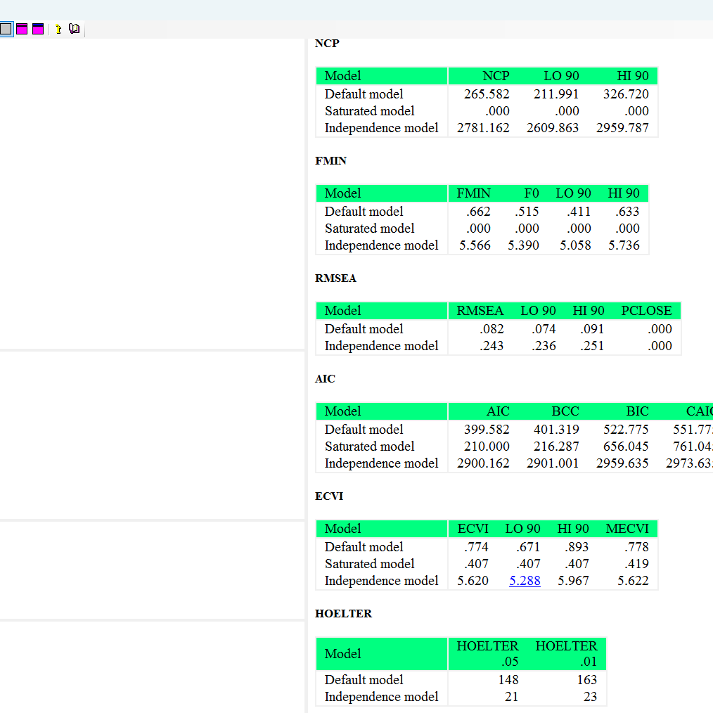
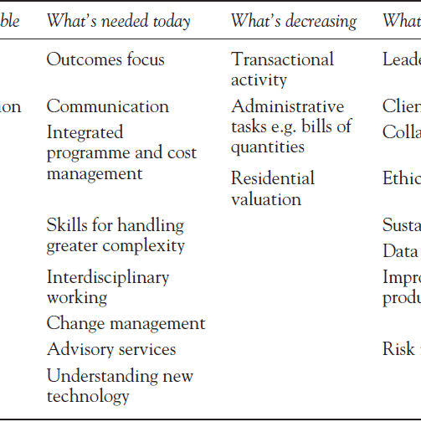
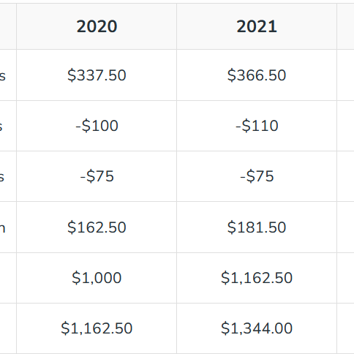
Financial modelling
concept
components
Uses
An elaborate system of planning incorporating financial statements, profit drivers and obstacles to business performance within an industry
historical data,
assumptions,
revenue estimates,
expense projections, and
analysis of cashflow
Strategic planning
Valuation
Investment analysis
Mergers and acquisitions
Performance analysis

Slide 20
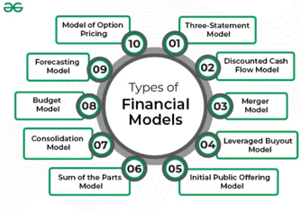
Types of financial models
Three-statement model
Discounted cashflow
M&A Model
As the nomenclature suggests, the three statements are income, balance sheet and cashflow.
A common practice normally involves separate tables for each company, say A & B, where A + B = Merged Company model
A common practice normally involves separate tables for each company, say A & B, where A + B = Merged Company model.

Slide 21
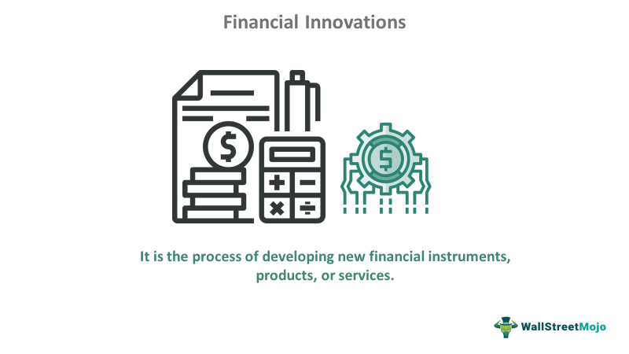
Financial innovation refers to the overall mechanisms that generates new financial products, services, or processes.
This involves leverages digital technology in transforming the financial services industry
changes in saving, borrowing, investing and payment for goods and services
Fintech is not a standalone industry per say, but a verticalized solution and a component of construction technology stack in which value is exchanged

Slide 22
Some financial innovations
crowdfunding
On-demand-loan
Esg grant
No one owns the consolidated firms, but become creditors and receive regular interests’ payments until loan is discharged.
instant, micro-loans available on-demand via mobile apps, tailored to individual needs with flexible repayment terms
tailoring practices to provide custom sustainable development goals optimization solutions to attract grants

Slide 23
Fintech platforms
crowdfunding
Micro-lending
SeedInvest and
FundersClub.
LendingClub
P2P (peer-to-peer lending where individuals can buy whole or fractional loan through tokenization)
Endelevu Africa;
GoFundMe
Kickstarter

Slide 24
“It is in times of crisis that winners are segregated from losers, and those who take bold moves fast can reap the reward strategic planning, emphasis mine.
McKinsey and Company 2020

Slide 25





