Slide 1

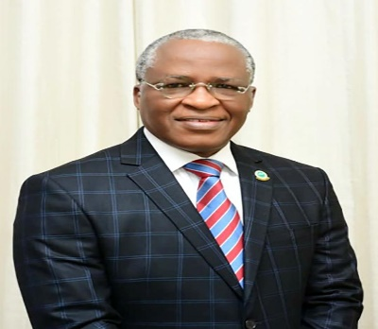
THEME: CLIMATE AND GLOBAL DISASTERS –
DEVELOPING SUSTAINABLE INFRASTRUCTURE TO ACHIEVE GROWTH AMIDST DECLINING ECONOMIC RESOURCES
TOPIC: ACHIEVING NET ZERO CARBON EMISSION IN CITY PLANNING AND ZONING FOR SUSTAINABLE DEVELOPMENT
PRESENTED AT
THE NIGERIAN INSTITUTE OF QUANTITY SURVEYORS
29TH BIENNIAL CONFERENCE/ GENERAL MEETING
BY
Tpl. Olutoyin Ayinde FNITP
National President,
Nigerian Institute of Town Planners

Slide 2

INTRODUCTION
PROTOCOLS
I always like to simplify things
Breaking down this complex topic brings it to:
PLANNING OUR CITIES AND COMMUNITIES FOR SUSTAINABLE DEVELOPMENT
From The Topic: "ACHIEVING NET ZERO CARBON EMISSION IN CITY PLANNING AND ZONING FOR SUSTAINABLE DEVELOPMENT“
We can simply have it as above and achieve all that we need to achieve
Our goal ultimately is sustainable development
What are the characteristics of a sustainable development?
- Livability of the human settlement
- Availability of the relevant resources
- Ability to live carbon-free (Net Zero Carbon Emission)
- Capability of the system to last generations
Notes:
How presentation will benefit audience: Adult learners are more interested in a subject if they know how or why it is important to them.
Presenter’s level of expertise in the subject: Briefly state your credentials in this area, or explain why participants should listen to you.

Slide 3
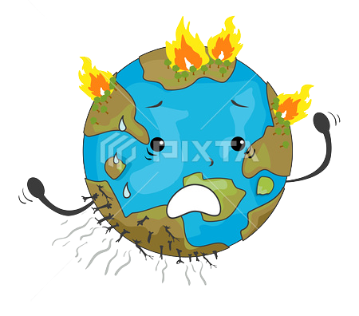
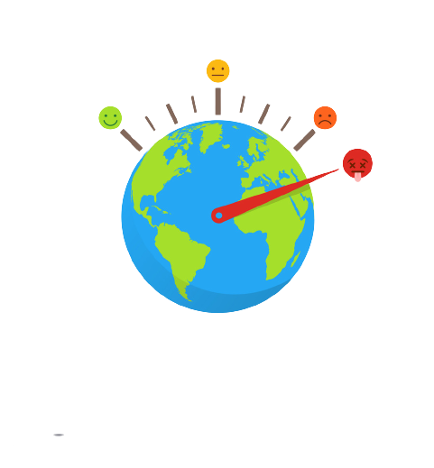

BACKGROUND
• Need to appreciate how the planet, earth, has existed for ages and has sustained life
• Over time the once friendly earth is seemingly becoming hostile
• Coolness is becoming warm and then, hot
• Flooding and wild fires are becoming prevalent
• These are signs of Climate change
Notes:
How presentation will benefit audience: Adult learners are more interested in a subject if they know how or why it is important to them.
Presenter’s level of expertise in the subject: Briefly state your credentials in this area, or explain why participants should listen to you.

Slide 4
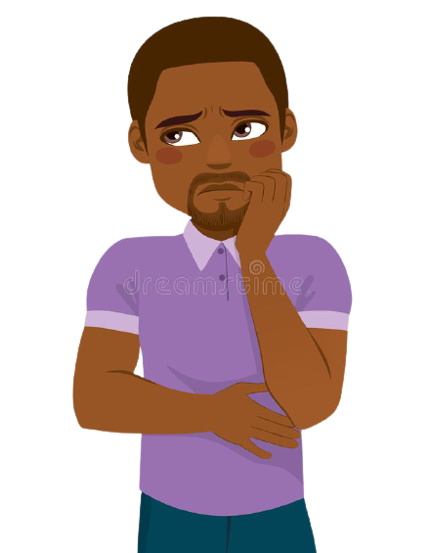
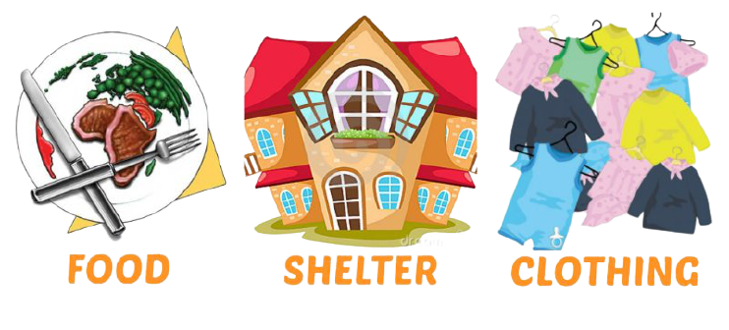

CLIMATE CHANGE CAUSES
Man and his activities (based on his need to survive)
Man's basic needs
• Food
• Clothing
• Shelter
Man's three needs in a sustainable human settlement
• Live
• Work
• Play
These invariably induce results that lead to climate change or making the impact more severe.
Notes:
How presentation will benefit audience: Adult learners are more interested in a subject if they know how or why it is important to them.
Presenter’s level of expertise in the subject: Briefly state your credentials in this area, or explain why participants should listen to you.

Slide 5


CLIMATE CHANGE CAUSES
There is a give and take scenario between man and nature. When this is balanced all will be well, but when not balanced, the result is life-threatening.
Man, through urban settlements, takes 75% of energy of the earth
In return, what does he give back to the earth? Emissions to the tune of 70%, and 25% of those emissions are because man needs to move about transporting goods and services.
Notes:
How presentation will benefit audience: Adult learners are more interested in a subject if they know how or why it is important to them.
Presenter’s level of expertise in the subject: Briefly state your credentials in this area, or explain why participants should listen to you.

Slide 6


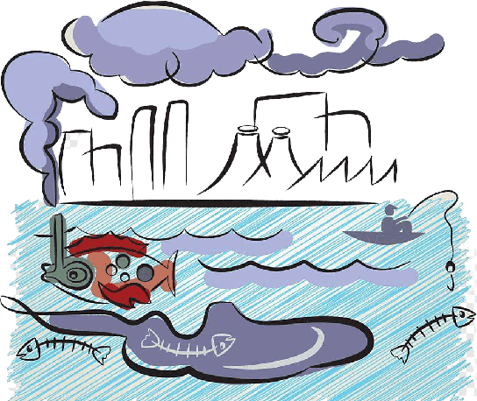
CLIMATE CHANGE CAUSES
From transportation alone, man generates two major types of pollution, and in some cases a third.
-Air pollution (fumes from exhaust, increasing the carbon emission that is our major concern)
-Noise pollution (automobile noise, and consequently human noise)
-Water pollution (when oils and products from engine lubricants are not well managed).
Notes:
How presentation will benefit audience: Adult learners are more interested in a subject if they know how or why it is important to them.
Presenter’s level of expertise in the subject: Briefly state your credentials in this area, or explain why participants should listen to you.

Slide 7

MAN AND HIS ACTIVITIES
The need to eat - burns fuel
The need for warmth - burns fuel, depleting forests
The need for shelter - cuts forests, releases heat, flooding, etc.
The need for cooling - releases carbon, heat
The need to move - (transportation)- burns fuel (carbon), noise, etc.
The need to work - (drive industrial machines)- burns fuel, releases heat, carbon, etc.
Uncontrolled sprawl - deforestation, encroachment on flood plains, ecological imbalance, depletion of endangered species
The need to manage wastes - air pollution, flooding, carbon emission.
Notes:
How presentation will benefit audience: Adult learners are more interested in a subject if they know how or why it is important to them.
Presenter’s level of expertise in the subject: Briefly state your credentials in this area, or explain why participants should listen to you.

Slide 8

THE COST OF MAN’S NEEDS
Man’s very own existence (none has felt the impact of these activities like man)
Man is threatened by the process of living
The more man chooses to meet his own needs alone (i.e. a life without balance), the more threatened is man’s existence
The more need for transportation (mobility), the more the carbon emission, but one of the characteristics of living things is mobility, so man must continue to move.
Question: If man’s gain induces so much pain, can there be a reversal or a balance?
Notes:
How presentation will benefit audience: Adult learners are more interested in a subject if they know how or why it is important to them.
Presenter’s level of expertise in the subject: Briefly state your credentials in this area, or explain why participants should listen to you.

Slide 9

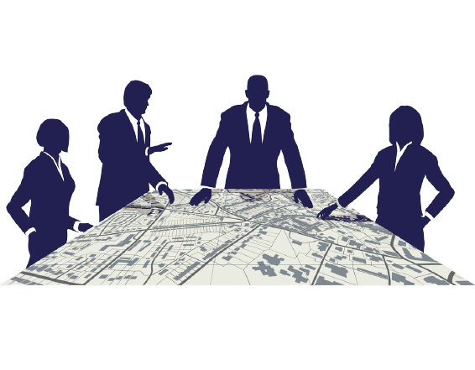

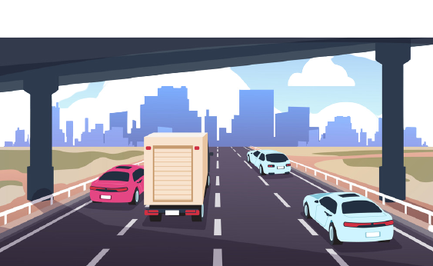
COVID-19 EXPERIENCE AND REALITIES
The pandemic struck- there was immediate need for open spaces
Lack of open spaces proved lack of attention to Urban Planning
There was need to move victims promptly to health (isolation) Centres
Lack of accessibility (road connectivity) was another proof of lack of attention to Urban Planning.
Notes:
How presentation will benefit audience: Adult learners are more interested in a subject if they know how or why it is important to them.
Presenter’s level of expertise in the subject: Briefly state your credentials in this area, or explain why participants should listen to you.

Slide 10
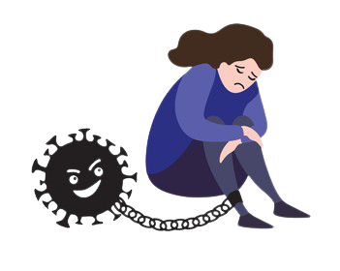

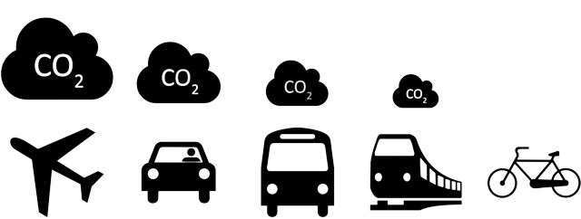
COVID-19 EXPERIENCE AND REALITIES
Lockdown became imminent, implying:
No movement
No transportation
No burning of fuel, No carbon emission, No noise pollution, No heat to release
Notes:
How presentation will benefit audience: Adult learners are more interested in a subject if they know how or why it is important to them.
Presenter’s level of expertise in the subject: Briefly state your credentials in this area, or explain why participants should listen to you.

Slide 11

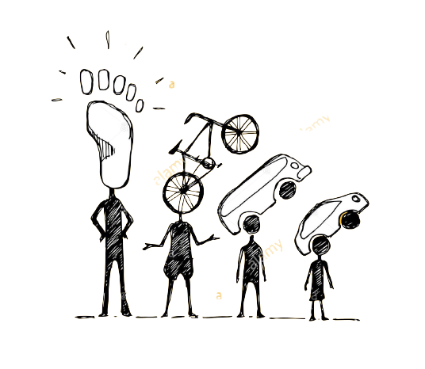
CHALLENGES PRESENTED
COVID-19 enforced better living but challenged our sustenance.
Mobility is a characteristic we must fulfill as living beings but how do we make it safe, knowing that movement (over long distances) implies transport, which in turn implies emissions?
How can we reduce movement over long distances and still fulfill our needs?
Those things that we travel to obtain, can we bring them closer and just take a walk?
If we do more of walking, how can we make it safer, more interesting/attractive and more convenient?
If we do need transport, how can we make it less harmful?
Notes:
How presentation will benefit audience: Adult learners are more interested in a subject if they know how or why it is important to them.
Presenter’s level of expertise in the subject: Briefly state your credentials in this area, or explain why participants should listen to you.

Slide 12
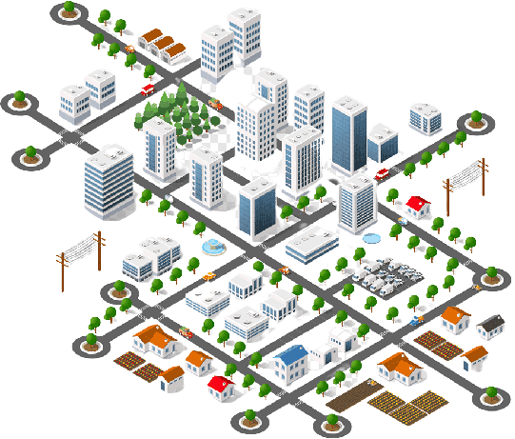
THE NEED FOR URBAN PLANNING
Urban Planning is concerned with the use of land and ensuring that there is harmony, beauty and functionality
All of man’s activities are carried out physically on land, and thus the need to plan
Every economic planning proposal, political promise and campaign manifestoes are destined to be fulfilled on land
This is why all conflicts arising from political, administrative and economic decisions need to be resolved through Urban Planning
That there is a nexus between physical planning and economic planning is a fact that must be understood.
Notes:
How presentation will benefit audience: Adult learners are more interested in a subject if they know how or why it is important to them.
Presenter’s level of expertise in the subject: Briefly state your credentials in this area, or explain why participants should listen to you.

Slide 13


SUSTAINABILITY THROUGH PLANNING
Urban Planning would promote:
Use of Renewable Energy
Green Housing
Compact settlement pattern (mixed uses)
Efficient management of land resources
Inclusion, increasing mobility
Landscaping
Re-afforestation
Creation of more open spaces
Carbon-free Public Transportation
The 3 R’s- Reduce, Reuse, Recycle
Notes:
How presentation will benefit audience: Adult learners are more interested in a subject if they know how or why it is important to them.
Presenter’s level of expertise in the subject: Briefly state your credentials in this area, or explain why participants should listen to you.

Slide 14



THE POSER:
What would make us ready for the paradigm shift?
And we can relate this to the new normal
There would be need for:
- Mindset change
- Lifestyle Change
- Instructional Change (Education and Re-education)
Notes:
How presentation will benefit audience: Adult learners are more interested in a subject if they know how or why it is important to them.
Presenter’s level of expertise in the subject: Briefly state your credentials in this area, or explain why participants should listen to you.

Slide 15
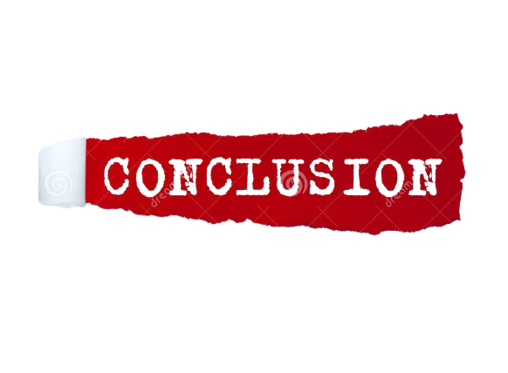
We need to recognize that planning should precede development, so that we can achieve order
With our increasing population and our limited land resources, it becomes more compelling for us to plan
The only way to manage a limited resource is to plan it
Planning to meet the goals of sustainability would help in controlling carbon emission
We will either plan, or we perish!
Notes:
How presentation will benefit audience: Adult learners are more interested in a subject if they know how or why it is important to them.
Presenter’s level of expertise in the subject: Briefly state your credentials in this area, or explain why participants should listen to you.

Slide 16


Tpl. Olutoyin Ayinde FNITP
Email: toyinayinde@yahoo.co.uk
Tel: 08033013849

