Slide 1




NATIONAL INSTITUTE OF
QUANTITY SURVEYORS
29TH BIENNUAL ELECTION / GENERAL MEETING
NOVEMBER 2021
#NETZERO
#SUSTAINABILITY

Slide 2
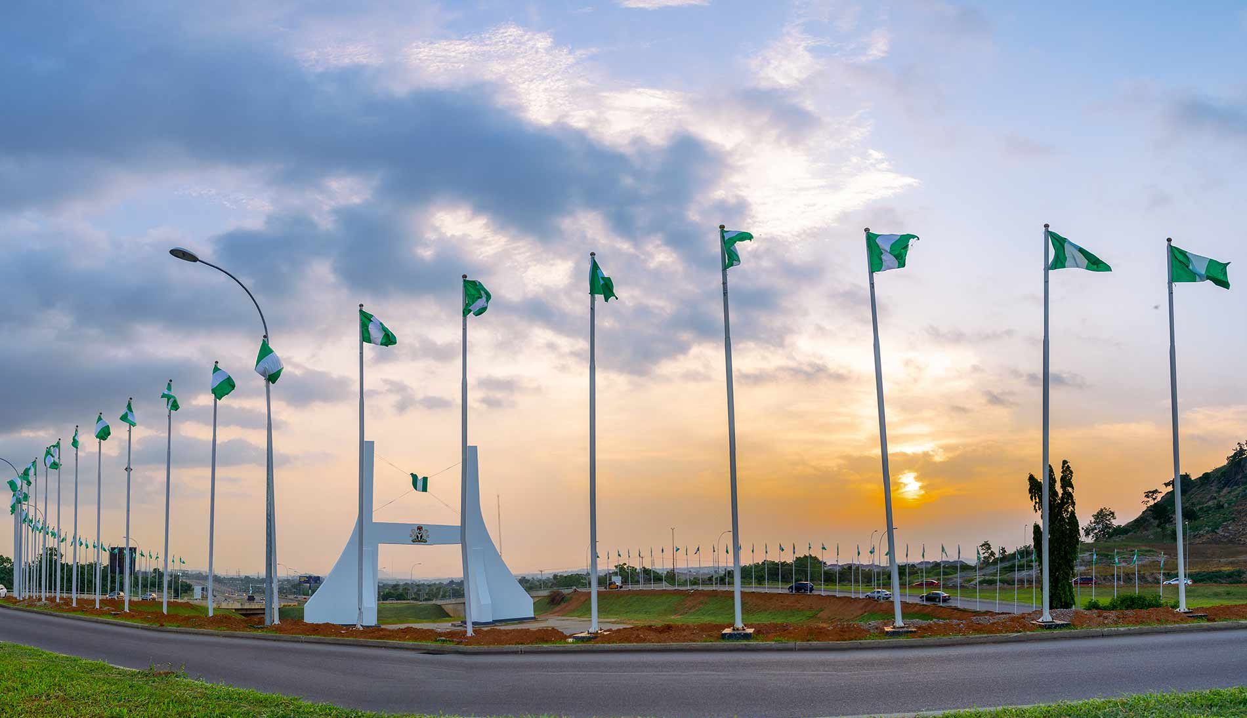

Welcome!!!
To The Nation’s Capital
Centre of Unity

Slide 3


^{SPEAKERS:}
^{OMOYEMI OLAYIWOLA}
PROJECT ARCHITECT, FMA ARCHITECTS LTD
^{TOPIC:}
Strategies for Achieving Carbon Reduction in Design of Sustainable Infrastructure Projects
^{TIME:}
^{2:15 – 3:15 PM}
climate change and global disasters
THEME:
CLIMATE CHANGE AND GLOBAL DISASTERS
DEVELOPING SUSTAINABLE INFRASTRUCTURES
TO ACHIEVE GROWTH AMIDST DECLINING
ECONOMIC RESOURCES
#NETZERO
BIENNIAL
CONFERENCE
#SUSTAINABILITY

Slide 4
    AREAS OF DISCUSSION
Presentation Title
Introduction / Big Facts
Carbon Emissions – definition, Sources, Effects
Net Zero - Importance
Carbon Reduction – Infrastructure lifecycle, Phases
Carbon Reduction – Strategies, BIM
The OSLO Advantage
Carbon Reduction and Sustainability
Conclusion
THEME:
CLIMATE CHANGE AND GLOBAL DISASTERS
DEVELOPING SUSTAINABLE INFRASTRUCTURES
TO ACHIEVE GROWTH AMIDST DECLINING
ECONOMIC RESOURCES
#NETZERO
BIENNIAL
CONFERENCE
#SUSTAINABILITY

Slide 5
    INTRODUCTION
In the year 2020, life as we knew it; changed. COVID - 19 Struck and even the most advanced nations of the world struggled to sustain the heath and wellbeing of her citizens.
As devastating as the effects of the pandemic was; It came with its own ray of sunshine on our environment. We achieved almost 7% reduction in global greenhouse gas emissions.
This came up effectively as a result of a sharp decline in human activities worldwide and also, little or no vehicular transportation in many countries
Carbon emissions were at an all-time high pre-pandemic and have slowly continued to rise again as life returns to Normalcy.
Net - Zero is not just a catch phrase; it is possible and as professionals in the built-environment we must ensure that our works mitigate the negative effect of carbon as well as contribute to the sustainability of Infrastructures and utilities.
THEME:
CLIMATE CHANGE AND GLOBAL DISASTERS
DEVELOPING SUSTAINABLE INFRASTRUCTURES
TO ACHIEVE GROWTH AMIDST DECLINING
ECONOMIC RESOURCES
#NETZERO
BIENNIAL
CONFERENCE
#SUSTAINABILITY

Slide 6







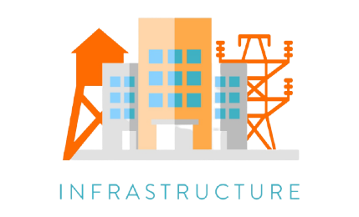
BIG DATA
ABOUT
CARBON
Climate change is a shift in the average climate conditions of a place
GHGs such as CO2, Methane, NO2, Methane
have caused 85% probability in climate change
BIENNIAL
CONFERENCE
Human Activity accounts for 85% of the change in climate
Human Activity accounts for 85% of the change in climate
THEME:
CLIMATE CHANGE AND GLOBAL DISASTERS
DEVELOPING SUSTAINABLE INFRASTRUCTURES
TO ACHIEVE GROWTH AMIDST DECLINING
ECONOMIC RESOURCES
#NETZERO
#SUSTAINABILITY
78% of burning of fossil fuels account for the volume of C02 in the atmosphere
Asia tops the lead with global CO2 emissions with China emitting about 60%
7 countries account for 65% of the total contribution with Nigeria as a part
Africa accounts for 4% of CO2 emissions with south Africa taking the lead and Nigeria ranking No. 4

Slide 7



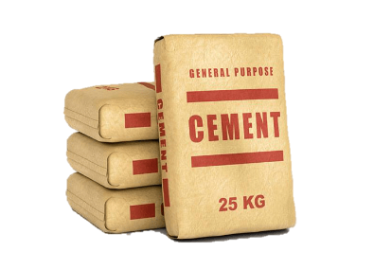

BIG DATA
ABOUT
CARBON
75% of Nigeria’s population will live in cities by 2050
Nigeria is the 3rd Most populous Country in the world after India and China – 231 Million
BIENNIAL
CONFERENCE
1 in 3 Nigerians do not have access to Electricity Only 15% of Nigerians have access to clean cooking
61% of the entire population believe that Nigeria has a “Serious Climate Problem”
THEME:
CLIMATE CHANGE AND GLOBAL DISASTERS
DEVELOPING SUSTAINABLE INFRASTRUCTURES
TO ACHIEVE GROWTH AMIDST DECLINING
ECONOMIC RESOURCES
#NETZERO
#SUSTAINABILITY
Nigeria has the largest cement
industry in West Africa
Deforestation, wood burning, and agriculture are major sources of carbon emissions
Cement Manufacturing constitutes about 12% of the GHG emissions
17th biggest emitter of greenhouse gases

Slide 8
    CARBON – DEFINITION. SOURCES. EFFECTS
Accounts for 80% of Greenhouse Gas emissions in the atmosphere. Followed by Methane (10%),
Nitrous Oxide (7%) and Fluorinated gases (3%)
01
Building Construction operational Emissions – 38%
Comes from Two Sources – Natural and Anthropogenic with Natural sources more dominant
02
Transportation – 29%
Anthropogenic CO₂ sources are part of our everyday activities and include those from power generation, transportation, industrial sources, chemical production, petroleum production, and agricultural practices
03
Electricity Generation – 25%
Carbon is the fourth most abundant element in the Universe.
04
Agriculture – 8%
THEME:
CLIMATE CHANGE AND GLOBAL DISASTERS
DEVELOPING SUSTAINABLE INFRASTRUCTURES
TO ACHIEVE GROWTH AMIDST DECLINING
ECONOMIC RESOURCES
#NETZERO
BIENNIAL
CONFERENCE
#SUSTAINABILITY

Slide 9
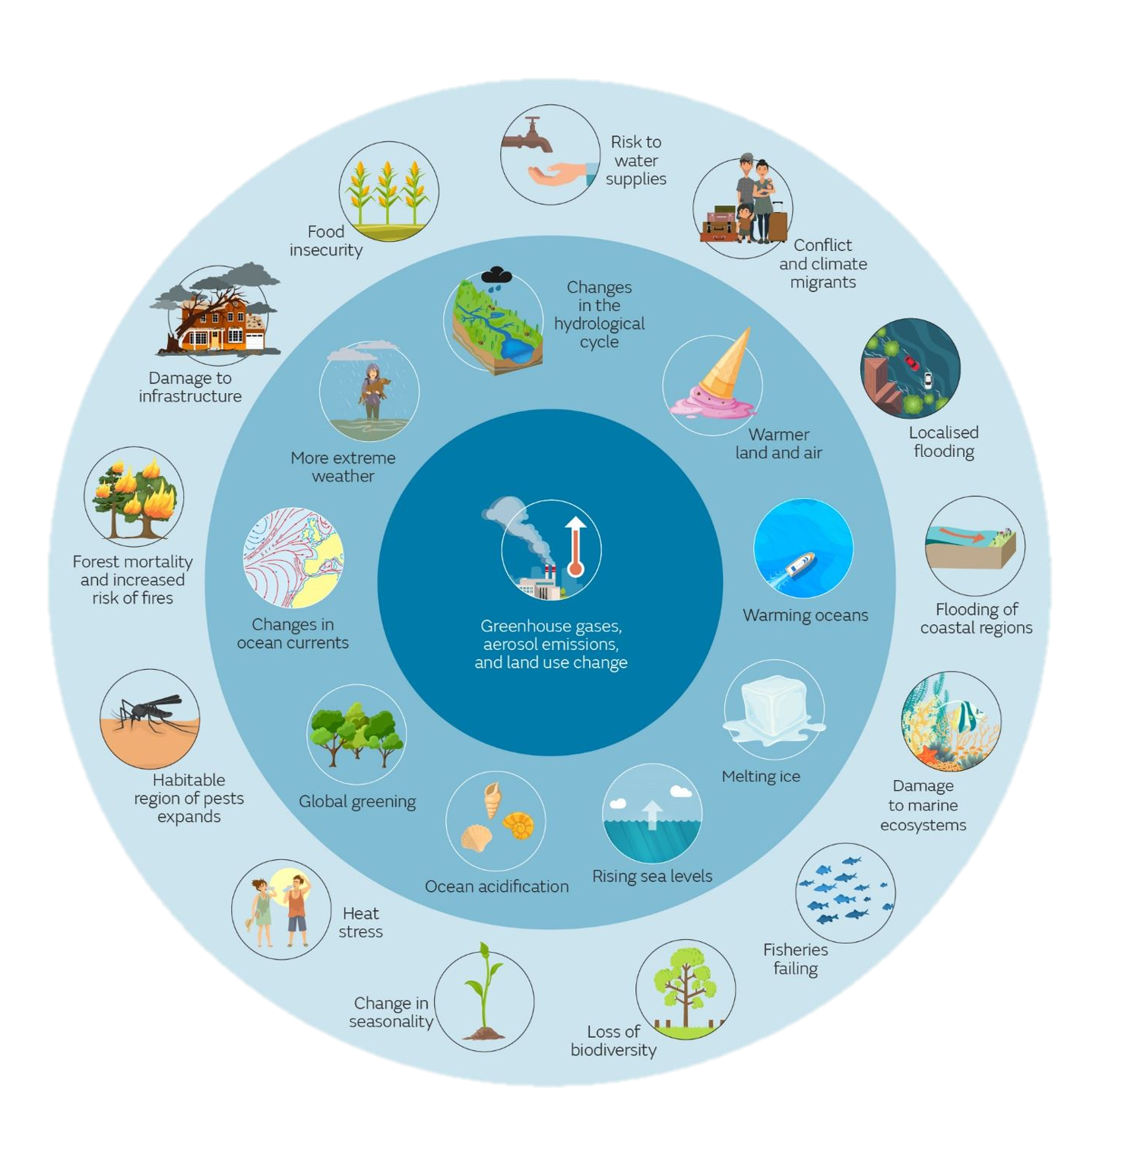
    CARBON – EFFECTS
TRANSPORTATION
Major contributor of emissions
Quite vulnerable to climate change effects
like flooding And extreme weather causes roads to fail
WATER-CARRYING INFRASTRUCTURE
A decrease in rainfall can also increase the cost of infrastructure, with higher maintenance and repair costs for water treatment systems due to lower quality inputs."
BRIDGES
adverse impacts on the safety, performance and
longevity of existing bridges
BUILDINGS
durability of building materials
indoor climate of buildings may be
affected – greater need for cooling
increase in the risk of collapse
Reduced building lifetime
THEME:
CLIMATE CHANGE AND GLOBAL DISASTERS
DEVELOPING SUSTAINABLE INFRASTRUCTURES
TO ACHIEVE GROWTH AMIDST DECLINING
ECONOMIC RESOURCES
#NETZERO
BIENNIAL
CONFERENCE
#SUSTAINABILITY

Slide 10
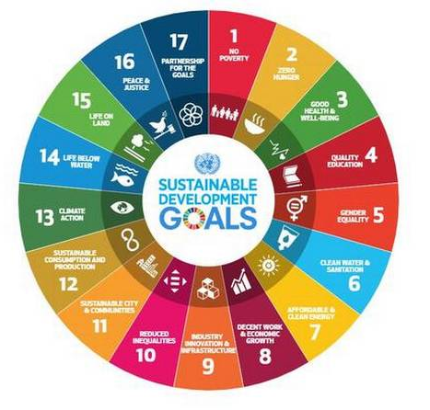

    NET ZERO – IMPORTANCE
Net zero emissions refers to achieving an overall balance between greenhouse gas emissions produced and greenhouse gas emissions taken out of the atmosphere.
Mitigate effects of climate change
Best practices to respond to market trends
Supports innovation in various sectors of the economy
Largely reduces hazardous impact on humans and the environment
Infrastructural Transformation – most powerful weapon
THEME:
CLIMATE CHANGE AND GLOBAL DISASTERS
DEVELOPING SUSTAINABLE INFRASTRUCTURES
TO ACHIEVE GROWTH AMIDST DECLINING
ECONOMIC RESOURCES
#NETZERO
BIENNIAL
CONFERENCE
#SUSTAINABILITY

Slide 11
    INTERACTIVE SESSION
T R U E O R F A L S E
Climate Change and Global Warming mean the same thing
Waste Management is a key indices in the reduction of Greenhouse gas emissions
Carbon in itself is not a problem but the volume of greenhouse gases absorbed by the earth’s surface
THEME:
CLIMATE CHANGE AND GLOBAL DISASTERS
DEVELOPING SUSTAINABLE INFRASTRUCTURES
TO ACHIEVE GROWTH AMIDST DECLINING
ECONOMIC RESOURCES
#NETZERO
BIENNIAL
CONFERENCE
#SUSTAINABILITY

Slide 12
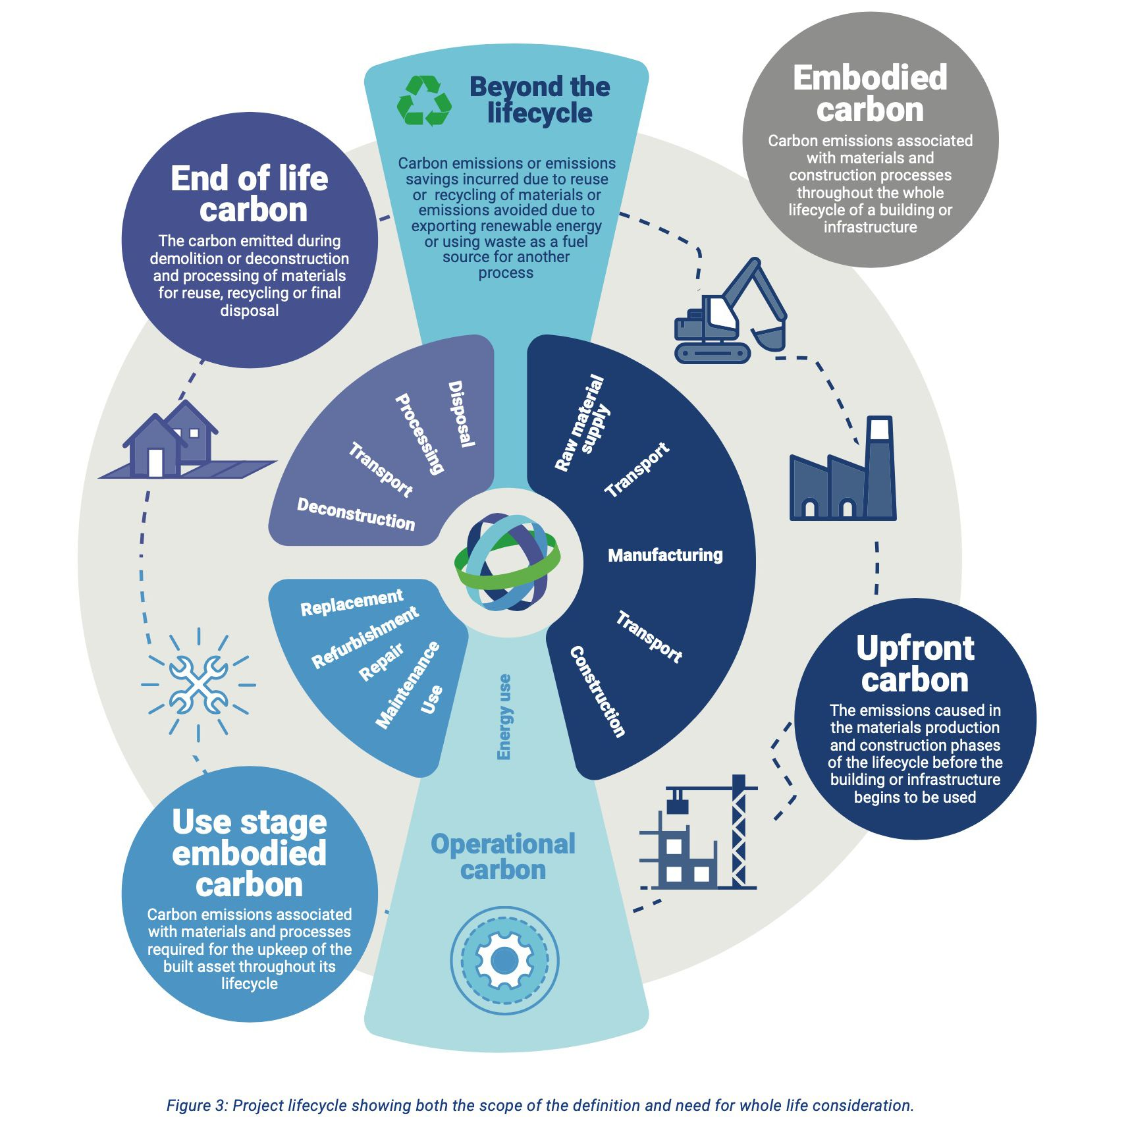
    CARBON REDUCTION – INFRASTRUCTURE LIFECYCLE
BIENNIAL
CONFERENCE
THEME:
CLIMATE CHANGE AND GLOBAL DISASTERS
DEVELOPING SUSTAINABLE INFRASTRUCTURES
TO ACHIEVE GROWTH AMIDST DECLINING
ECONOMIC RESOURCES
#NETZERO
#SUSTAINABILITY

Slide 13
    CARBON REDUCTION – PHASES
CONSTRUCTION
Conserve land use and reduce artificial ground work in the soil.
Limit the use of Carbon Intensive Materials
REUSE AND RECYCLE
PRE-CONTRACT / DESIGN
The Objective at this stage is to ensure design optimization through the use of materials. Explore Alternatives at this stage as the design works commences.
DO WE NEED TO BUILD?
PROCUREMENT / MATERIALS
Consider existing assets during the process of infrastructure design. Make continuous reviews to the proposal in order to ensure over 60% reduction in embodied carbon off materials.
CONSIDER CARBON EFFICIENT MATERIALS
POST CONTRACT
Minimize waste.
Energy Efficiency
Cradle to Cradle
THEME:
CLIMATE CHANGE AND GLOBAL DISASTERS
DEVELOPING SUSTAINABLE INFRASTRUCTURES
TO ACHIEVE GROWTH AMIDST DECLINING
ECONOMIC RESOURCES
#NETZERO
BIENNIAL
CONFERENCE
#SUSTAINABILITY

Slide 14



    CARBON REDUCTION – STRATEGIES
1
Conventional building materials have a significant impact on the environment and contribute close to 11% of all global Co2 emissions.
MANUFACTURERS SHOULD BEGIN TO LOOK AT PRODUCTION OF LOW CARBON MATERIALS
RAW MATERIALS SOURCES
PRE-CONTRACT
2
Where are my building products coming from?
Locally sourced or imported? CAN IT COME FROM A CLOSER DEPOT?
How will these materials be transported to Site?
TRACK SUSTAINABILITY METRICS
SUPPLY CHAIN
MANAGEMENT
3
From the Client’s Brief, SET STRATEGIES
Low – Carbon Construction / Deconstruction
Flexible Design – REUSE / FUTURE ADAPTATION
DESIGN
THEME:
CLIMATE CHANGE AND GLOBAL DISASTERS
DEVELOPING SUSTAINABLE INFRASTRUCTURES
TO ACHIEVE GROWTH AMIDST DECLINING
ECONOMIC RESOURCES
#NETZERO
BIENNIAL
CONFERENCE
#SUSTAINABILITY

Slide 15

    CARBON REDUCTION – STRATEGIES
MATERIALS
Recycled Content . Low carbon material replacement (LOW CARBON CEMENT)
Product Certifications
6
ZERO EMISSION SITES
Use of equipment that are battery powered or renewable energy operations
1
CONSTRUCTION METHODOLOGY
5
WASTE MANAGEMENT
Recycle and reuse buildings, materials and equipment
2
CONSTRUCTION
(GREEN)
GREEN INFRASTRUCTURES
Low energy demand. Indoor air quality.
4
3
REUSE / LIFETIME EXTENSION
Enhance existing building utilization
Deconstruction methodologies
THEME:
CLIMATE CHANGE AND GLOBAL DISASTERS
DEVELOPING SUSTAINABLE INFRASTRUCTURES
TO ACHIEVE GROWTH AMIDST DECLINING
ECONOMIC RESOURCES
#NETZERO
BIENNIAL
CONFERENCE
#SUSTAINABILITY

Slide 16

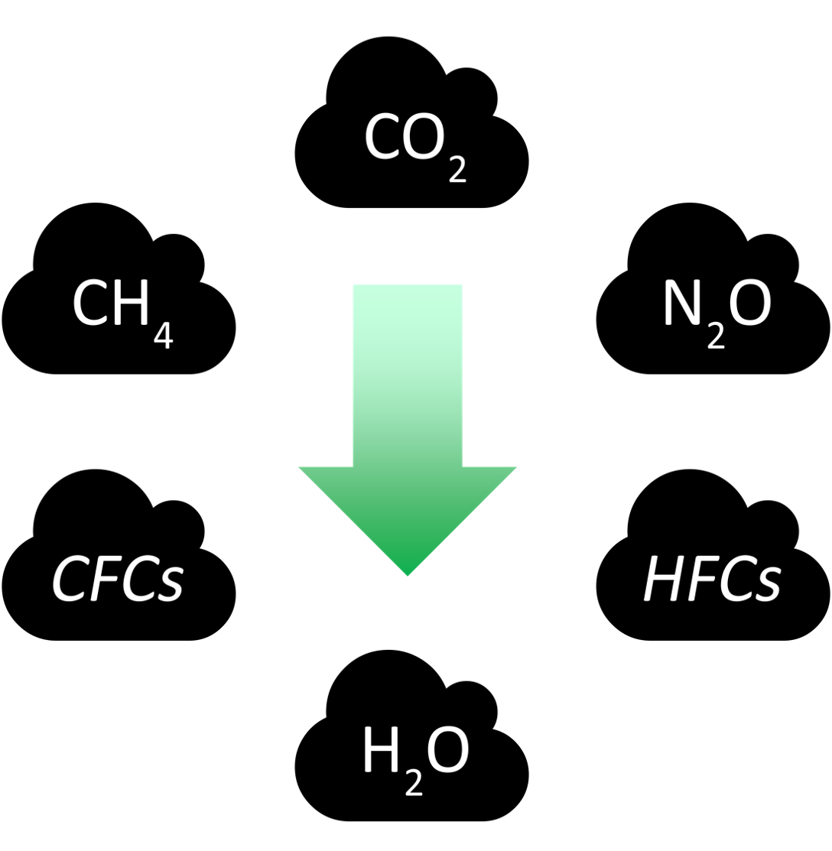
    CARBON REDUCTION – STRATEGIES
    POST CONSTRUCTION
ECO-FRIENDLY TRANSPORT NODES
REDUCE OPERATIONAL CARBON
REFURBISHMENTS
BIKES . WALKWAYS. ELECTRIC VEHICLES / MACHINERY.
SITE OPTIMIZATION
Waste Reduction and Diversion Initiatives
REDUCE METHANE EMISSIONS
Infrastructure projects should only be done when necessary.
ENCOURAGE REUSE
OPTIMUM ASSET USAGE
The costs of O&M within the building must be kept in check in line with green building strategies incorporated
TECHNOLOGY
Renewables. Evs. Emission Trading System
Supply enforcement
LIFE CYCLE COSTING
INNOVATIONS
THEME:
CLIMATE CHANGE AND GLOBAL DISASTERS
DEVELOPING SUSTAINABLE INFRASTRUCTURES
TO ACHIEVE GROWTH AMIDST DECLINING
ECONOMIC RESOURCES
#NETZERO
BIENNIAL
CONFERENCE
#SUSTAINABILITY

Slide 17

THEME:
CLIMATE CHANGE AND GLOBAL DISASTERS
DEVELOPING SUSTAINABLE INFRASTRUCTURES
TO ACHIEVE GROWTH AMIDST DECLINING
ECONOMIC RESOURCES
#NETZERO
BIENNIAL
CONFERENCE
#SUSTAINABILITY

Slide 18
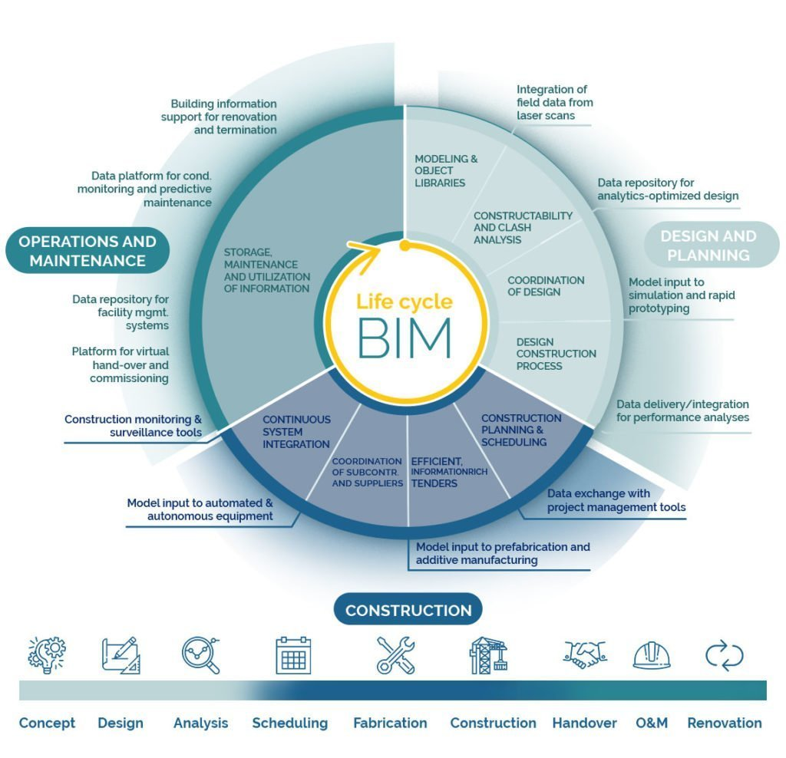
BIM is largely undervalued in the measurement and reduction of Carbon emissions from Construction.
Focus on Pre-construction activities
Poor adoption of new technologies and information management
Providing design and construction information of building components, including their environmental costs AND TOTAL LIFECYCLE COSTING
Accurate Carbon reporting and capture.
The Key that opens our net zero FUTURE.
    CARBON REDUCTION – TECHNOLOGY
BIENNIAL
CONFERENCE
THEME:
CLIMATE CHANGE AND GLOBAL DISASTERS
DEVELOPING SUSTAINABLE INFRASTRUCTURES
TO ACHIEVE GROWTH AMIDST DECLINING
ECONOMIC RESOURCES
#NETZERO
#SUSTAINABILITY

Slide 19
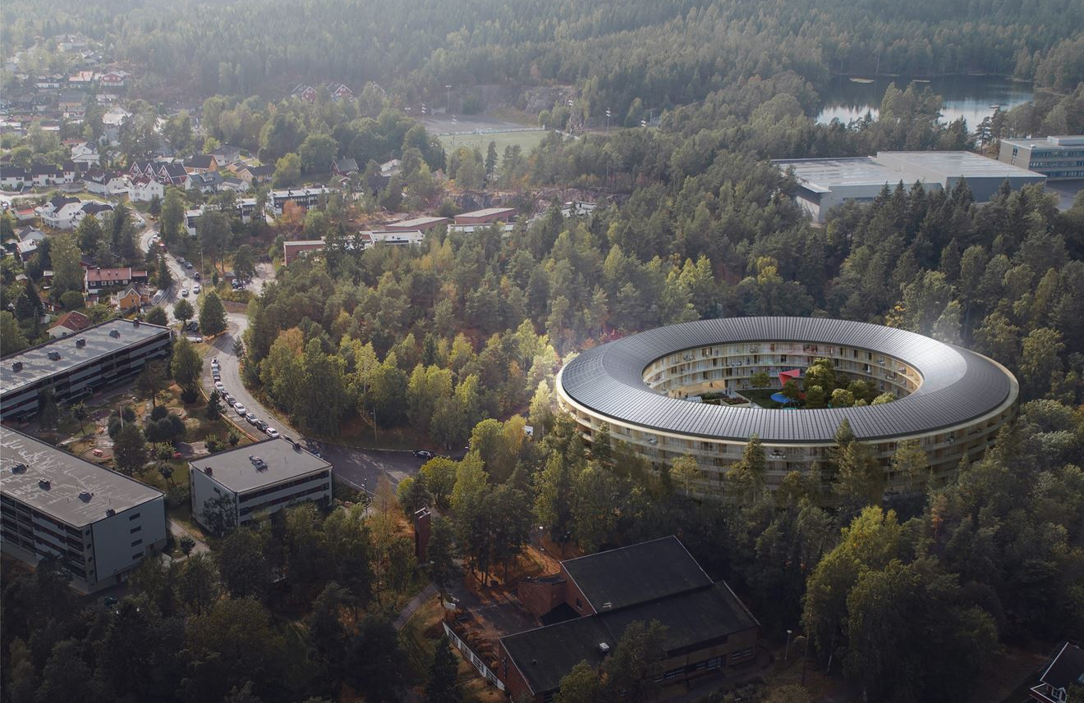
THE SYN.IKIA INNOVATION PROJECT
highly energy efficient neighbourhoods with a
surplus of energy from renewable sources

Slide 20
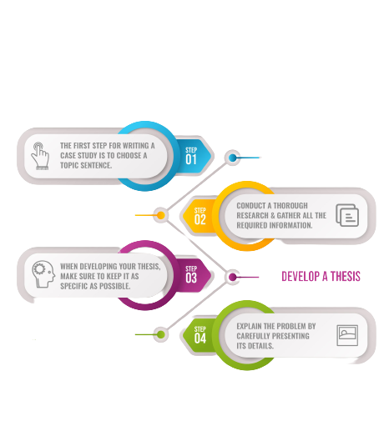
    THE OSLO ADVANTAGE – CASE STUDY
TARGET – NET ZERO BY 2030
(Same time Nigeria is expecting to reduce emissions by 20% and
pledging to eliminate planet-warming emissions by 2060)
8th Country on the Climate change performance
index and 30th Greenest Country
Electrified construction equipment
PUBLIC PROCUREMENT
Oslo expects all public transit to be emissions-free
by 2028.
Zero Carbon heavy duty Vehicles and Machinery
INCENTIVES
Bike capital of the world - 6.6 times more bikes than cars
Clean construction technology
TENDER CRITERIA
1st place as the country most likely to survive a climate change apocalypse
majority of new car sales are Evs. most EVs per capita of any city globally
A fossil-free
construction site
NO EMISSIONS
THEME:
CLIMATE CHANGE AND GLOBAL DISASTERS
DEVELOPING SUSTAINABLE INFRASTRUCTURES
TO ACHIEVE GROWTH AMIDST DECLINING
ECONOMIC RESOURCES
#NETZERO
BIENNIAL
CONFERENCE
#SUSTAINABILITY

Slide 21
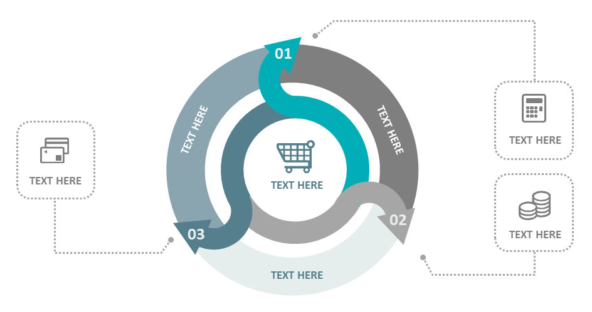

    CARBON REDUCTION & SUSTAINABILITY
Green buildings and Infrastructure
Reduction of Emissions from fossil fuels
Biodiversity Preservation
Funding
Green Funds (Rwanda)
Procurement Strategy
ECONOMIC
(PROFIT)
ENVIRONMENT
(PLANET)
SOCIAL
(PEOPLE)
Health Benefits
Government Involvement
Strategic Incentives
Building Codes
THEME:
CLIMATE CHANGE AND GLOBAL DISASTERS
DEVELOPING SUSTAINABLE INFRASTRUCTURES
TO ACHIEVE GROWTH AMIDST DECLINING
ECONOMIC RESOURCES
#NETZERO
BIENNIAL
CONFERENCE
#SUSTAINABILITY

Slide 22
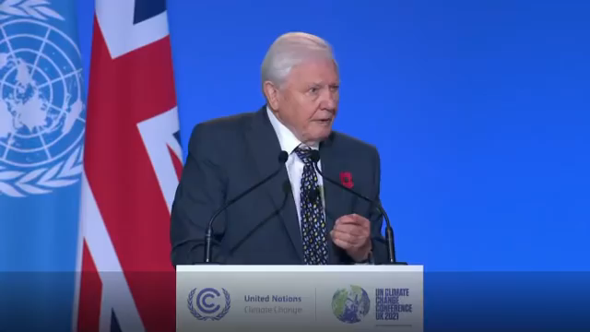
THEME:
CLIMATE CHANGE AND GLOBAL DISASTERS
DEVELOPING SUSTAINABLE INFRASTRUCTURES
TO ACHIEVE GROWTH AMIDST DECLINING
ECONOMIC RESOURCES
#NETZERO
BIENNIAL
CONFERENCE
#SUSTAINABILITY

Slide 23
    WHICH WAY NAIJA?
NIGERIA
FUTURE STATE
3rd most populous country in the world with over 200 million people and made pledges towards NET ZERO
NORWAY
With a population of less than 5.5 million people; they are striving hard to achieve Net Zero by 2030 and the citizens are cooperating to ensure this goal becomes a reality
-
NOW STATE
THEME:
CLIMATE CHANGE AND GLOBAL DISASTERS
DEVELOPING SUSTAINABLE INFRASTRUCTURES
TO ACHIEVE GROWTH AMIDST DECLINING
ECONOMIC RESOURCES
#NETZERO
BIENNIAL
CONFERENCE
#SUSTAINABILITY

Slide 24
Q U E S T I O N S
THEME:
CLIMATE CHANGE AND GLOBAL DISASTERS
DEVELOPING SUSTAINABLE INFRASTRUCTURES
TO ACHIEVE GROWTH AMIDST DECLINING
ECONOMIC RESOURCES
#NETZERO
BIENNIAL
CONFERENCE
#SUSTAINABILITY

Slide 25
    REFERENCES – MORE AVAILABLE ON REQUEST
ONLINE LIBRARY
https://www.carbonbrief.org/the-carbon-brief-profile-nigeria
https://www.c40.org/news/mayors-of-copenhagen-oslo-and-stockholm-commit-to-clean-construction/
https://citymonitor.ai/community/four-technological-innovations-can-help-reduce-urban-carbon-emissions-2103
https://www.nature.com/articles/d41586-021-00090-3
https://norwegianscitechnews.com/2019/09/ntnu-will-lead-european-sustainability-project/
https://www.ecowatch.com/carbon-emissions-building-construction-climate-2650743234.html
https://www.oneclicklca.com/designing-net-zero-carbon-buildings-article/
https://www.universityofcalifornia.edu/longform/where-do-greenhouse-gas-emissions-come
https://www.sydney.edu.au/news-opinion/news/2019/11/27/how-climate-change-impacts-infrastructure--experts-explain.html
https://www.treehugger.com/embodied-carbon-hidden-climate-challenge-5199118
https://www.weforum.org/agenda/2021/09/how-to-build-zero-carbon-buildings/
https://www.sintef.no/en/latest-news/2019/ntnu-will-lead-european-sustainability-project1/
https://www.smartcitiesdive.com/news/5-key-ways-to-reduce-ghg-emissions-in-building-construction/564707/
THEME:
CLIMATE CHANGE AND GLOBAL DISASTERS
DEVELOPING SUSTAINABLE INFRASTRUCTURES
TO ACHIEVE GROWTH AMIDST DECLINING
ECONOMIC RESOURCES
#NETZERO
BIENNIAL
CONFERENCE
#SUSTAINABILITY

Slide 26
THANK YOU
For
Joining Us Today
THEME:
CLIMATE CHANGE AND GLOBAL DISASTERS
DEVELOPING SUSTAINABLE INFRASTRUCTURES
TO ACHIEVE GROWTH AMIDST DECLINING
ECONOMIC RESOURCES
#NETZERO
BIENNIAL
CONFERENCE
#SUSTAINABILITY

