Slide 1










COST IMPLICATION OF ADOPTING CARBON REDUCTION IN THE DESIGN OF SUSTAINABLE INFRASTRUCTURE PROJECT
Theme: Climate Change and Global Disasters: Developing Sustainable Infrastructures to Achieve Growth Amidst Declining Economic Resources
DELIVERED BY:
Amb. SANMI OLOWOSILE_{RQS MNIQS MCent}

Slide 2

DEFINITION
Global Commission on the Economy and Climate defined Infrastructure Projects as: “ structures and facilities that underpin power and other energy systems (including upstream infrastructure, such as the fuel production sector), transport, telecommunications, water, and waste management.
Which Infrastructural Project is Sustainable?
Infrastructure projects that are planned, designed, constructed, operated, and decommissioned in a manner to ensure economic and financial, social, environmental (including climate resilience), and institutional sustainability over the entire life cycle of the project. (IDB Group, 2018)

Slide 3
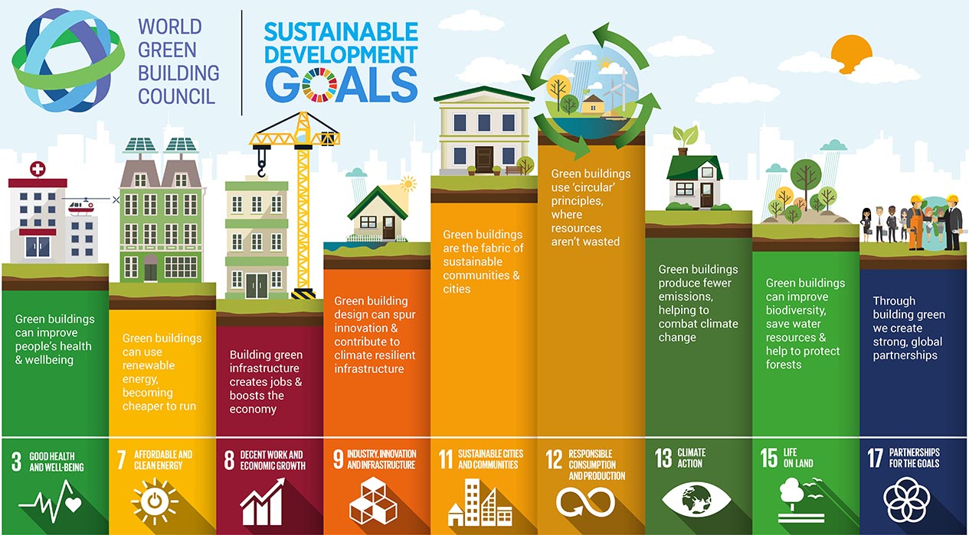

Slide 4
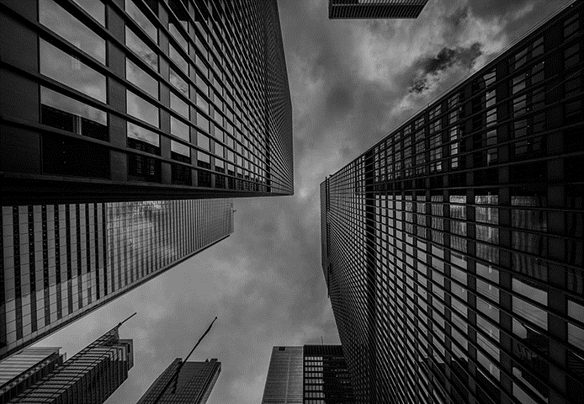

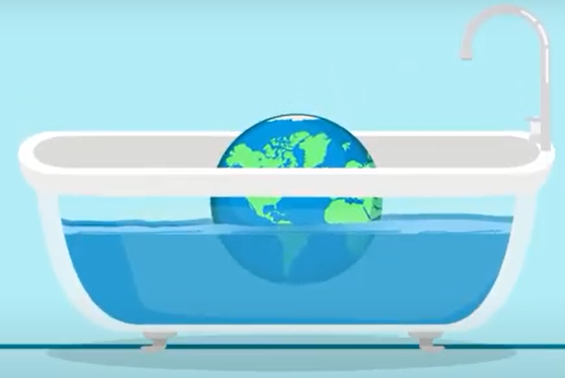
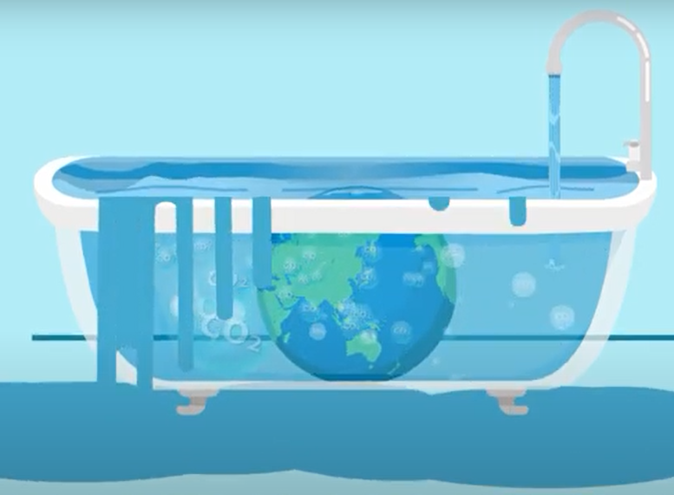
What’s the FUSS about?
Imagine that our Earth is in a bathtub. For millions of years, that bathtub has had a healthy level of carbon dioxide in it. That level has sometimes risen or decreased, but it has stayed approximately the same. When the Industrial Revolution happened and humans began burning huge quantities of fossil fuels, we turned on the faucet, increasing the level of carbon dioxide in the tub.

Slide 5
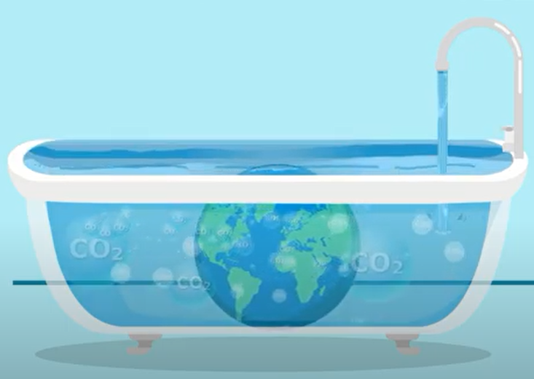
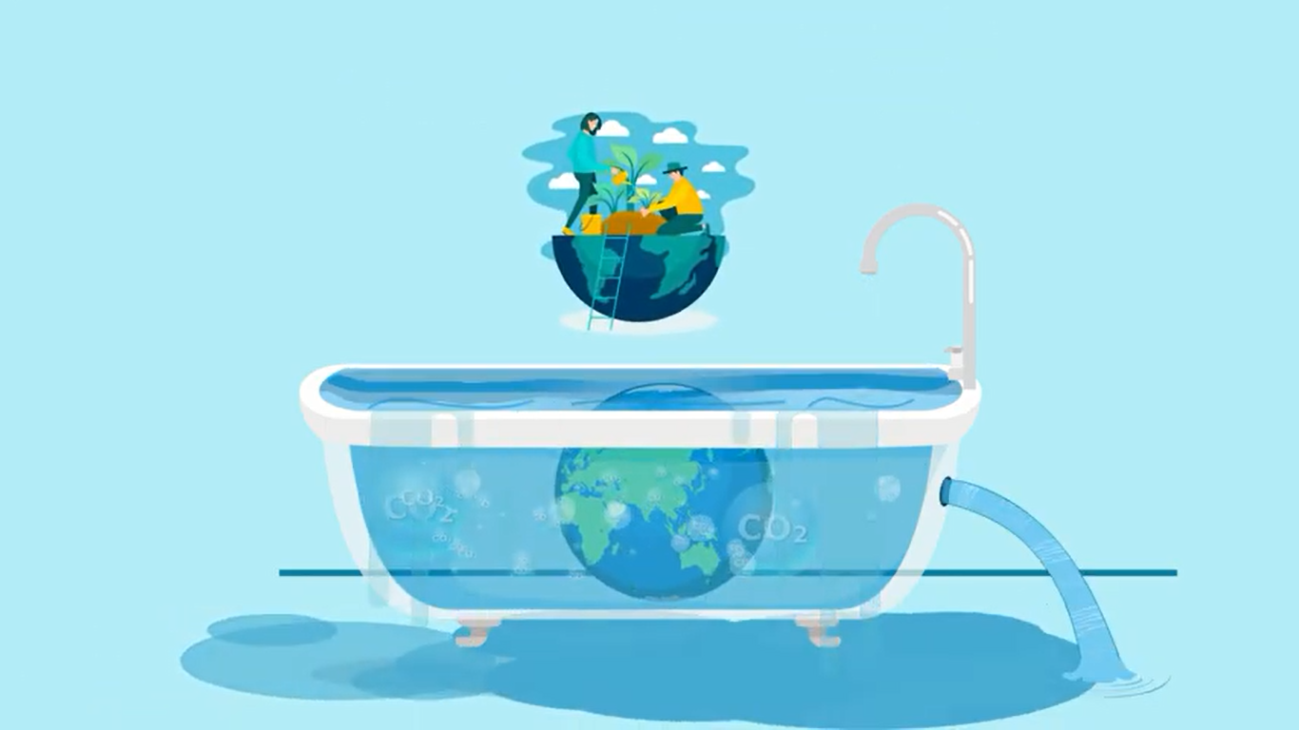
What’s the FUSS about?
Now, Earth is drowning in an overflowing tub of carbon dioxide. Most climate action to this point has focused on reducing emissions, or turning down the faucet. But today’s annual emissions only constitute 5% of the cause of climate change. Even when we achieve net-zero and turn the faucet off completely, the tub will still be overflowing.

Slide 6
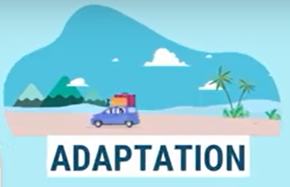
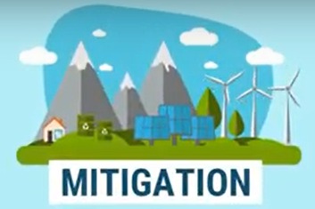

Slide 7
Introduction
Climate Restoration is the goal of returning our climate to a safe and healthy state, with atmospheric CO₂ levels below 300 parts per million, by the year 2050.
It requires the safe and permanent removal of the trillion tons of excess CO₂ that has accumulated in our atmosphere since the Industrial Revolution.
Humans and ecosystems require a climate similar to the one in which we evolved and flourished.
The last time CO₂ levels exceeded 400 ppm was close to 3 million years ago, when camels roamed the Arctic. Would eight billion humans survive conditions so radically different from those that enabled the growth of agriculture and civilizations? The answer is likely “No.”

Slide 8
CARBON EMISSION OVERVIEW
TOTAL GHG EMISSIONS
50GtCO₂
CO₂
Non
CO₂
Non
CO₂
13.7Gt CO₂
CO₂
36.4
GtCO₂

Slide 9
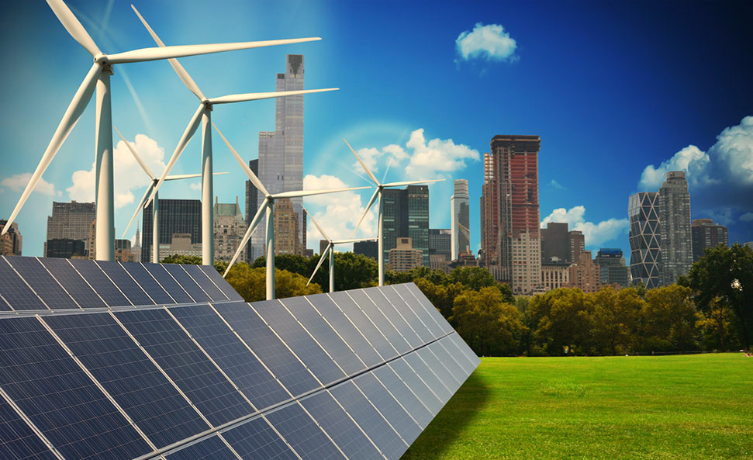
Global carbon outlook
Global GHG Emission = 50GtCo₂
Global emission from Non-Co₂ = 13.7GtCo₂
Global emission from Co₂ = 34.8GtCo₂
Global Energy-related Co₂ emission = 31.5GtCo₂
Global Co₂ Emission from CI = 11.97GtCo₂
Global per capital Emission = 4.47tCo₂

Slide 10
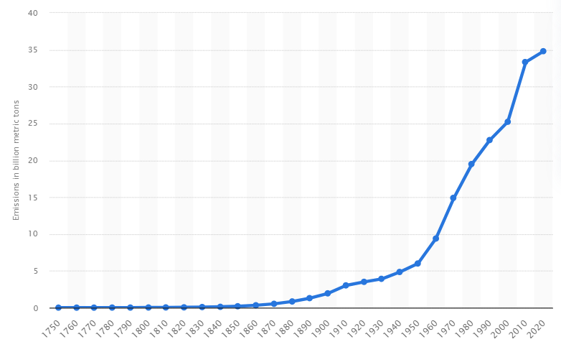
Historical Co₂ emissions from global fossil fuel combustion and industrial processes from
1750 to 2020
34.81GtCO₂

Slide 11
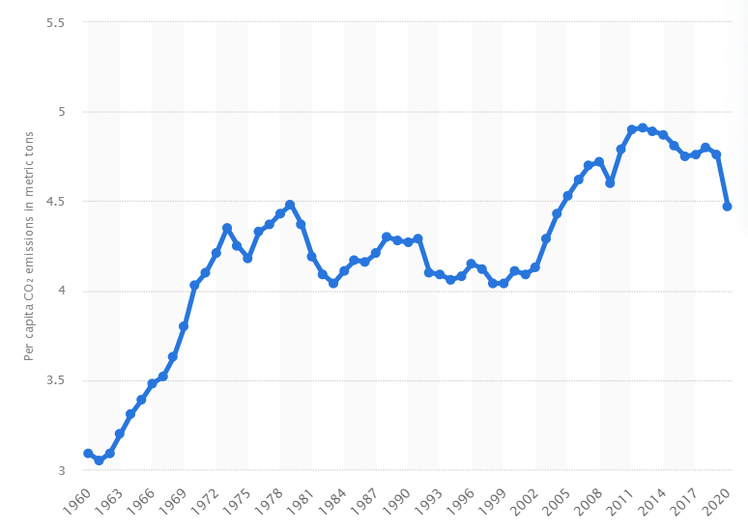
Average per capita carbon dioxide emissions worldwide from 1960 to 2020
4.47tCO₂

Slide 12
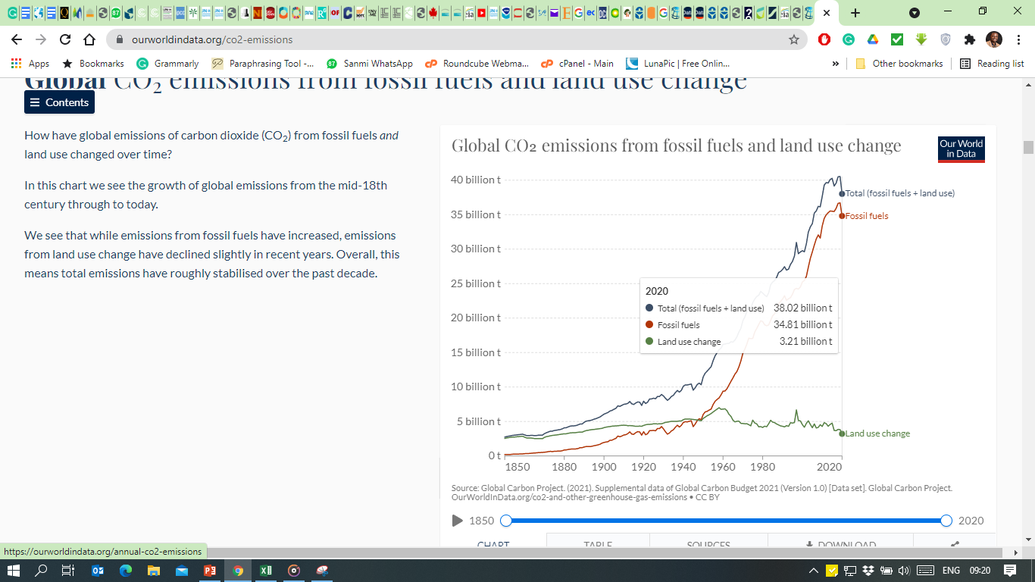
Historical Co₂ emissions from global fossil fuel combustion and industrial processes from
INCLUDING LAND USE CHANGE

Slide 13
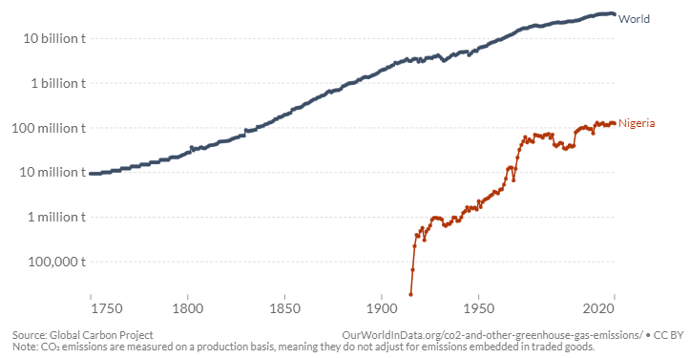
NIGERIA Co₂ emissions from global fossil fuel combustion and industrial processes
34.81GtCO₂
125.46MtCO₂

Slide 14
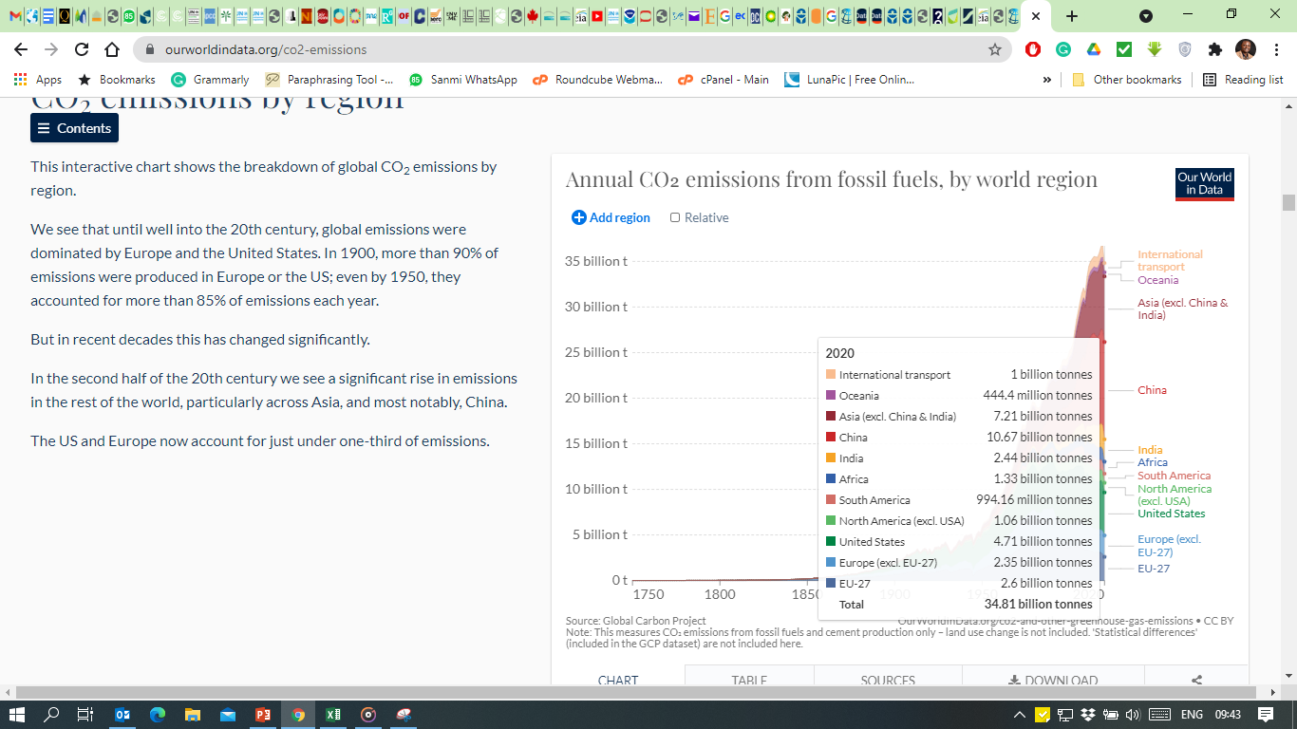
Annual CO₂ emissions from fossil fuels
by world region

Slide 15
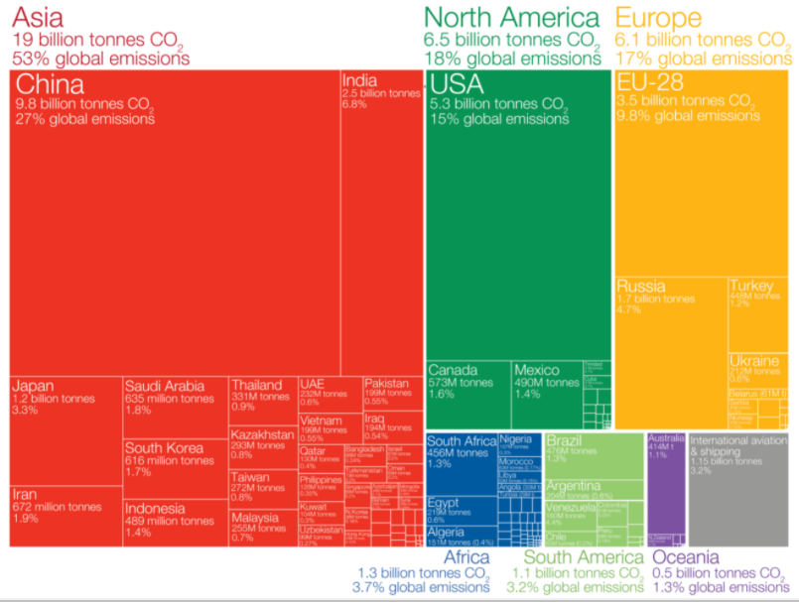
WHO EMITS THE MOST?

Slide 16
RENEWABLE ENERGY

Slide 17
Renewable Energy
Bioenergy can be produced from a variety of biomass feedstocks, including forest, agricultural and livestock residues; short-rotation forest plantations; energy crops; the organic component of municipal solid waste; and other organic waste streams.
Direct solar energy technologies harness the energy of solar irradiance to produce electricity using photovoltaics (PV) and concentrating solar power (CSP), to produce thermal energy (heating or cooling, either through passive or active means), to meet direct lighting needs and, potentially, to produce fuels that might be used for transport and other purposes.
Hydropower harnesses the energy of water moving from higher to lower elevations, primarily to generate electricity.
Ocean energy derives from the potential, kinetic, thermal and chemical energy of seawater, which can be transformed to provide electricity, thermal energy, or potable water.
Wind energy harnesses the kinetic energy of moving air. The primary application of relevance to climate change mitigation is to produce electricity from large wind turbines located on land (onshore) or in sea- or freshwater (offshore)

Slide 18
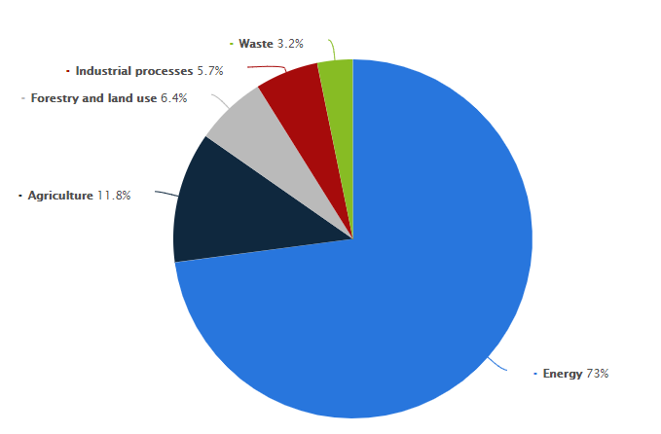
Distribution of greenhouse gas emissions worldwide in 2017, by sector

Slide 19
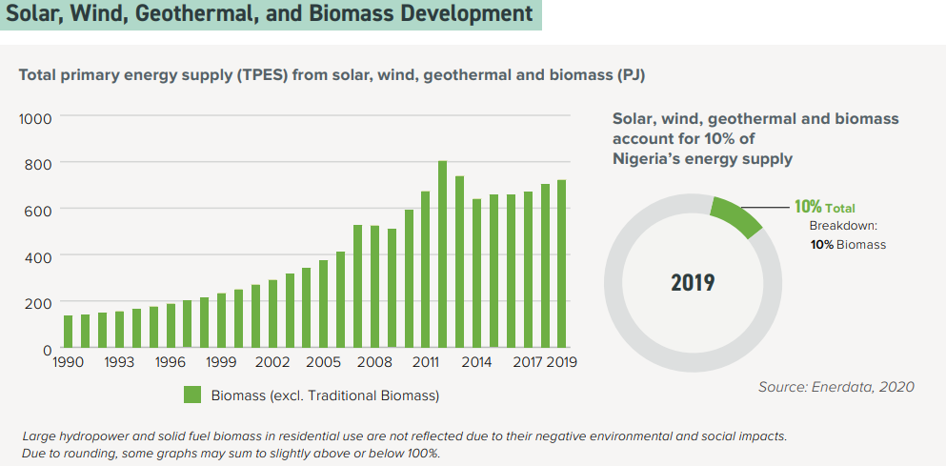
RENEWABLE ENERGY IN NIGERIA

Slide 20
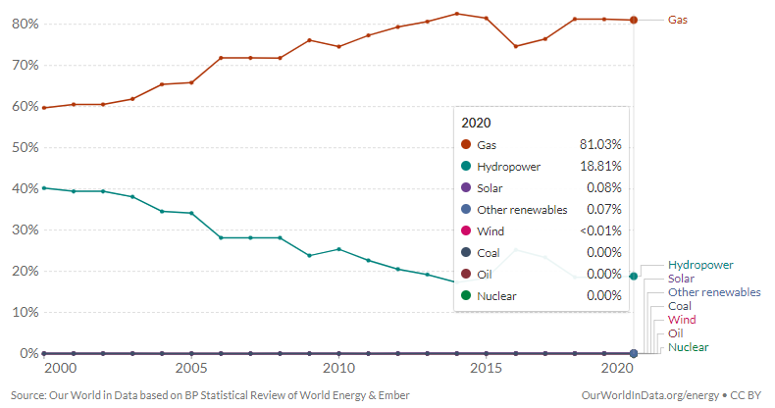
Share of electricity supply in nigeria

Slide 21
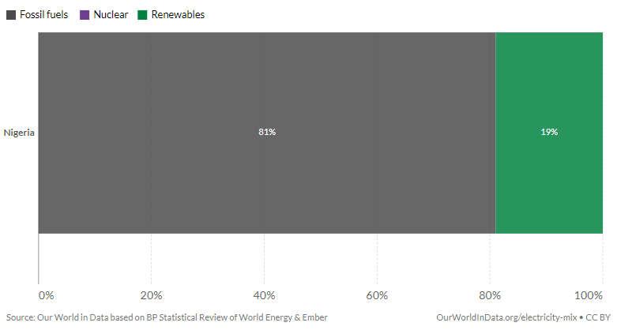
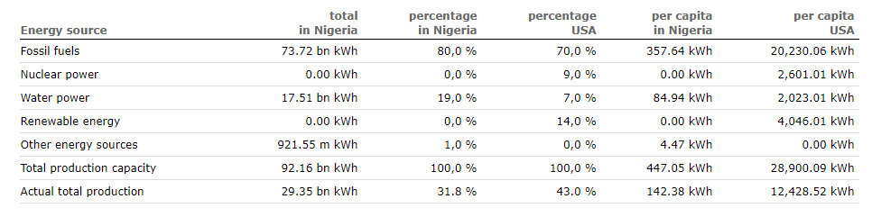
Share of electricity supply in nigeria

Slide 22
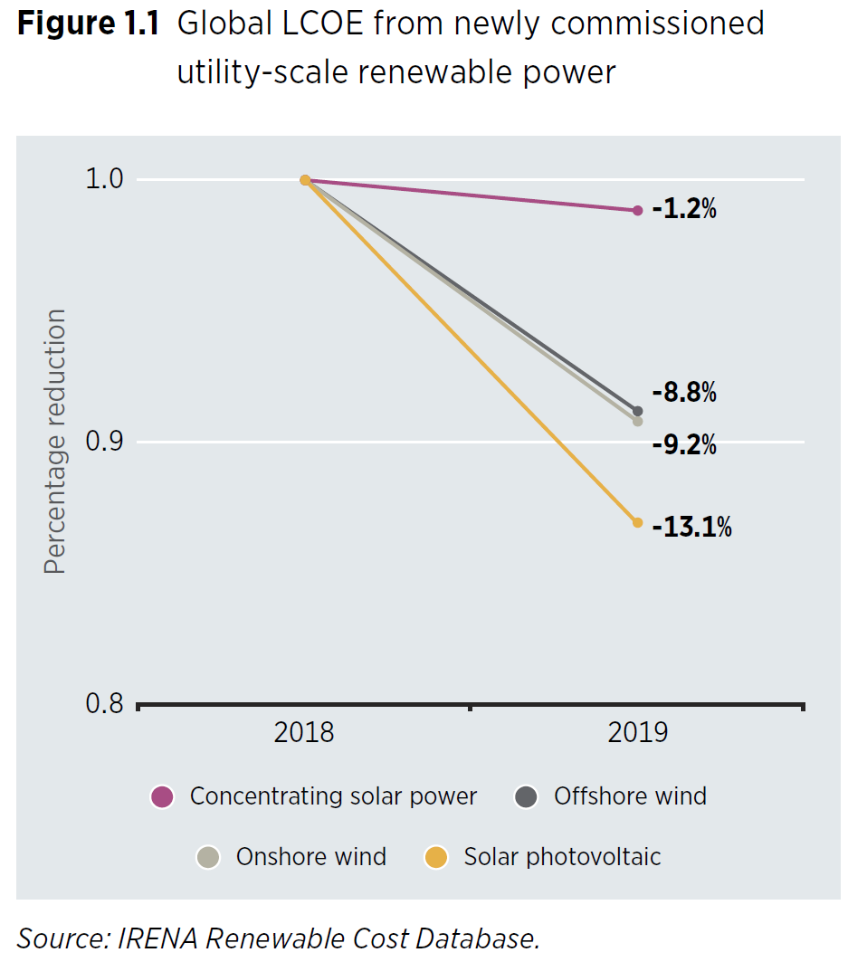
Year-on-year percentage reduction in weighted-average LCOE, 2018-2019
Technology % difference
Solar Photovoltaic - 13.10%
Concentrating solar power -1.20%
Offshore wind - 8.80%
Onshore wind - 9.20%

Slide 23
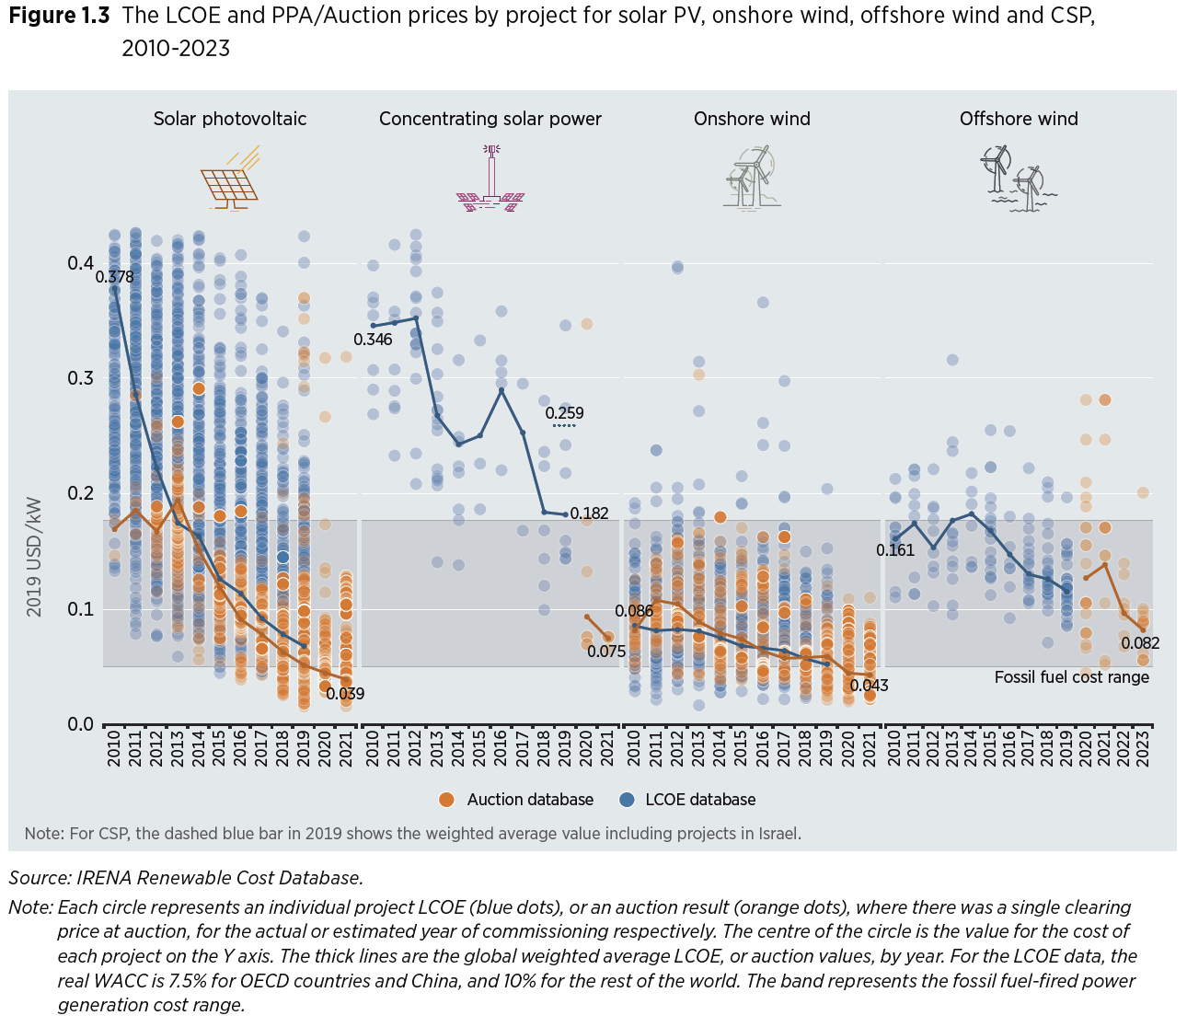

Slide 24
WHY SHOULD I BE CONCERNED?
Green buildings represent one of the biggest global investment opportunities of the next decade, estimated by the IFC to be USD 24.7 trillion by 2030.
For example, of the 1,005 real estate companies, developers, and funds representing more than USD 4.1 trillion in assets under management that reported to The Global ESG Benchmark for Real Assets in 2019, 90 per cent aligned their projects with green building rating standards for construction and operations.

Slide 25
IS THERE HOPE FOR RENEWABLE ENERGY IN NIGERIA?
IN THE YEAR 2000, THE WORLD PROJECTED TO REACH 30GW OF WIND CAPACITY
IN THE YEAR 2015, THE WORLD ALREADY BEAT THAT 14.5X
YEAR 2002, IT WAS PROJECTED THAT THE SOLAR ENERGY MARKET WILL GROW 1GW / YEAR BY 2010
IN 2010, WE BEAT THAT 17x
IN 2015, WE BEAT THAT 58x

Slide 26
IS THERE HOPE FOR RENEWABLE ENERGY IN NIGERIA?
IN 1980, AT&T Commissioned mckinsey to forecast cellphone use by the end of
2000
They projected 900,000 users
The actual figure at the end of 2000 Was
109million
120 X higher
There are presently more than 7.6billion cell phone connection in the world today

Slide 27
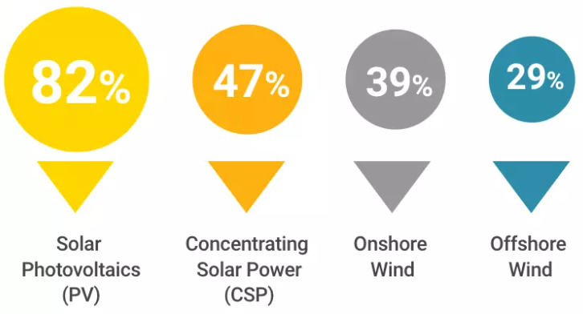
IS THERE HOPE FOR RENEWABLE ENERGY IN NIGERIA?
Some of the falls in the costs of renewable energy are dramatic. Between 2010 and 2019, the cost of large, utility-scale solar photovoltaic projects – where energy is converted directly into electricity – fell by 82%.

Slide 28
concrete

Slide 29
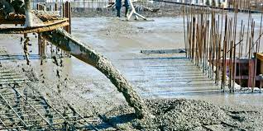
CONCRETE
Concrete is the most-used material in the world
More than 10 billion tons of concrete is produced annually
Twice as much concrete is used in construction as compared to all other building materials
With cement as its main ingredient, it is also responsible for 8% of the world’s carbon dioxide (CO2) emissions

Slide 30
CONCRETE
In the U.S. alone, cement is more than 500 million tons. Worth more than $37 billion
Nigeria is Sub-Saharan Africa’s largest market for cement, consuming more than 22Mt in 2020.
For the first 9month of 2021, domestic cement sales rise by 30% totalling $3.46billion

Slide 31
Economical
Versatile
Durable
Constructable
Available
Beautiful
Why is Concrete the most use building material in the world?

Slide 32
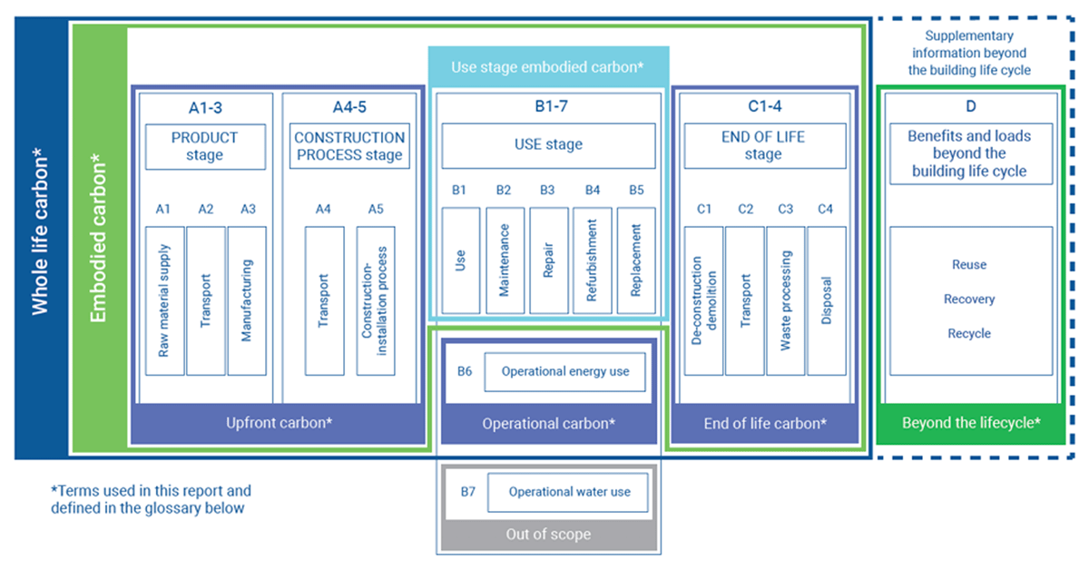
Source: Anderson, J., & Moncaster, A. (2020)

Slide 33
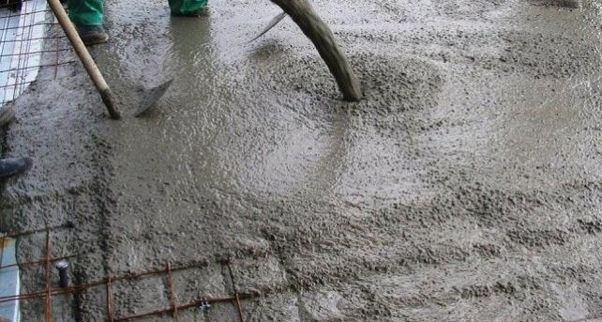
ACHIEVING ZERO CARBON CONCRETE
Concrete is 100% recyclable, therefore recycling of concrete should be promoted.
Clinker the main emitting ingredient of cement is already being substituted with alternative materials
Transport infrastructure can be decarbonized
Building Codes must focus on low carbon materials like zero carbon concrete.
Alternative fuels and the electrification of kiln can drive fossil fuels out of its energy use
Carbon sequestration technology can be employed to manage unavoidable process emission.

Slide 34
WATER

Slide 35
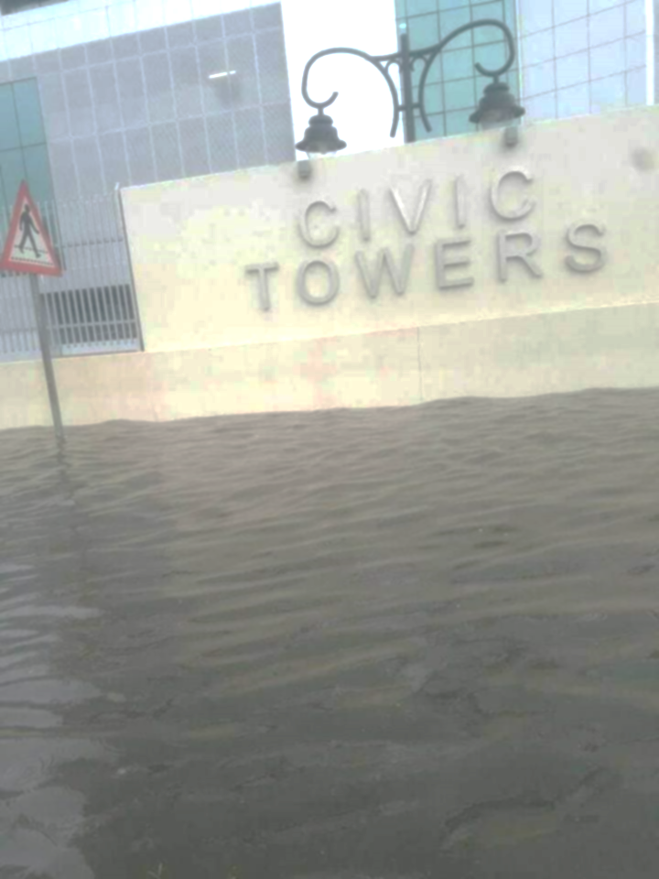
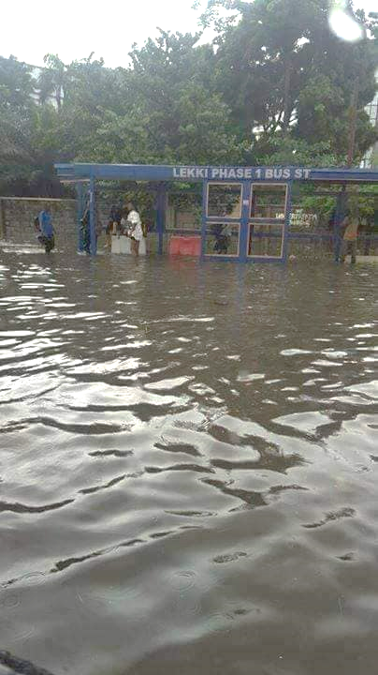
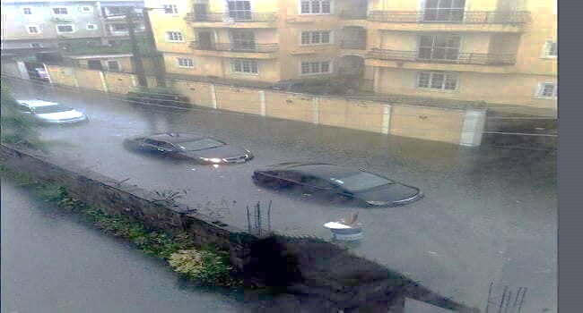
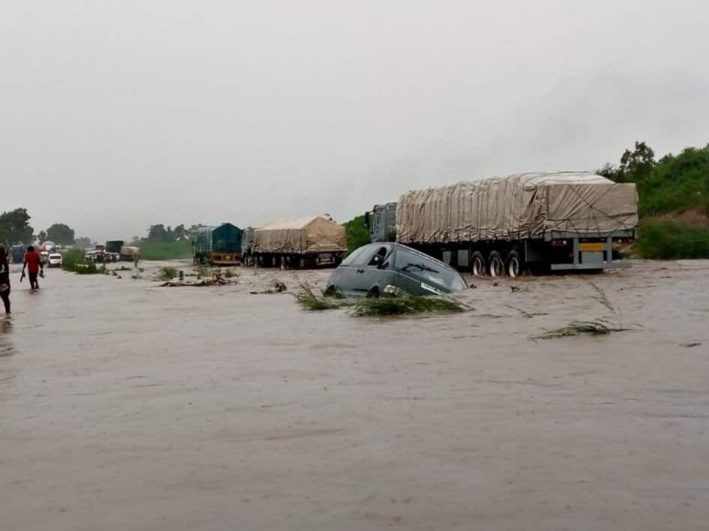
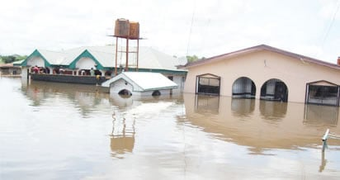
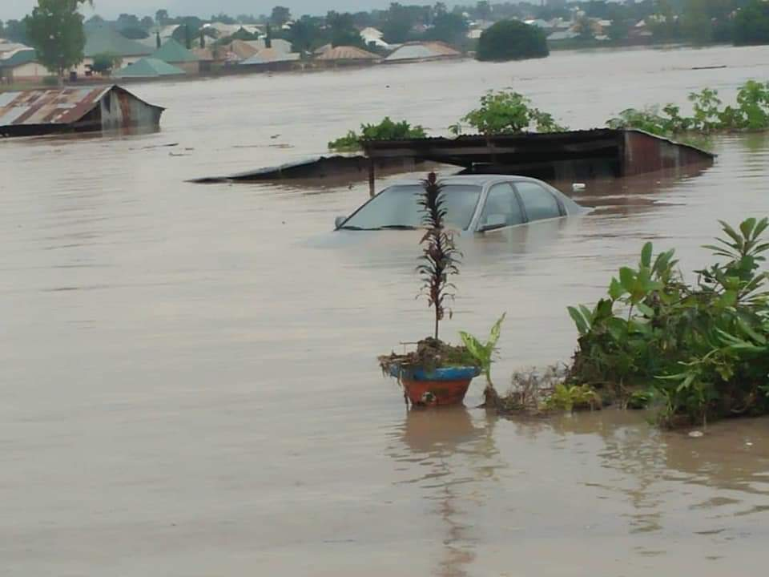
WATER
Abuja – Lokoja Road

Slide 36
COST IMPLICATION OUTLOOK

Slide 37
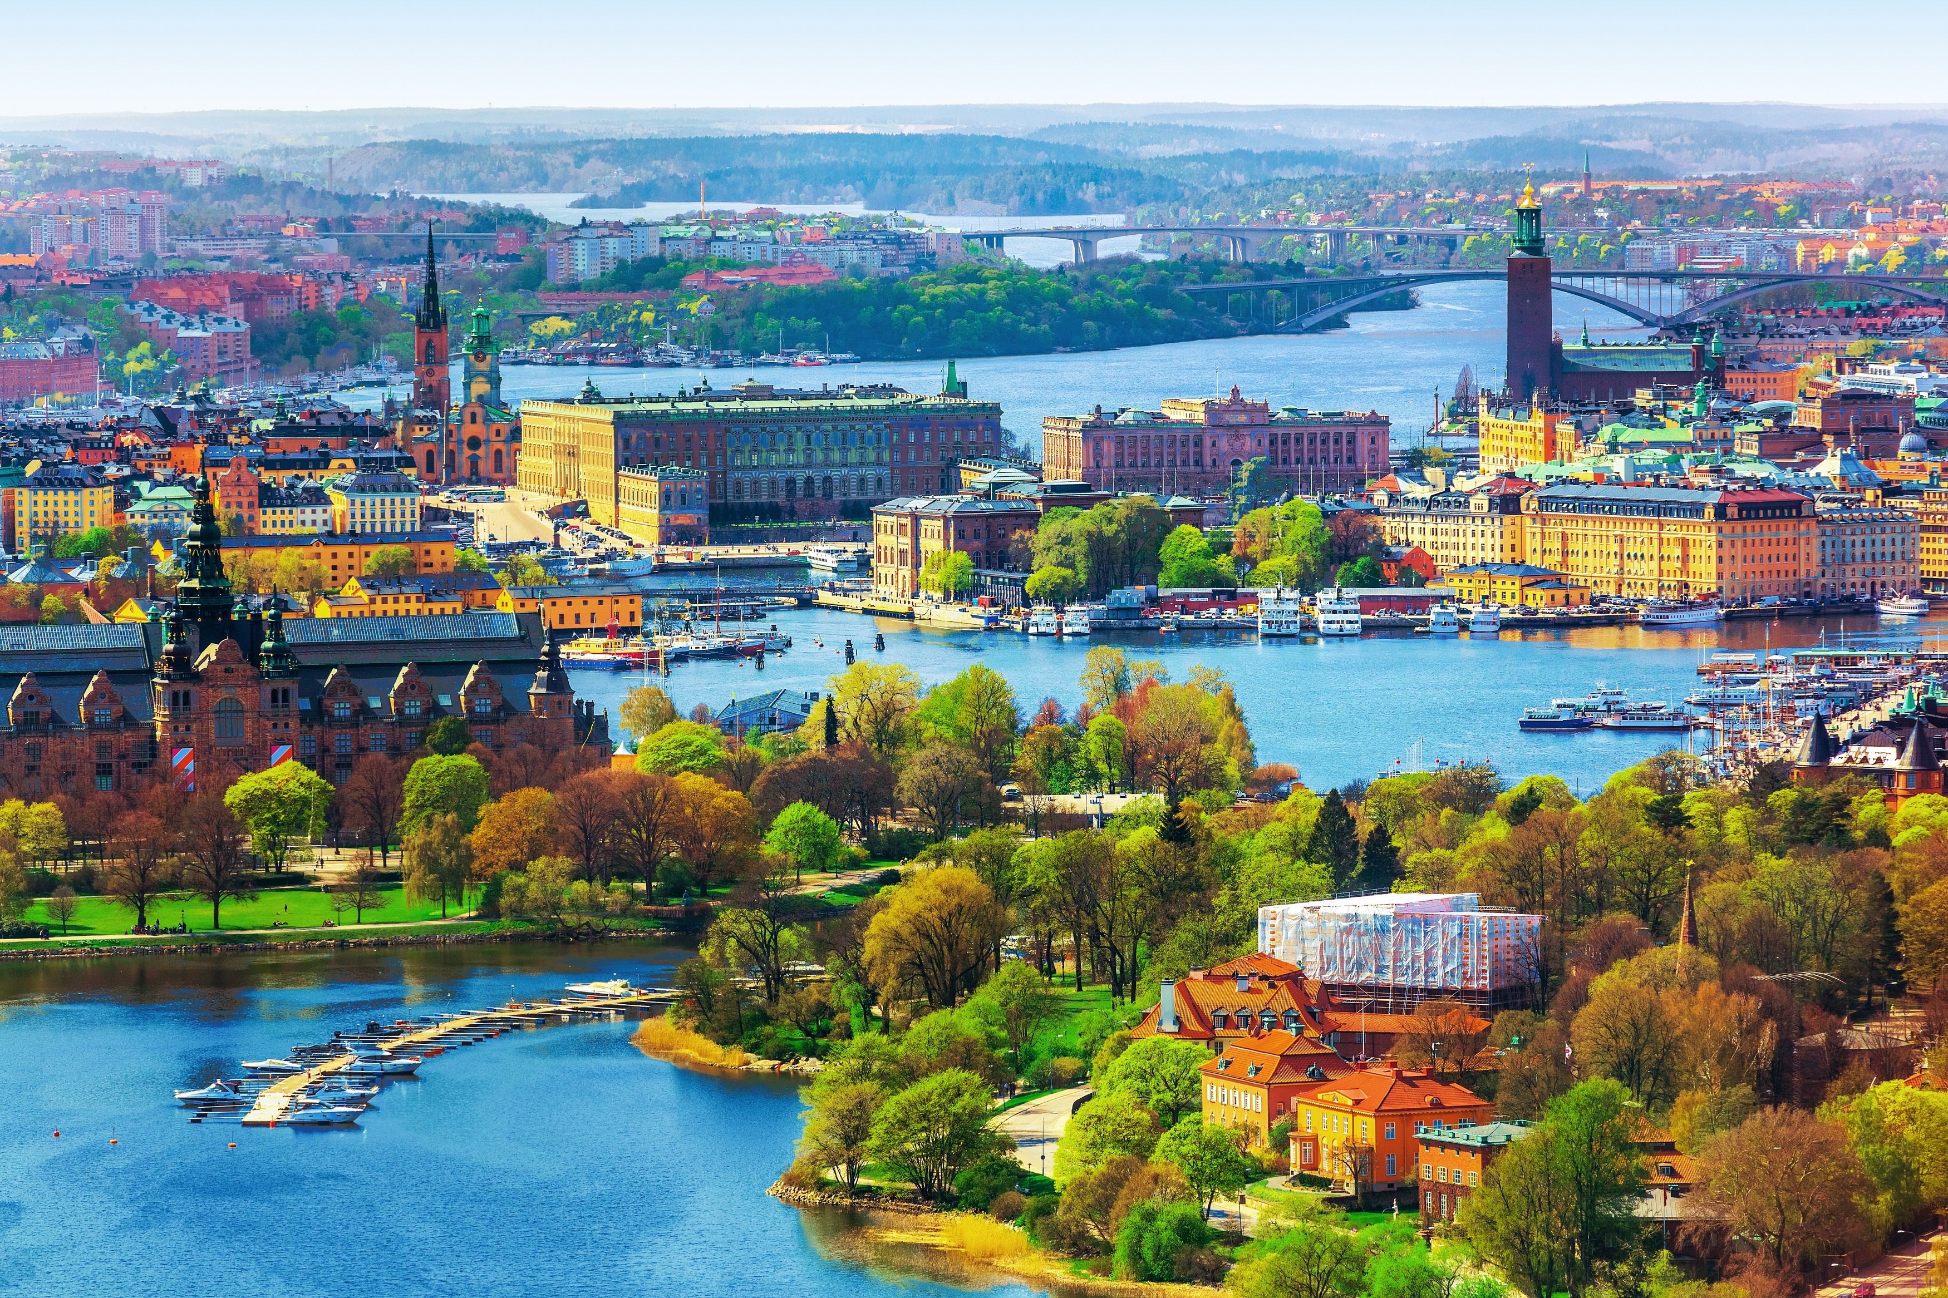
Is $75/TON a good deal
CARBON TAX - IMF PROPOSITION
Sweden Carbon Tax is $127/TON and has reduced emission by 25% since 1995 while the economy expanded by 75% since then.

Slide 38
cost implication OF ADOPTING CARBON REDUCTION IN THE DESIGN OF SUSTAINABLE INFRASTRUCTURE PROJECT
Adopting carbon reduction COST
$0.28 PER SQM
N114.8 PER SQM
Reference: USGBC

Slide 39
cost implication OF ADOPTING CARBON REDUCTION IN THE DESIGN OF SUSTAINABLE INFRASTRUCTURE PROJECT
Cost = 2% to 3% addition
Save = 18% to 85% emission
Reference: USGBC

Slide 40

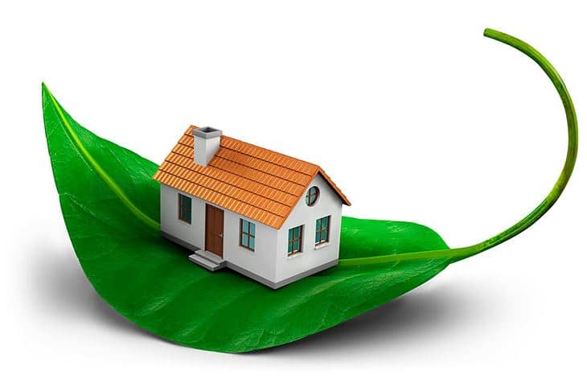
Non-green building
green building
Floor Area = 1000sqm
Cost/m2 = N350,000
Location = ABUJA
Construction Cost = N350million
Floor Area = 1000sqm
Cost/m2 = N350,000
Location = ABUJA
Construction Cost = N359.8million

Slide 41
BUILDING MATERIALS
CONCRETE
STEEL
TIMBER

Slide 42


CARBON REDUCTION IN BUILDINGS
House Made Primarily With Manufactured Materials (Hollow-brick Walls, Concrete Frame And Concrete Roof) =1583MJ/m2
House made partly with manufactured materials (clay-brick walls, concrete frame, steel-sheet roof) = 1314MJ/m2
House built primarily with local materials (adobe walls, timber frame, steel-sheet roof) = 590MJ/m2

Slide 43
Non-green building
green building
1 MEGAJOULE (mj) = 0.00024TON
Floor Area = 1000sqm
Emission impact =18% - 85%
1583MJ
0.00024 x 1583
0.38ton/m²
Floor Area = 1000sqm
Emission impact = 0% - 5%
590MJ
0.00024 x 590
0.14ton/m²

Slide 44
Non-green building
green building
1 MEGAJOULE (mj) = 0.00024TON
0.38ton/m² x 30,750 x 1000 x 60
0.14ton/m² x 30,750 x 1000 x 60
701,100,000.00
258,300,000.00

Slide 45
Non-green building
green building
Floor Area = 1000sqm
Emission impact =18%
Location = ABUJA
CARBON TAX = N30,750/TON
LIFETIME COST (60years) =
N701,100,000.00
Floor Area = 1000sqm
Emission impact =5%
Location = ABUJA
CARBON TAX = N30,750/TON
LIFETIME COST (60years) =
N258,300,000.00

Slide 46
Cost outlook

Slide 47
Cost outlook

Slide 48
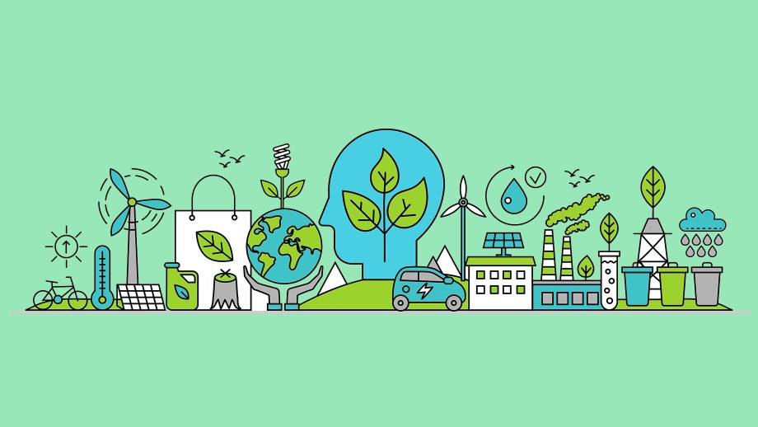
COST IMPLICATION
Climate change is expected to increase the death rate by between 60% and 80% in Africa more than in any other region by 2030 (WHO 2008)
Climate change is expected to have a worse impact on agricultural yields in Africa than in any other region of the world. Iglesias and Rosenszweig (2010)
Cost of sea level rise in Egypt equals US$2.5 billion and 14% of GDP (van Drunen et al., 2005).
A sea level rise of 0.5m in Tanzania would inundate 2,000km² at a cost of approx US$51million
Shorelines behind bleached coral more vulnerable to storm damage and lost tourism by 2050, particularly in small islands (Stern, 2006).

Slide 49
COST IMPLICATION
Between 75 and 250 million people will suffer from increased water stress (IPCC WGII, 2007)
By 2050, between 224 and 310 million people in North Africa will be at risk of water stress (Arnel 2004)
Africa will see a US$2-3 billion net loss from market impacts (Mendlesohn, 1997)
Between $4 and $6 billion losses in forest ecosystem services by 2060 (Mendlesohn, 1997)
10-15% of sub-Saharan species will be at risk of extinction (IPCC WGII, 2007)

Slide 50
COST IMPLICATION
Coastal flooding causes $50 billion of damage (Mendlesohn et al., 1997)
In Nigeria, 75% of total agricultural area threatened with 1m sea level rise (Awosika et al., 1993).
259 producing oil fields in the Niger Delta at risk of a 1m. sea level rise, costing approx US$11 million (French et al., 1995)
Between US$510-675 billion between now and 2030 are required for low-carbon development growth in Africa
Africa received less than 2.5 per cent of financial flows from international carbon markets. Representing around US$22 billion

Slide 51
BENEFITS FROM climate tax, feebates, and policies GENERATED REVENUE
Used to offset/subsidize payroll taxes that harm incentives for work & investment
Contribute to between 0.5% and 4.5% of GDP growth
Used to support disproportionately affected workers & communities e.g. coal mining areas
Pay equal dividend to the entire population.
Compensate the poorest 40% of households
¾ of the revenue can still be used for additional investment in Green Projects or fund SDGs
Climate Tax revenue would save 700,000 people a year who die from air pollution

Slide 52
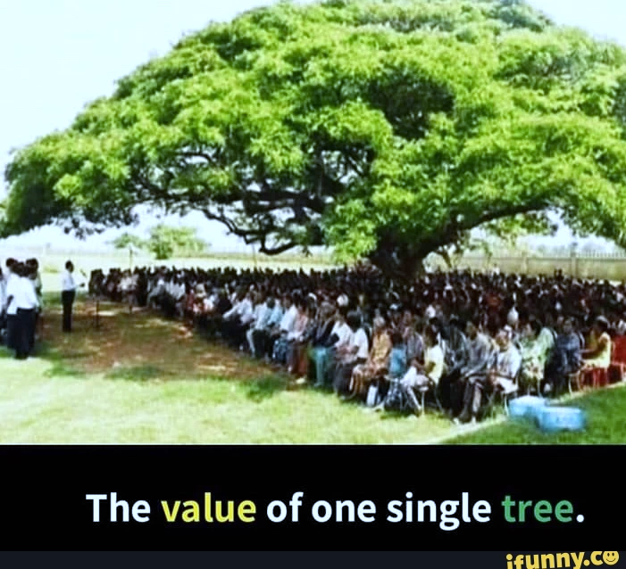
THANK YOU FOR LISTENING
The same way one single tree can shelter so many people, so can your one single deed transform many lives. Be intentional with your deeds today to positively impact lives.

Slide 53
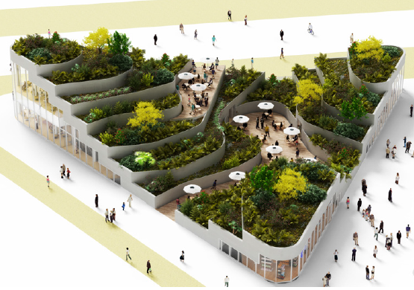
Connect with me https://linktr.ee/sanmiolowosile

