Slide 1
The Place of Digital Technologies in the Implementation of Carbon Reduction in Construction
Ayodeji Oke
Department of Quantity Surveying
Federal University of Technology Akure
NIQS BCGM, Abuja
17 – 20 November 2021

Slide 2
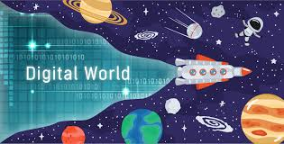

Outline
Introduction
Carbon
Carbon Emission & Reduction
Carbon Emission Trading
Digital vs Analog
Digital Technologies
DT for CER/T
Recommendations

Slide 3

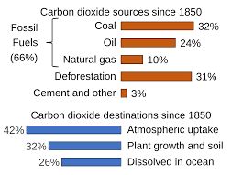
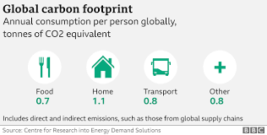
Carbon / Emission
One of the major factor aggravating global warming is the increase in the rate of greenhouse gas emission, of which carbon dioxide (CO2) is the primary contributor.

Slide 4
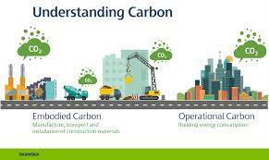
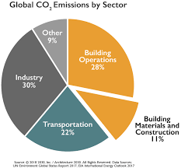
Carbon Emission
Infrastructures by the construction industry consumes large amount of energy which are unrenewable (majorly), leading to the massive emission of CO2.

Slide 5




Carbon Reduction

Slide 6
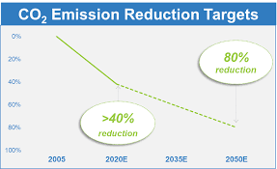
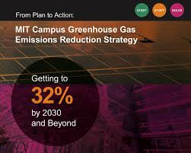
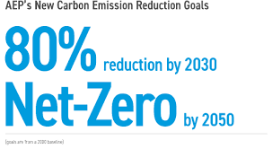
Carbon Reduction

Slide 7
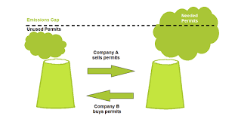
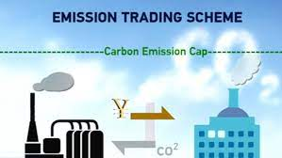
Carbon Reduction
Carbon Emission Trading
Cap and trade (establishing a cap on emissions that can be released into the atmosphere).
Baseline and credit (introducing a transfer of the ability to freely emit from emitting sources to the government).
While cap and trade schemes are based on allowance allocation and targets, baseline and credit schemes are based on how emissions differ from the baseline.

Slide 8
Carbon Reduction
Carbon Emission Trading
The world’s biggest carbon trading system is the European Union Emissions Trading System (EU ETS).
Others are:
California's AB-32 cap-and-trade system (CaT) and the Regional Greenhouse Gas Initiative
The Canada Quebec Carbon Market
Australia's New South Wales Emission Scheme (NSW ETS)
Korea Carbon Market
China Carbon Trading Pilots

Slide 9
Carbon Emission Trading

Slide 10
Carbon Emission Trading
Carbon Trade | Awareness |  | Current Adoption elsewhere |  | Willingness to Adopt
Cap and trade | 1.95 | 1 | 3.20 | 1 | 3.02 | 2
Baseline and credit | 1.67 | 2 | 2.80 | 2 | 3.57 | 1

Slide 11
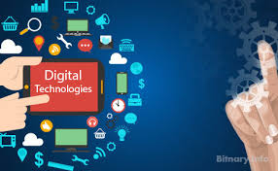
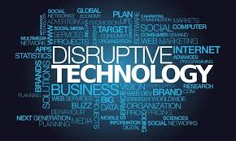
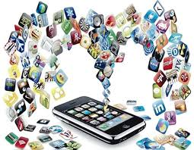
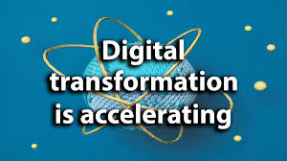

DT

Slide 12
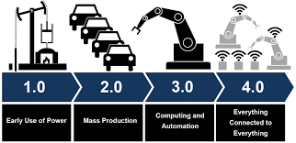
Industrial Revolutions
From stone age to industry 4.0
Notes:
History lane

Slide 13
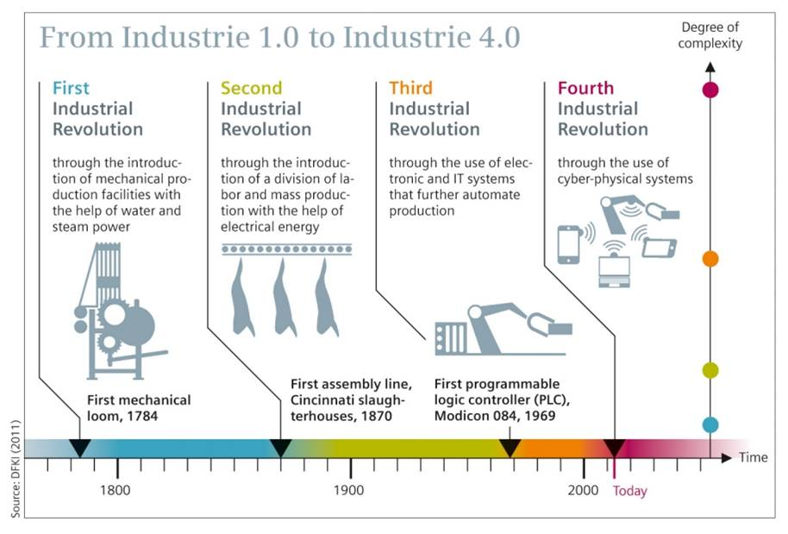
Industrial Revolutions
Notes:
History lane

Slide 14
DT
Digitization is the conversion of analogue information into digital information.
Digitalization is the successful application of technological devices that allows it to improve our daily life and also of the organization around us.
It entails the intersection of new technologies.
These technologies are known as digital technologies.

Slide 15
DTs
3D printing
3G/4G/5G Network Evolutions
Artificial Intelligence
Augmented Reality
Automation
Big Data
Biomimetic
Biomimicry
Blockchain
Building Information Modelling
Cloud Computing
Cognitive Radio
Connected Machines
Cryptocurrency
Cyber physical system
Cyber Security
Cyber technology
Data Analytics
Digital technology
Digital transformation
Digital twin
Distributed ledger technology
Drone
Ecological economics
Energy economics
Environmental economics
Gamification
Grid Computing
Internet of Things
Machine Learning
Machine to Machine
Mechatronics
Mixed reality
Mobile Applications
Mobile Computing
Nanotechnology
Quantum Computing
RFID
Robotics
Robotics
Segmentation Techniques
Smart computing
Smart contract
Social Computing
Surveillance
Virtual Reality
ETC.
Notes:
History lane

Slide 16



DT for CER/T

Slide 17
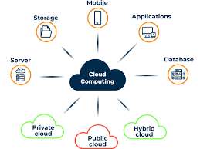
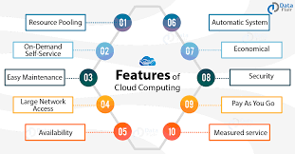
DT for CER/T
Cloud Computing
A type of internet computing that allows users to access a variety of customisable resources .
The main goal is to provide access to computation and data storage to several users without the need for individual licenses.

Slide 18
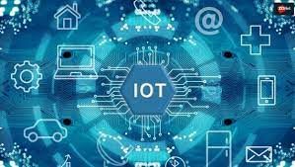
DT for CER/T
Internet of Things
A tool that allows any device to connect to the internet utilizing embedded software and sensors for data gathering, exchange and communication.
Usage of the Internet of Things on construction sites results in intelligent construction management.

Slide 19
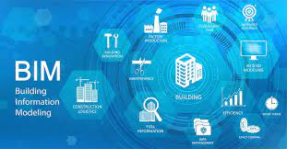
DT for CER/T
BIM
An innovative digital platform that aids information sharing among project participants and improves project performance in the process.
Attention given to BIM in the AECO industry is as a result of its ability to provide easy use and reuse of project data across the project development phases

Slide 20
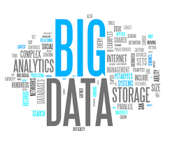

DT for CER/T
Big Data
BD is a core driver of digital transformation in organisations.
It is the gathering of data from diverse sources and their comprehensive evaluation in a bid to provide strategic information that will support real-time decision making.
BD aids Data Mining which involves the deep digging into data to get possible trends.

Slide 21
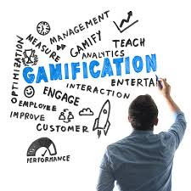
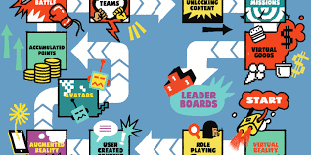
DT for CER/T
Gamification
Deliberate use of game concepts for a non-game task.
It employs the technique of using game elements in a context that is unrelated to games in order to enhance loyalty, participation, and motivation of people.

Slide 22
DT for CER/T
Gamification
Gamified experiences leads to a more competitive environment by comparing the outcome of each result.
The results could be channelled in combating unnecessary material wastage and create awareness about the structures and concepts that are now employed in the construction industry.
Improve stakeholders’ engagement and involvement (including users) in the construction industry.
Encourage collaboration and culture of innovation

Slide 23
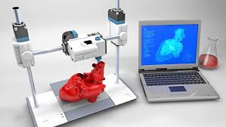
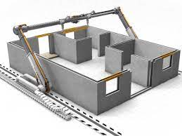
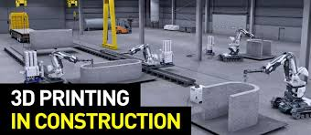
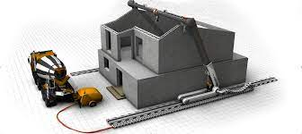
3D Printing
It is an automated process that requires the use of software, hardware and materials all working together to produce a solid final product.
Digital model created with 3D software will be scanned with a 3D scanner, and the scanner processes the digital model into a readable file format for which the 3D printer can process.
3D technologies in construction include Contour crafting, Batiprint 3DTM, D-shape Monolite, etc.

Slide 24
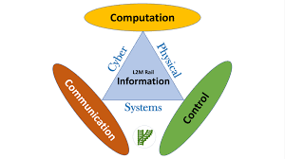
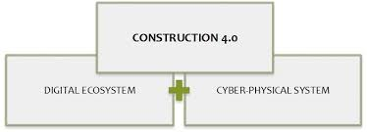
DT for CER/T
Cyber-Physical System
CPS are systems where physical and software components are deeply intertwined, each operating on different spatial and temporal scales, exhibiting multiple and distinct behavioural modalities, and interacting with each other in a myriad of ways that change with context.
This is useful for construction projects, which involve different phases and cycles from its inception to onsite activities and management of the completed facility .

Slide 25
DT for CER/T

Slide 26
DT for CER/T
Variables | Awareness |  | Usage |  | Gap
 | MIS | Rank | MIS | Rank
Social Media | 4.39 | 1 | 4.03 | 1 | 0.36
Internet of Things | 4.18 | 2 | 3.69 | 2 | 0.49
Mobile Computing | 4.10 | 3 | 3.34 | 3 | 0.76
BIM | 3.92 | 4 | 3.21 | 4 | 0.71
Virtual Reality | 3.86 | 5 | 3.09 | 6 | 0.77
Human computer Interaction | 3.84 | 6 | 3.10 | 5 | 0.74
Robotic | 3.75 | 7 | 2.60 | 12 | 1.15
Drone | 3.74 | 8 | 2.98 | 7 | 0.76
Cloud Computing | 3.70 | 9 | 2.96 | 8 | 0.74
Big Data | 3.63 | 10 | 2.88 | 9 | 0.75
Cyber-Physical System | 3.42 | 11 | 2.69 | 10 | 0.73
Augmented Reality | 3.28 | 12 | 2.65 | 11 | 0.63
Smart factory | 2.96 | 13 | 2.27 | 13 | 0.69

Slide 27
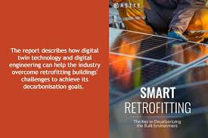
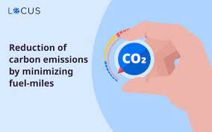
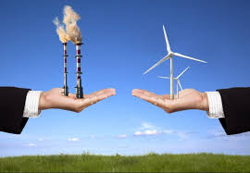

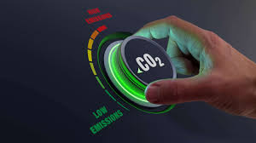
Recommendations

Slide 28
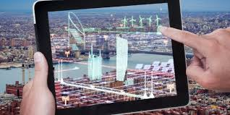
Recommendations
Training and workshop at various levels
Additional study, learning and practice
Software purchase and usage
Implementation at various levels
Keeping track with international practices

Slide 29


Thank you for Listening!

