Slide 1
CLIMATE CHANGE AND GLOBAL DISASTERS: DEVELOPING SUSTAINABLE INFRASTRUCTURES AMIDST DECLINING ECONOMIC RESOURCES
BY
PROF. H. A. ODEYINKA (PhD, FNIQS, MRICS, FHEA)
OBAFEMI AWOLOWO UNIVERSITY, ILE IFE, OSUN STATE, NIGERIA
A KEYNOTE PAPER
DELIVERED AT THE 29TH BIENNIAL CONFERENCE/ELECTION GENERAL MEETING OF THE NIGERIAN INSTITUTE OF QUANTITY SURVEYORS
“ABUJA 2021”

Slide 2
The concept of Climate Change and Sustainable Development
Climate change refers to a large-scale, long-term shift in the planet's weather patterns and average temperatures” (Meteorological Office UK (Met Office) (2021).
Sustainable Development (SD) is a development that meets the needs of the present without compromising meeting the needs of the future generation (WCED, 1987).
The need for Sustainable Development – Emission, depletion of ozone layer, disaster risk
Notes:
World Commission on Environment and Development (WCED) popularly called ‘the Brundtland Report’.

Slide 3
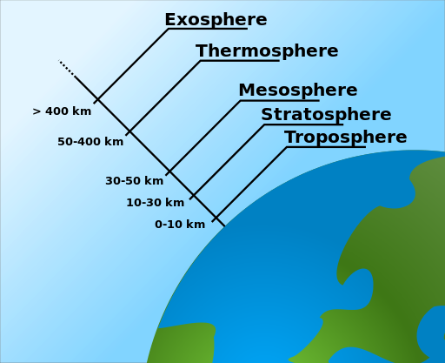
Atmospheric Layers

Slide 4
Ozone Layer
The ozone layer or ozone shield is a region of Earth's stratosphere that absorbs most of the Sun's ultraviolet radiation.
It contains a high concentration of ozone in relation to other parts of the atmosphere, although still small in relation to other gases in the stratosphere.

Slide 5
Carbon emission and depletion of the ozone layer
Stratospheric layer shields harmful incoming solar ultraviolet radiation that can damage the ecosystems
Atmospheric carbon dioxide and other greenhouse gas (such as Nitrous oxide - N₂O, methane - CH₄ and others) increased by human and natural processes
Increased frequency and magnitude of disasters witnessed in recent past has been attributed to the changes in global climatic conditions due to depletion of ozone layer
Notes:
(about 15 to 35 kilometers above Earth’s surface)
levels of atmospheric carbon dioxide and other greenhouse gas (such as Nitrous oxide - N₂O, methane - CH₄ and others) emission

Slide 6
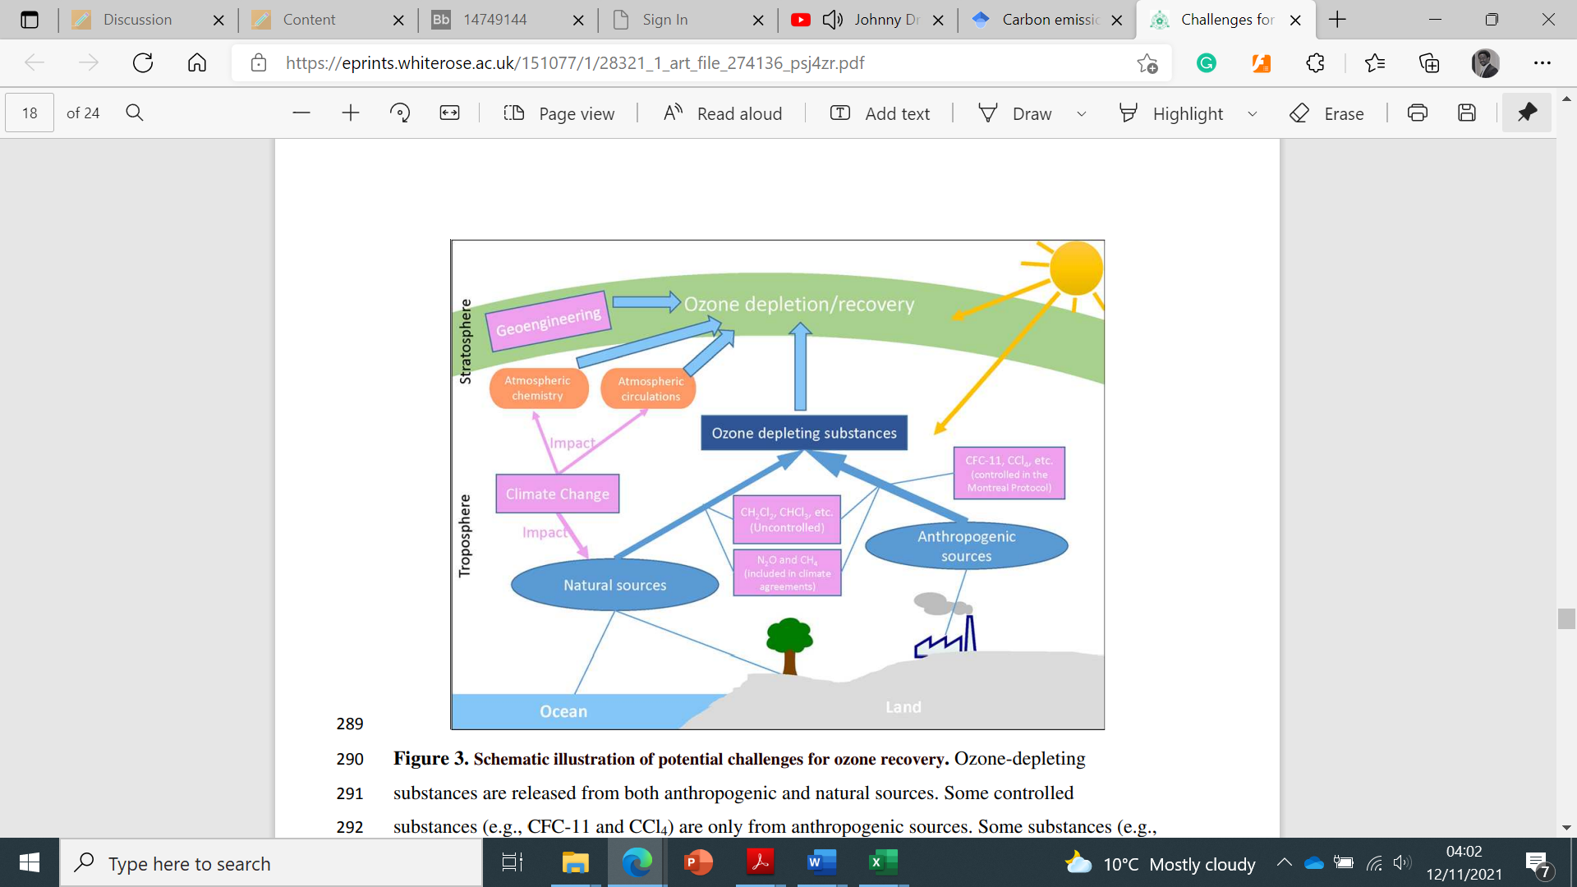
Sources of ozone layer depleting substances and challenges to ozone layer protection

Slide 7
Contributory activities
several activities across several sectors
Buildings and construction sector reportedly accounts for
  about 36% of global final energy use and
  about 40% of energy and process-related carbon dioxide (CO2) emissions.
  The manufacturing of building materials and products accounted for about 11% of this stock (United Nations Environment Programme (UNEP), 2018)

Slide 8
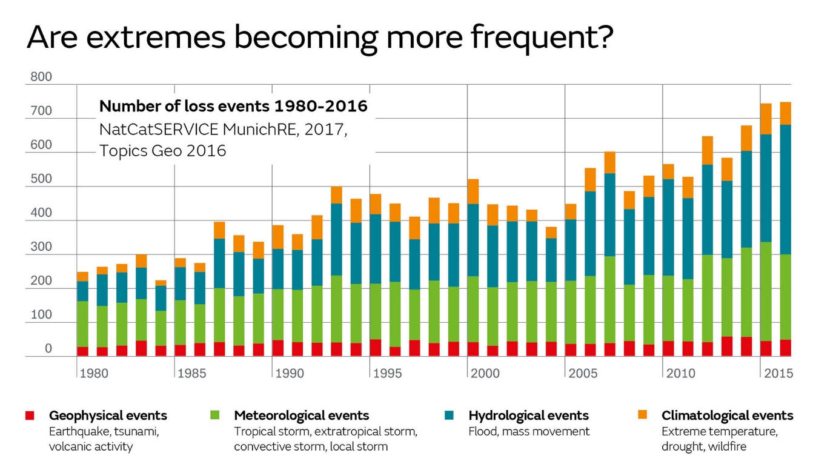
Key Global Disasters
MunichRe’s account of the number of natural catastrophes 1980 - 2016 (Loss events)

Slide 9
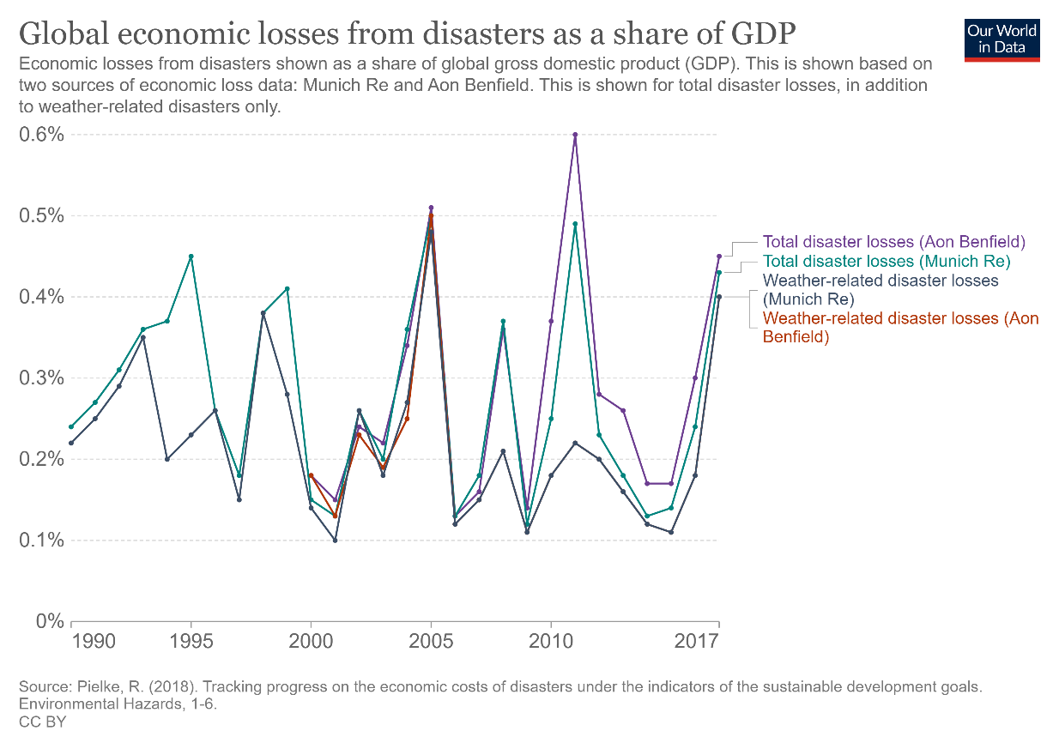
Global economic losses from disasters as a share of GDP
Notes:
Figure 3 shows the recorded global economic losses from disasters as a share of global Gross Domestic Product (GDP) between 1990 and 2017. It should be noted that the percentages shown are with respect Gross values of domestic product, the significance of the figures will be more prominent when compared with country wealth.

Slide 10
Key UN initiatives addressing Climate Change
Brundtland Report (1987) highlighted the three fundamental components of sustainable development, the environment, the economy, and society
The Paris Agreement 2015 (Paris Accord) – COP21 is a legally binding international treaty on climate change. Its goal is to limit global warming and covers climate change mitigation, adaptation, and finance
The 2030 Agenda for Sustainable Development” is another intervention with a blueprint for peace and prosperity of the people and the planet.
  clear targets described 17 Sustainable Development Goals (SDGs) (United Nations, 2015)
Notes:
Brundtland Report highlighted the three fundamental components of sustainable development, the environment, the economy, and society, and highlighted several recommendations which include the need to conserve and enhance our resource base, by gradually changing the ways in which we develop
The Paris Agreement (Paris Accord) is a legally binding international treaty on climate change adopted by 196 Parties. Its goal is to limit global warming and covers climate change mitigation, adaptation, and finance
The Sendai Framework for Disaster Risk Reduction (SFDRR) (2015–2030) was initiated to advance Disaster Risk Reduction (DRR) efforts, it aids the understanding of disaster risk and highlights steps for mitigating disaster risk (Busayo et al, 2020)
UK became the world’s first major economy to pass a law committing the country to a target of ‘net zero’ emissions by 2050 (Met Office, 2021)

Slide 11
Key UN initiatives addressing Climate Change (Contd.)
The Sendai Framework for Disaster Risk Reduction (SFDRR) (2015–2030) was initiated to advance Disaster Risk Reduction (DRR) efforts
2021 United Nations Climate Change Conference (COP 26) Glasgow Agreement
  the rise in the average global temperature is limited to 1.5 degrees
  Parties are encouraged to strengthen their emissions reductions and to align their national climate action pledges with the Paris Agreement
Notes:
Brundtland Report highlighted the three fundamental components of sustainable development, the environment, the economy, and society, and highlighted several recommendations which include the need to conserve and enhance our resource base, by gradually changing the ways in which we develop
The Paris Agreement (Paris Accord) is a legally binding international treaty on climate change adopted by 196 Parties. Its goal is to limit global warming and covers climate change mitigation, adaptation, and finance
The Sendai Framework for Disaster Risk Reduction (SFDRR) (2015–2030) was initiated to advance Disaster Risk Reduction (DRR) efforts, it aids the understanding of disaster risk and highlights steps for mitigating disaster risk (Busayo et al, 2020)
UK became the world’s first major economy to pass a law committing the country to a target of ‘net zero’ emissions by 2050 (Met Office, 2021)

Slide 12
Country-based interventions
UK became the world’s first major economy to pass a law committing the country to a target of ‘net zero’ emissions by 2050 (Met Office, 2021)
On 18th March 2021, Nigeria also launched a National Action Plan on Gender and Climate Change (NAPGCC) which aims to ensure that climate actions in Nigeria integrates the contributions of everyone.
Beyond the overarching policies, there is the need for country and organisation-specific alignment of principles.
Notes:
On 18th March 2021, Nigeria also launched a National Action Plan on Gender and Climate Change (NAPGCC) which aims to ensure that climate actions in Nigeria integrates the contributions of everyone. The Action Plan targets the attainment of a climate-resilient Nigeria, the important and critical roles of all class of individuals in the implementation policies and strategies. Nigeria has a Department of Climate Change in the Federal Ministry of Environment and I believe that the domestication of all relevant action plans in the construction industry

Slide 13
Sustainable Infrastructure Development – A Response Strategy to Global Warming
The significant contribution of the construction industry to global warming is huge
The construction industry also has a lot to contribute to the global response of sustainable infrastructure development
  “…quicken human development, mainly in the poorest countries, and to eradicate the gross inequities present in the world today; while at the same time preventing the depletion of the resources and biological systems of the planet to such a degree that future generations would not be impoverished’
Notes:
But one thing remains, Quantity Surveyors and other professionals need to know how the sustainability agenda can be supported through existing traditional and emerging roles. Infrastructure expenditures should preserve the present day, defend the climate, reduce disaster risks, and meet economic and functional targets.

Slide 14
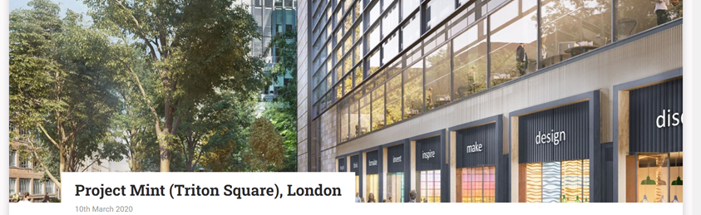
Examples of Sustainable Infrastructure/Project – leading to reduction in carbon emission
Commercial office complex (BREEAM, 2020)
Commercial office space named Project Mint (Triton Square), London. The project attained post-construction rating of outstanding.

Slide 15
The key attributes of the project
Stairs are centrally located to facilitate walking between floors with a daylight provision and an exemplary view, external terraces are also provided as well as gym and cycle space to promote wellbeing
The use of low carbon and efficient technologies such as hybrid air source heat pumps, boilers with 94% efficiency and solar PV achieving 35% reduction in carbon emission
Greywater and rainwater harvesting are implemented with a use of low flow sanitary ware that improves water use
Notes:
It is good to know that there are some EDGE certified properties in Nigeria as well such as Peridot Parkland Estate and Cornerstone Towers. Incorporating sustainability in building services only requires the consideration of sustainable options for Lighting, heating, ventilation and air conditioning (HVAC), piped systems, power supply, transportation system and automation options.

Slide 16
The key attributes of the project
(Contd.)
Choosing refurbishment over demolition thereby reducing about 6000 vehicle movements, 35,000 tonnes of concrete and 2000 tonnes of steel have been reused as well as granite and cladding system. These measures led to embodied carbon savings of 57,000 tonnes – equivalent to powering 14,000 homes or driving 150 million miles. 99.9% of waste has been diverted to landfill.
Innovation on the project – A small company was assisted to provide lifecycle assessment data and create an Environmental Product Declaration (EPD) for their product. The EPD is produced based on Life Cycle Assessment (LCA) calculations and provides a quantitative basis for comparison of products and services.
Notes:
It is good to know that there are some EDGE certified properties in Nigeria as well such as Peridot Parkland Estate and Cornerstone Towers. Incorporating sustainability in building services only requires the consideration of sustainable options for Lighting, heating, ventilation and air conditioning (HVAC), piped systems, power supply, transportation system and automation options.

Slide 17
Sustainable Infrastructure Development
Sustainable infrastructure is the practice of creating constructed facilities by using best-practice, clean and resource - efficient measures
Certification programmes like LEED (Leadership in Energy and Environmental Design) in the United States and BREEAM (Building Research Establishment Environmental Assessment Method) in the UK.
The areas of assessment of BREEAM include: 1. Energy 2. Land use and ecology 3. Water 4. Health and wellbeing 5. Pollution 6. Transport 7. Materials 8. Waste 9. Management.
Notes:
The practical way to contextualise how a Quantity Surveyor can contribute to sustainable construction is to influence decisions on energy consumption, carbon emission of built environments of all activities at the planning, design, and construction stage. Full influence can be exerted to achieve a reduction in cost-in-use of the built asset and social cohesion of users should be promoted as much as possible.

Slide 18
The Implication for the Quantity Surveyor
The need to shift focus from costing capital expenditure (CAPEX) of infrastructure project alone to including operating expenditure (OPEX)
The need to be knowledgeable in ‘whole life costing’ so as to enable construction client to choose between traditional construction and sustainable construction.
Traditional construction may appear cheater initially but extremely costly when the life cycle cost (Operating expenditure) is factored in as well as the cost of carbon emission (externality).
Notes:
The practical way to contextualise how a Quantity Surveyor can contribute to sustainable construction is to influence decisions on energy consumption, carbon emission of built environments of all activities at the planning, design, and construction stage. Full influence can be exerted to achieve a reduction in cost-in-use of the built asset and social cohesion of users should be promoted as much as possible.

Slide 19
De-mystifying the High Cost of Sustainable Infrastructure - the UK Example
Evidence collected by UK’s Building Research Establishment (BRE) and Cyril Sweett (a firm of Chartered Quantity Surveyors) [BRE Trust 2005]
Housing Project
EcoHome’s Good rating can be achieved for an additional capital cost of between 0.3% and 0.9%. Achieving a Very Good rating can be achieved with an additional cost of between 1.3% and 3.1% and an Excellent rating for between 4.2% and 6.9%, for a range of locations.

Slide 20
De-mystifying the High Cost of Sustainable Infrastructure - the UK Example
Evidence collected by UK’s Building Research Establishment (BRE) and Cyril Sweett (a firm of Chartered Quantity Surveyors)
Naturally Ventilated Office
A BREEAM Good rating can be achieved for a saving of between 0.3% and 0.4% of the capital cost. A Very Good rating can be achieved for between a cost saving of 0.4% and an additional cost of 2% and an Excellent rating for an additional cost of between 2.5% and 3.4%, for a range of locations.

Slide 21
De-mystifying the High Cost of Sustainable Infrastructure - the UK Example
Evidence collected by UK’s Building Research Establishment (BRE) and Cyril Sweett (a firm of Chartered Quantity Surveyors)
An Air-conditioned Office
A BREEAM Good rating can be achieved for an additional cost of between 0% and 0.2% of the capital cost. A Very Good rating can be achieved with an additional cost of between 0.1% and 5.7% and an Excellent rating for between 3.3% and 7.0%, for a range of locations.

Slide 22
De-mystifying the High Cost of Sustainable Infrastructure - the UK Example
Evidence collected by UK’s Building Research Establishment (BRE) and Cyril Sweett (a firm of Chartered Quantity Surveyors)
Private Financed Initiative (PFI) procured health centre project
For a Private Financed Initiative (PFI) procured health centre project, the report shows that the base case health centre already achieves a Good rating. A Very Good rating can be achieved at no additional cost and an Excellent rating for an additional cost of between 0.6% and 1.9%, for a range of locations

Slide 23
De-mystifying the High Cost of Sustainable Infrastructure - the UK Example
Overall, the report demonstrates that significant improvements in the sustainability performance of a building can be achieved at very little additional cost.
The report also demonstrates that more sustainable buildings can offer major life-cycle cost benefits.
This implies that whilst the majority of Quantity Surveyors (QS) are versed in the techniques of determining the capital cost of a building, they also need to up skill themselves in determining the life cycle cost and whole life costs of buildings.

Slide 24
Conclusion
Themes such as emissions, climate change, disaster risk and interventions aimed at tackling these global challenges have been discussed.
It is clear that collective action is required towards reducing the triggers of climate change
Operate sustainably to protect the people and our planet.
Globally, construction is a major sector, and the role stakeholders play is fundamental to the realisation of sustainable development.
There is more to do to help stakeholders embed sustainable principles in their day-to-day activities.
Operationalising the concept of sustainable procurement is still germane for our industry

Slide 25

CLOSING
Further interesting and insightful discussions are upcoming during this conference. I wish everyone a productive deliberation.

