Slide 1
29TH BIENNIAL CONFERENCE
“ABUJA 2021”
CLIMATE CHANGE AND GLOBAL DISASTERS:
DEVELOPING SUSTAINABLE INFRASTRUCTURE TO ACHIEVE GROWTH AMIDST DECLINING ECONOMIC RESOURCE
TOPIC: EXAMINING THE PHENOMENON AND THE QUANTITY SURVEYOR’S ROLE IN SUSTAINABLE INFRASTRUCTURAL DEVELOPMENT
BY
HUMPHREY AMEGADOE FGhIS, MRICS (Currently Chair, Public Affairs Committee-GhIS)

Slide 2
Introduction
Climate Change as a Phenomenon and the Issues
Global Disasters
Environmental Impact
Skeptics
The Politics
Construction Industry and Climate Change
Sustainable Infrastructure Development
The Larger Politics or the Looming Danger
The Quantity Surveyor & Climate Change
Recommendations

Slide 3
INTRODUCTION
. Great Theme for the Conference: Climate Change is not only a global concern, but also the future concern.
The attention on it with it’s attendant world disasters must be very engaging, henceforth.
The impact on Infrastructure and therefore, the need for a sustainable infrastructure development, to achieve growth in the amidst “Declining Resources” must be applauded
This theme is completely an Agenda Setting for: Profesionals, our Nations and the Continent.

Slide 4
Our Challenge!!
Our Challenge!!!
How do we capture the knowledge, the wisdom, the inspiration and the emotions of this Conference and INVEST it into our future?????
Is very important and must engage US (our attention) long before this Conference closes.
We must not leave here and allow the law of DIMINISHING INTENT to take away all the great things that have been poured upon US.
This paper therefore, will make far reaching recommendations for the consideration of
Every participant
Nigeria Institute of Quantity Surveyors (NIQS)
Finally our two Institutions, NIQS and the Ghana Institution of Surveyors (GhIS)

Slide 5
CLIMATE CHANGE
The phenomenon of Climate Change raises issues for every living thing;
The Land/Soil
The Sunshine
The Economy
The Forest/Vegetation
The Animals in the bush and in the home
Every Profession or Industry
The phenomenon is calling for changes not only in lifestyles, but Professional Practices, Outlook and future goals – travels.
Climate change is a huge crises of our time.

Slide 6
CLIMATE CHANGE
Human Activities from fossil fuels and other behaviourial activities has caused high emission of CO2 into he atmosphere.
The CO2 get into the atmosphere to cause heat, some of this heat get trapped in the atmosphere resulting in earth getting warmer.
We are one degree warmer than pre industrialised years of 1800.
Sea levels are rising millimetres each year, because sea water expands when warm.
It is predicated that by 2100 our earth shall be warmer by 1.5⁰ of even 2⁰.
However, it is appearing that if we are not careful we shall be 1.5⁰ warmer in just ten (10) years.
We have broken CO2 records since 1950s and the World is getting warmer too quickly.
It is anticipated that the cities of Osaka in Japan & Miami in United States will be submerged in 80 years under water, if things continue unchecked.

Slide 7
GLOBAL DISASTERS
Almost all the world has agreed that:
The high and long rains,
Fires due to high temperatures
Sea levels rising to 3 millimetres because of expansion when sea water get warmer, and others
Aare all due to Climate Change
Evidence in 2021 alone:
Flooding in San Francisco
Heavy Rains in Cornoro Argentine
Severe flood in Mahabrako Iran
Flooding in Naples in Italy
Earthquake over 5.8 scale in Chile
Intense hail storm in Ecuador
Heavy snow fall in Austria

Slide 8
Effect of these Severe Disasters:
Broken Bridges
Waterlines, Telephone lines destroyed
Homes, Offices, the human habitat is being destroyed
Loss of human
It is anticipated that the cities of Osaka in Japan and Miami in the United States, will sink under water if care is not taken in 80 years.

Slide 9
ENVIRONMENTAL IMPACT
Our environment is under siege.
The four years drought in Southern Africa alone and it’s environmental impact has been enormous;
Death of animals
Drying of rivers and springs
Environmental fire and loss of Forest Vegetation cover
Food scarcity or food security threatened

Slide 10
SKEPTICS
There are scientist who do not believe in Climate Change.
They are also accusing politicians, environmentalist of such damaging Campaign.
They include
Wolfang Muller
Patrick Michaels
Malcom Roberts
In Everything there will be Skeptics, BUT you, or we, as an individual(s), must equip your Guiding System to be informed and take personal and professional decision.
Explore this theme from now and convince yourself like Covid 19, there will be Skeptics but that stop people from dying.

Slide 11
THE POLITICS
2016, World Leaders sign to do everything the Paris Agreement. Countries sign to regulate how much CO2 emit.
US has pulled out of the Agreement under the previous President
General commitment by countries to work to reduce CO2
The danger that looms is that Developing Countries may join China to make case for the need to develop any controls. ( We shall come to this soon.)
Turkey wants to use coal for power .

Slide 12
CONSTRUCTION INDUSTRY AND CLIMATE CHANGE
The Construction Industry is responsible for building Infrastructure.
Diesel Engines also emit a lot of CO2 .
The Heavy Fuel Oil (HFO) the diesel we use.
So our Industry and the Mines are heavy Contributors.
We must also leave here with the firm knowledge that the industry we work, the Construction Industry is also a contributor to the global warming.
We destroy vegetation quickly
We go through virgin Forest
The CO2 emissions from the Plant and Equipment is enormous

Slide 13
SUSTAINABLE INFRASTRUCTURE DEVELOPMENT
Sustainable Infrastructure to achieve growth.
Our Industry must come face to face with the severe pressures that is put on our infrastructure.
How do we ensure that the Disaster from Climate Change do not erode the items of infrastructure to zero? Do we need to strengthen existing Bridges and Dams????
Going forward, how do we construct infrastructure to withstand Climate Change and it’s attendant disasters and ensure that there is growth in our countries.

Slide 14
THE LARGER POLITICS OR THE LOOMING DANGER
There is larger politics ahead which we must prepare for:
China and Turkey, Poland wants more power plant (Thermal) are not bending. Their argument is simple “Others caused the current challenge to the World by their development why should they prevent others now”.
There is going to be bigger push to reduce this level of warming

Slide 15
THE QUANTITY SURVEYOR
Where does the Quantity Surveyor fit in.
The Quantity Surveyor comes in with his/her natural career or professional bent for:
Procedure
Process(es)
Obligation
Responsibilities
Planning
Costing
Financial Management
We can deepen this list or these areas of natural bent.
Illustration:

Slide 16
Formwork in BOQ
Procedure:
The Q/S thinks how it will be done – procedural in measurement and in pricing.
Process(es) – He knows materials will be Assembled-timber or Steel, Nails or Tie Rods, Labour.
Obligation – Who is obligated to what – Carpenter or Form fixers.
Responsibilities – Whose duty it is to supply, to purchase, to produce, to renew.

Slide 17
Planning – Form get to Site on time.
Ready by fixers of carpenter
Costing – How much will it cost.
Financial Planning – if one buys form work now, what other materials may suffer.

Slide 18
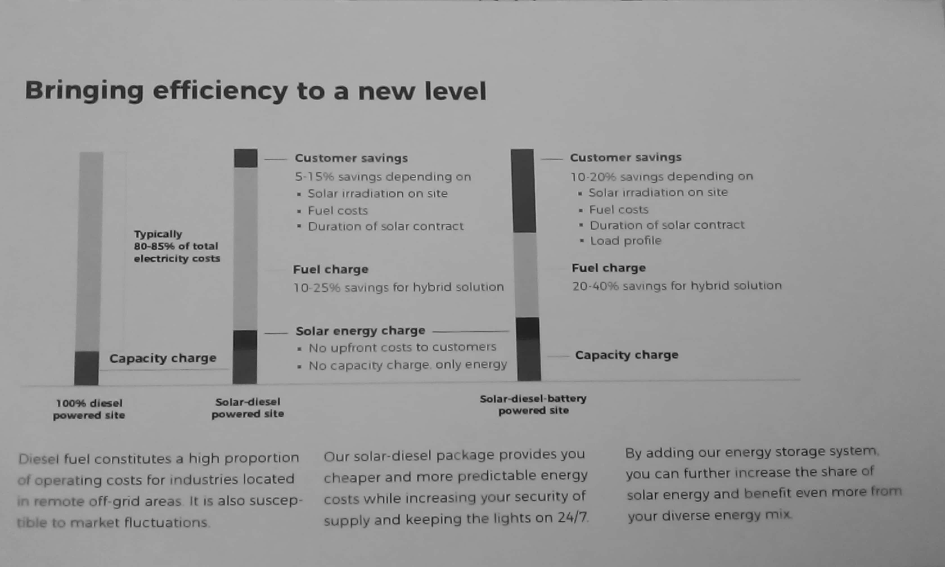

Slide 19
SOME SOLUTIONS
“With the rally towards more renewable sources of energy energy in full force, gas remains the best bet as a source of clean fuel for economies owing to it’s availability and readiness of infrastructure to process” CEO, Ghana gas Company, Dr. Ben KD Asante.
Energy mix Thermal, harvesting the waste for additional power.

Slide 20
RECOMMENDATIONS
Let us all return to schooling on this – CPD of all kinds to undress the real challenges and problems in it’s entirety.
Begin to tackle the challenge from;
  Design point of View
  Value Enginoering
  Critical look at Tender/Contract Documentations necessary, should a contruction method of work must include renewable energy, which option must be chosen over others.
  Award.
  Design Team Education can be led by the QS at pretender stage.

Slide 21
3. Construction stage and throughout let us be mindful of CO2 emission.
4. Standing Committee between GhIS/NIQS
  Strengthen all the efforts at collaboration ever since time immemorial
  Influence the Continent, Nigeria/Ghana here we come
  Cover all the corridors of power – Aso Rock, Jubilee House and others.
  AU
  360 Relationships
    Industry Players
    Politicians
    Scientist
    Historian

Slide 22
5. Quantity Surveyors must become champions of Climate Change and it’s devastation in our time and race straight away to greater control of Contract and documentations to ensure carbon neutrality in the processes of Design, Construction and Maintenance.
Become investigators of every process or procedure of infrastructure development.
This is a transition period for carbon neutrality 2050 – let us make our voice strong (very very very strong)
6. In the advocacy for this concerns – Climate Change and it’s devastation.

Slide 23
7. Enlist the Young Surveyors very early in all the battles ahead of us and those confronting us now.
8. Rethinking our Call.
what is a calling?
Have we gotten a sense of a calling?
Are in this to make money alone??? No,we must think of the future generations.
That also call for a new Image for ouselves

Slide 24
We must practice this Quantity Surveying Profession with a deep sense of mission. As if everything is dependent on it.
9. Congratulation to NIQS for a theme like this. I think on the side, let there be a faculty or commission within the NIQS, which must continue to explore the theme 70 years after this Conference, to continue examining the issues/phenomenon and come out with regular publication to make us relevant to the subject of sustainable infrastructure development - it will be a complete business development agenda.
This a very good Theme for a Conference in our Day
10. More Professionalism and Excellence – A Professional does not do what he loves alone he loves what he does, to create professional environment to flourish. Take a Professional Boxer!!!!!! They do not like to be hit at all, but you must find a ay to love it, if you must win

Slide 25
THANK YOU
FOR ATTENTION

