Slide 1
THE PLACE OF ESTIMATING IN THE DELIVERY OF SUSTAINABLE CONSTRUCTION PROJECT
A Presentation in the Workshop organised by NIQS, at CMD Secretariat, Lagos
Theme: Construction Estimating for Successful Project Delivery
Dr. Abdulhakeem GARBA Phd Aberdeen
Department of Quantity Surveying, Kaduna Polytechnic, Kaduna
hakeemgarba@gmail.com

Slide 2
INTRODUCTION
The construction industry has a profound impact on the natural environment, public health, economy, and productivity (Darko et al., 2018).
Globally, the construction industry consumes 40% of total energy production, 12-16% of all water available (Lemmet, 2009).
Also, it consumes 25% of all timber, 40% of all raw materials, produces 30-40% of all solid wastes, and emits 35-40% of carbon dioxide (CO2) (Darko et al., 2018; Garba et al. 2016).
These have resulted in a rising global awareness of the importance of sustainability in the construction industry (Wang et al., 2014).
Rising demand for more sustainable or green buildings (GBs), over the last twenty years have witnessed an increased interest in GB concepts and practices globally (Gou and Xie, 2016).
Sustainable building largely refers as Green Building has emerged as a viable solution for delivering buildings that are sustainable with limited harmful effects on the natural environment, less resource consumption and human health (Darko et al., 2018).

Slide 3
INTRODUCTION cont’d
Despite the ample benefits of GB, there is still a perception that they are expensive and that green technologies are not sufficiently proven (Samosir et al., 2020).
Also, the cost estimating techniques and standards method of measurements used in the conventional buildings development perhaps are not suitable and adequate for GB (Naamandadin, Sapian and Khuzzan 2014)
Hence, this paper evaluates the position of cost estimating in the delivery of sustainable construction project.

Slide 4
CONCEPT OF GREEN BUILDING
The concept of Green Building (GB) started when the awareness of sustainable development increased in the construction industry.
GB awareness become more important because by the year 2050, it is predicted that almost half of the World’s carbon emissions will be from developing countries (Pomeroy, 2011).
GB concept has been adopted by many nations as the best way forward in preserving natural resources and sustaining our environment (Al-Kaabi et al., 2009).
Chatterjee, (2009) defined “sustainable building” or “green building” as a process to create buildings and infrastructure in such a way that minimize the use of resources- energy, water and materials, reduce harmful effects on human and the environment, during the building’s lifecycle.
GB maximizes the use of efficient building materials and construction practices, optimizes the use of onsite sources, uses minimum energy to power itself, uses efficient equipment to meet its daily consumer consumption, maximizes the use of renewable sources of energy, uses efficient waste and water management practices.

Slide 5
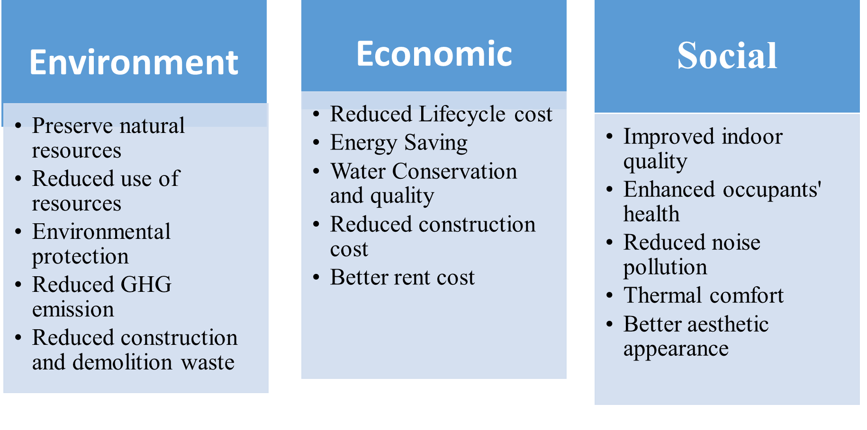
The Benefits of Green Building

Slide 6
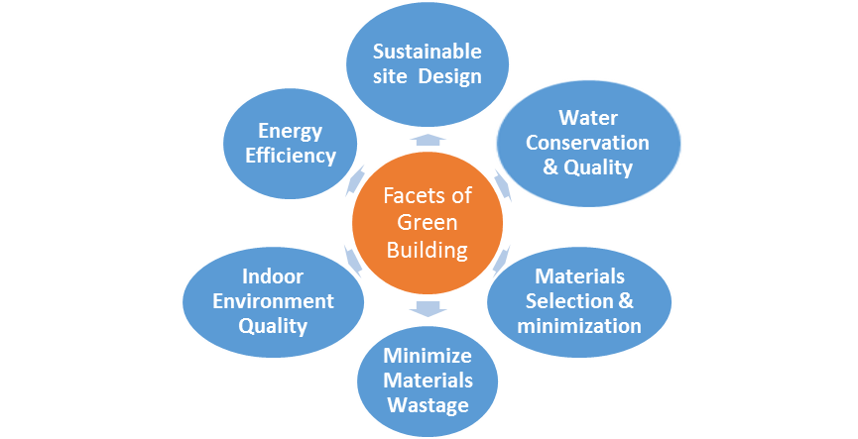
Measures of Green Building
Adopted from; Gupta and Shrivatava 2015

Slide 7
CONCEPT OF GREEN BUILDING Cont’d
Sustainable Site Design
Site layout
Hard surfacing
Economic
Optimizing the use of renewable energy to reduce electricity purchases
Water Conser.
More Efficient Fixtures
Waterless Urinals &Toilets
Scheming for efficient energy utilization to reduce initial capital costs
Designing for Mechanical systems of ventilation to reduce running costs
Rainwater Reuse
Grey water Reuse

Slide 8
CONCEPT OF GREEN BUILDING Cont’d
Materials Selection and Minimization
Prescribing Low Energy Materials
Utilizing Potential of Non-Conventional Materials and Technology
Indoor Envir. Quality
Natural Lighting and ventilation
Waste Minimisation
Reduction – modulation, off-site construction
Reuse
Passive Solar Design
Recycling

Slide 9
Strategies for Achieving Affordable GB
Process- according to a growing collection of case studies, deconstruction is producing cost savings in projects throughout the U.S., often up to 40% less compared to demolition costs.
Materials - there is revenue (for sale—or tax benefit of donation to a non-profit t) from reused or recycled materials.
Landfill fee- there is then the “value” of avoiding the cost of disposal.
Labor costs - are higher for deconstruction than for demolition because of the manual work required to un-install materials and then process them, plus the time required to plan and organize and market/sell the salvaged materials.
Time- given it takes longer to salvage and process materials for deconstruction, it’s important to identify the likely savings up-front in order to make up for the time.

Slide 10
Emerging Skills Required by QS for Practicing Sustainability
Sustainability Advisor
Life cycle Costing
Value Engineering
Risk Analysis advisor
Environmental services measurement and costing
Advice on cost limits and budgets.
Alternative green materials identification and specification

Slide 11
Myth of Sustainable Construction Projects
GBs and their associated installation costs are substantially higher than conventional Buildings.
GB have many advantages, but the additional construction costs of green buildings are also very important issues (Sun et al. 2019).
High cost of Renewable Energy Technologies are the major barrier preventing their wider utilisation.
Limited experience of construction practitioners particularly on the materials utilisation, operation systems and lack of change in the total delivery of project
Majority of governments, International organisations, and other agencies set target of achieving 80% of existing building to greener buildings between 2030-2040.
Globally, there is no statistical difference in the square metre cost of the buildings between those that were green and those that were not (Macaluso, 2008).

Slide 12
Costing Sustainable Construction Projects
Developing a green project estimate requires a balancing of long term savings against initial costs.
Often the approach to green building costs is to get the most “Return on Investment” by incorporating as many low- or no-cost green measures as possible, or in the case of a credit rating programmes, earning the most credits at the lowest cost.
It is difficult to make blanket statements about the cost of a GB because of the thousands of systems and components that make up a facility, and the countless design options.
How those systems (or “assemblies”) are selected and interconnected and the green strategies used greatly affect both initial and future building costs.

Slide 13
Cost Estimating and Green Building
Cost estimating is the process of projecting the cost of building a physical structure.
Absence of a cost model and standard method of measurement for green home design, is causing additional cost towards the construction of green homes as compared to the traditional building development (Naamandadin, Sapian and Khuzzan 2014)
Cost is one of the measures of function and performance of a building.
Construction development cost does not only involve the material costs but also the method of implementation.
However, improving occupant health, comfort, and productivity or pollution reduction are not easy to quantify.
When considering green design and its relationship to the construction costs, the costs and benefits have to be analysed using a holistic approach.
To achieve higher Green rating/marks and to minimizing life cycle impact on both new and rehabilitation programmes, it is essential to establish accurately the cost implications incurred and higher value that GB offer (Qian and Foong, 2013) .

Slide 14
Cost Estimating and Green Building cont’d
In China incorporation of GB systems such as energy-efficient appliances, equipment, and lighting caused the construction costs to increase by 10.77% compared to traditional buildings.
Also, in China energy efficient technology application (EETA) accounted for a large proportion (more than 50%) of the total incremental costs of GBs (Sun et al., 2019).
China’s GB case analysis showed that the average green premium percentage of the overall project investment in China is 10.9%
According to Dahiru (2014) and Darko et al., 2017, GBs deliver projects at reduced cost.
Naamandadin, Sapian and Khuzzan (2014) suggests that, to succeed in building green and to keep the costs of its design under control, three critical factors must be understood and implemented;
(i) Clear goals should be determined at the very beginning in the design process,
(ii) Once the sustainability goals have been defined, it is necessary to integrate them into the design,
(iii) Integrate the construction team into the project team as to avoid poor construction practices.

Slide 15
Green Building Certification System
In order to practice the goal of sustainable development, several countries launched green building promotion activities by the end of the 20th century
Many countries have developed various evaluation systems and certification systems for green buildings, such as the BREEAM in the UK; LEED in the USA.
Revenue considerations of GBs are also worthy of investment; however, additional construction cost associated with GB is also source of concern (Sun et al., 2019).
GB certification benefits include tax incentives, visibility of commitment, increased sales and lease rates.

Slide 16
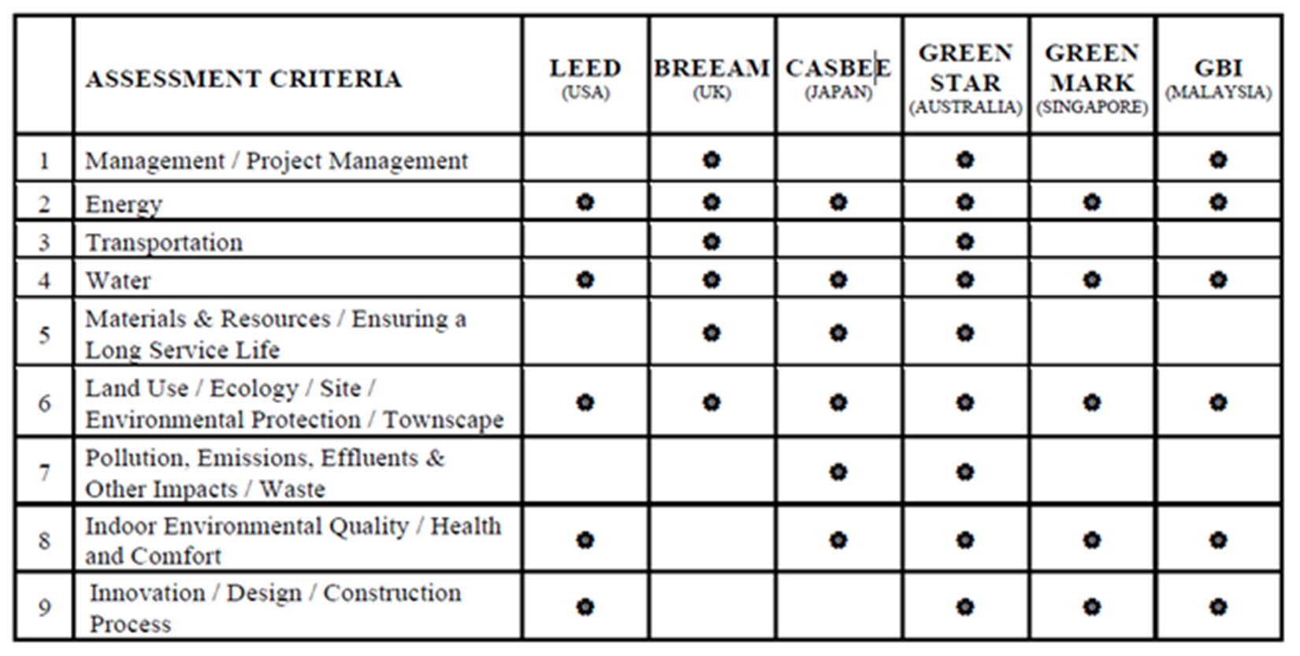
Green Building Certification System cont’d

Slide 17
Green Building Economic Evaluation Techniques
Following incorporation of GB components like energy-efficient appliances, equipment, and lighting caused the construction costs to increase by 10.77% compared to traditional buildings (Sun et al., 2019).
Energy used in buildings accounts for nearly 50% of Carbon Dioxide emissions in the UK (John and Jones, 2019).
It is indicative that energy system in building is the most contentious in terms of GB design and implementation.
Hence, means of sustainable energy provision has to be subjected to economic evaluation.
Renewable energy systems (RES) has been identified as the most sustainable means of energy provision in all ramifications.
However, RES have been tagged exorbitant in terms of initial cost but with no/less running cost.

Slide 18
Green Building Economic Evaluation Techniques cont’d
According to Short et al., (2005) there are many available techniques for economic evaluation and investment appraisal of energy systems, including net present value (NPV), levelised cost of energy (LCOE), whole life costing (WLC)), revenue requirements (RR), internal rate of return (IRR) etc.
However, the most widely utilized techniques for economic evaluation in the energy sector, particularly for decentralised/self-contained supply systems are LCOE, LCC (WLC- annualized and present value), NPV.
Thus, WLC is suitable for both selections between mutually exclusive options and in ranking among the same set of investment alternatives.
It also has a value in determining the exact maintenance and operating costs of an asset before procurement occurs.
However, the WLC approach has been criticised for not taking into account returns and benefits of investment (Short et al. 2005), but this problem can be resolved by taking the total expenditure throughout the lifespan of an asset into consideration.

Slide 19
Whole-life Costing
Given lack of statistics or reports indicating GB are cheaper than traditional buildings at the initial cost stage development, the best strategy to evaluate GB cost estimating is through whole-life costing (WLC).
WLC is defined as the sum of all expenditure related to a physical asset from the commencement stage through the operation to the end of the asset’s life (Woodward 1997)
Woodward & Demirag (1989) “optimise the cost of acquiring, owning and operating physical assets over their useful lives by attempting to identify and quantify all the significant costs involved in that life, using the present value technique”.
WLC aims to assess various alternatives with a view to ensuring the adoption of the optimum asset configuration.
Also, during the life phases of the assets, it allows trade-offs between cost elements to be studied so as to ensure optimum selection and enable the total cost to be realised (Woodward & Demirag 1989).

Slide 20
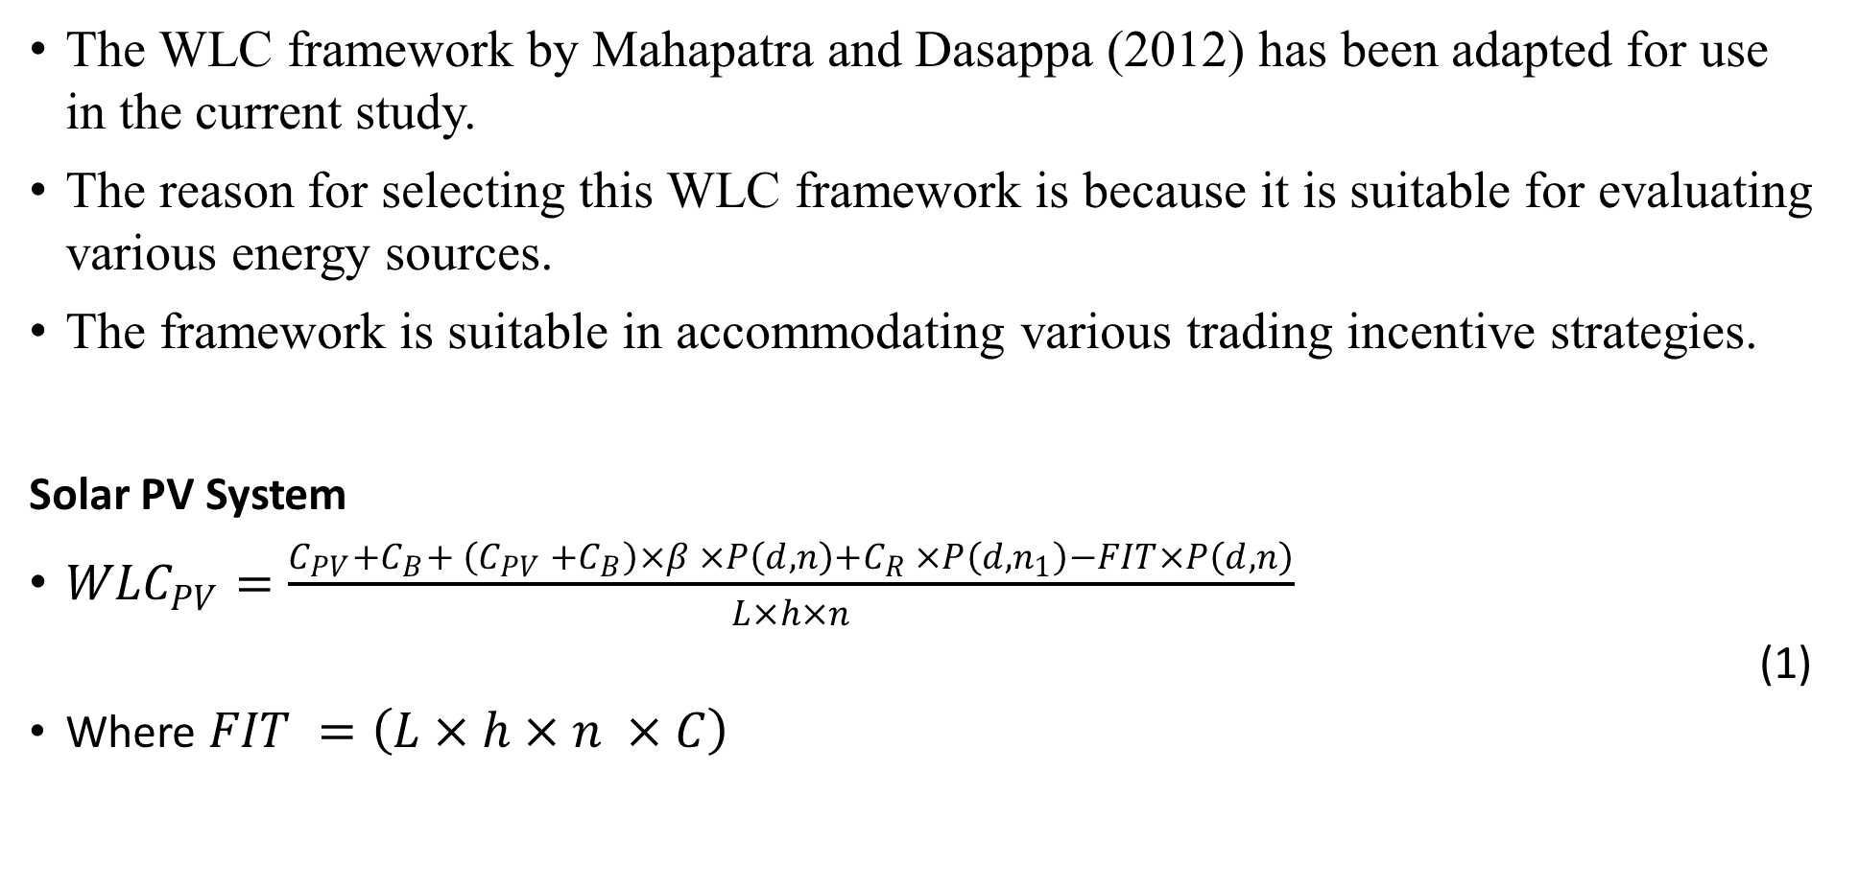
WLC and RETs Evaluation
The WLC framework by Mahapatra and Dasappa (2012) has been adapted for use in the current study.
The reason for selecting this WLC framework is because it is suitable for evaluating various energy sources.
The framework is suitable in accommodating various trading incentive strategies.
Solar PV System
${WLC}_{PV}=\frac{C_{PV}+C_{B}+ \left(C_{PV }+C_{B}\right)×β ×P\left(d, n\right)+C_{R }×P\left(d, n_{1}\right)−FIT×P\left(d,n\right)}{L×h×n}$
(1)
Where $FIT =\left(L×h×n ×C\right)$

Slide 21


WLC and RETs Evaluation
Gridline Extension System
${WLC}_{GE}=\frac{{WLC}_{gen}+ {WLC}_{grid ×} X}{L ×h ×n}$ (2)
Where
${WLC}_{gen}={ t}_{gen }×L ×h × \left(\frac{1}{1−δ_{t\&d}}\right)$ (3)
(4)
(5)

Slide 22
WLC and RETs Evaluation Cont’d
SOLAR PV SYSTEM | GRID EXTENSION SYSTEM
C_{PV} = capital cost of the photovoltic C_{B} = capital cost of Battery β = fraction of capital cost for annual operation and maintenance of system C_{R =} component replacement cost P = present worth factor d = discount rate n = life of the project n₁ = life of each component FIT = feed-in-tariff benefit h = annual operation hours L = load (kW) | X = distance of the village to existing grid point L = Load demand h = annual operation hours d = discount rate n = life of the project t_{gen =} electricity generation cost δ_{t&d =} transmission and distribution losses C_{grid} = grid line cost C_{t} = distribution transformer cost S_{C =} gasifier rating (kg) β = fraction of capital cost (for operation and maintenance of the grid)

Slide 23
CONCLUSION
GB construction is becoming more important as we reduce the Planets’s resources and seek to lessen our impact on the earth s environment.
Given the raising global population vis-a-vis demand for accommodation buildings, meeting up with this demand should be through GBs system, otherwise GHG emission will increase.
Recent impact of global warming such as flooding, wild bush burning, adoption of GBs construction will mitigate occurrence of these perils.
More opportunities for construction practitioners particularly Quantity Surveyors in term of GB certification and more knowledge in terms of new materials utilisation among others

Slide 24
THANK YOU
FOR
LISTENING

