Slide 1
Evolving Issues in Information and Communication Technology in Development of Reliable Project Estimates
Dr. Ayodeji Oke MAQS, MNIQS, RQS
Department of Quantity Surveying
Federal University of Technology Akure
NIQS Workshop, Magodo, Lagos state.
3rd – 4th August 2021

Slide 2
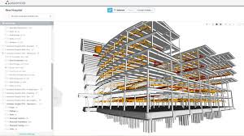


Slide 3
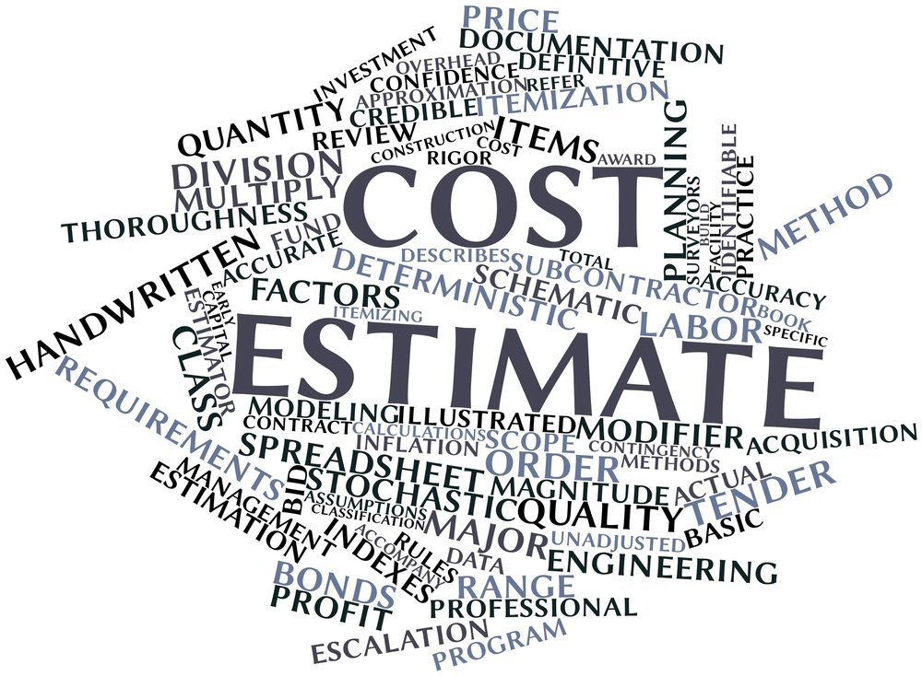
Outline
Introduction
Reliable estimate
ICT explained
Evolving ICTs
Industry 1.0 to 4.0
History of estimating
Digital estimating
Recommendations

Slide 4
Introduction
What is an estimate?
An approximate calculation or judgement of the value, number, quantity and extent of something.
A construction estimate is a document that lays out, in detail, all of the costs involved in a construction project.
A good construction cost estimate will provide an idea of the cost of the project for concerned stakeholders.

Slide 5
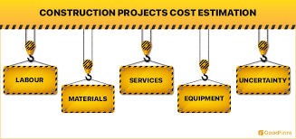
What makes project estimates reliable?

Slide 6
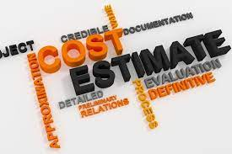
What makes project estimates reliable?
Fundamental basis
Well researched
Best value
Trustworthy
Precision (not necessarily accurate)
Detailed
Credible

Slide 7
ICT
What is ICT?
ICT is an extensional term for IT that stresses the role of unified communications and the integration of telecommunications (telephone lines and wireless signals) and computers, as well as necessary enterprise software, middleware, storage and audiovisual, that enable users to access, store, transmit, understand and manipulate information ICT (Wikipedia 2021)
ICT is a broad subject and the concepts are evolving.

Slide 8
Evolving ICT Issues
ICT, Digitalization and 4IR
ICT is the infrastructure and components that enable modern computing
Digitalisation is one of the evolving concepts
This is related to Fourth Industrial Revolution

Slide 9
Industrial Revolutions
From industry 1.0 to 4.0
Early age (Stone, Bronze, etc.)
1st industrial revolution
2nd Industrial revolution
3rd Industrial revolution
4th Industrial revolution
Notes:
History lane

Slide 10
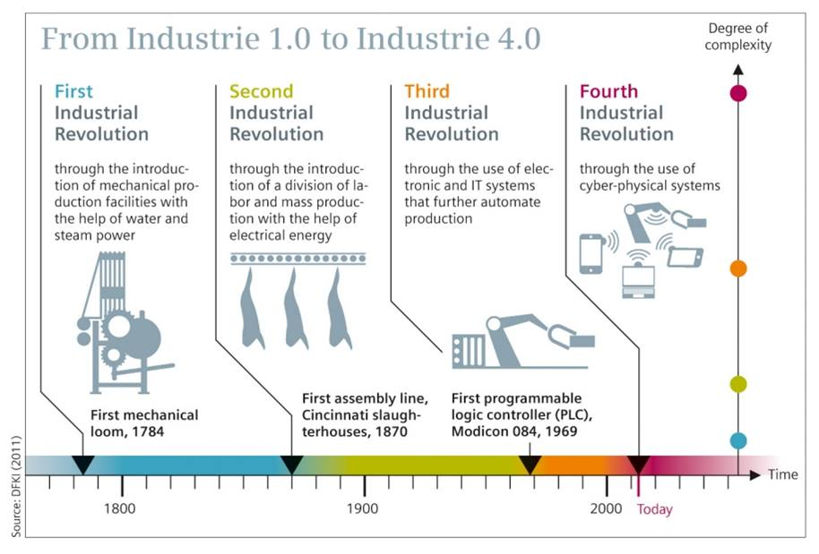
From industry 1.0 to 4.0
Notes:
History lane

Slide 11
History of Estimating
Stone age
Estimating Methods Characteristics:
  Simple calculation
  Use of abacus
  Mostly individual based
  Handwritten
  Same material for multiple use
  More than enough materials or otherwise

Slide 12
Estimating History
1st industrial revolution
  1700s and mid 1800s
  The mechanized or agricultural revolution
  Water and steam power engine
Estimating Methods Characteristics:
  Use of simple calculating tools
  Wage estimation
  Exchange of goods and/or services
  Others from stone age

Slide 13
Estimating History
2nd Industrial revolution
  Early 1900s
  Electrical era
  Mass production revolution
Estimating Methods Characteristics:
  Exchange of data through electrical means
  Use of simple calculators
  Permutation and combination
  Simple regression
  Others from stone age to 1st

Slide 14
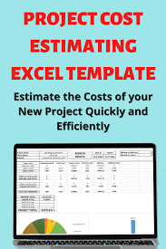
Estimating History
3rd Industrial revolution
  Late 1960s
  Computer age
  The internet or jet age revolution
  IT and electronics for industrial production
  Beginning of digital age
Estimating Methods Characteristics:
  Use of scientific calculators
  Use of computer
  Use of Ms-Excel (launched in 1985)
  Multiple and logistic regression
  Other from stone age to 2nd
Notes:
The world a global village

Slide 15
Estimating History
4th Industrial revolution
  Late 2000s
  The digital revolution
  Characterized by Automation, AI, AR, IoT, Machine learning, Robotics, VR, MR, Digita twin, Smart wearables, etc.
Estimating Methods Characteristics:
  Simulation, coding and computer modelling
  Software, program and Apps
  High level of sophistication
  Others from early age to 3rd revolution

Slide 16
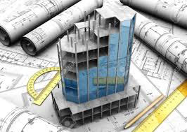
Estimating 4.0
Why Estimating 4.0?
Changing needs, project nature, complex projects, etc.
Saudi Arabian former oil minister, Sheikh Zaki Yemani, in the 1980s said “the Stone Age did not simply disappear for lack of stones, something more efficient and effective was discovered to replace them”
Estimating process need to be digitalised
Notes:
History lane

Slide 17
Required principles
Interconnection (of machines, devices, sensors, and people)
Information transparency
Technical assistance to human
Decentralized decisions (cyber physical systems make decisions and perform their tasks as autonomously as possible)
Notes:
History lane

Slide 18
Construction Estimating Software
STACK (offers both estimating and take-off capabilities)
Clear Estimates
Sage Estimating (Best for Large Enterprises)
Sigma Estimates (Best for Windows)
simPRO Estimating Software (for trade service, maintenance)
ConEst Estimating Software (Good for Electrical works)
Buildertrend Estimating Software (Estimating & Bidding Software)
SmartBid Software (Bid Management Software for Contractors)
Candy (a cloud-based on-screen take-off and estimating tool )
ProEst
Notes:
History lane

Slide 19
Construction Estimating Software
Assemble (Assemble Insight is a cloud-based construction and model data management software solution.)
QuickBooks Desktop Enterprise
Procore (Procore manages your projects, resources and financials from project planning to closeout.)
HeavyBid (HCSS HeavyBid estimating and bidding software is built specifically for the construction industry. Used by more than 50,000 estimators)
PlanSwift (PlanSwift is a popular Take-off & Estimating software! It is designed for Commercial, Industrial, Institutional, Residential and all forms of Contractors.)
Others
Notes:
History lane

Slide 20
ProEst Estimating Software
It takes advantage of spreadsheets and tables, it is by no means “excel-based” as many estimating products tend to be. The software is fully cloud-based, so it works with any laptop, tablet, or desktop computer but with internet connection
Notes:
History lane

Slide 21
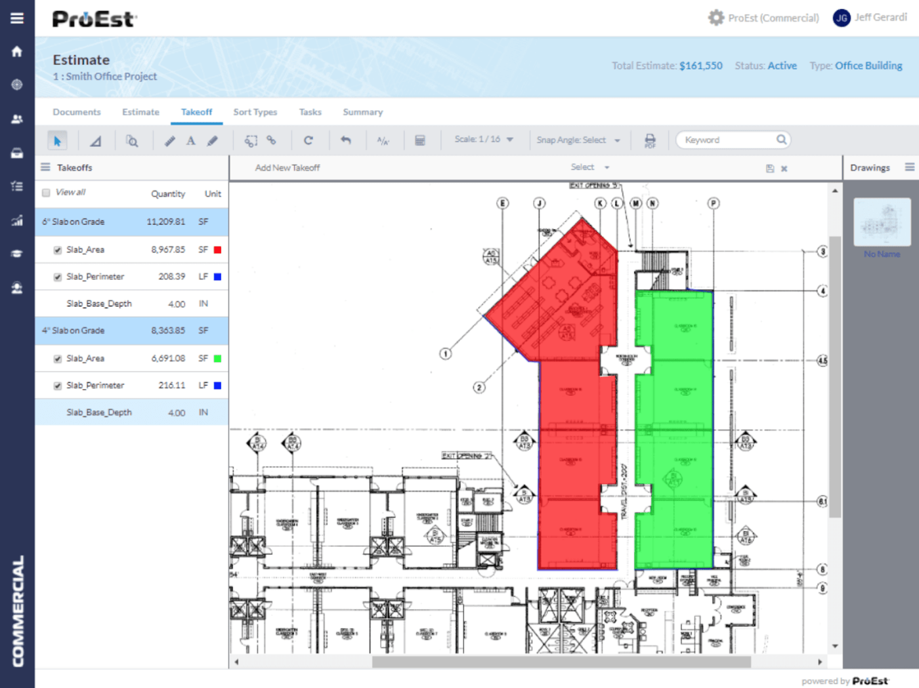
ProEst Estimating Software
Notes:
History lane

Slide 22
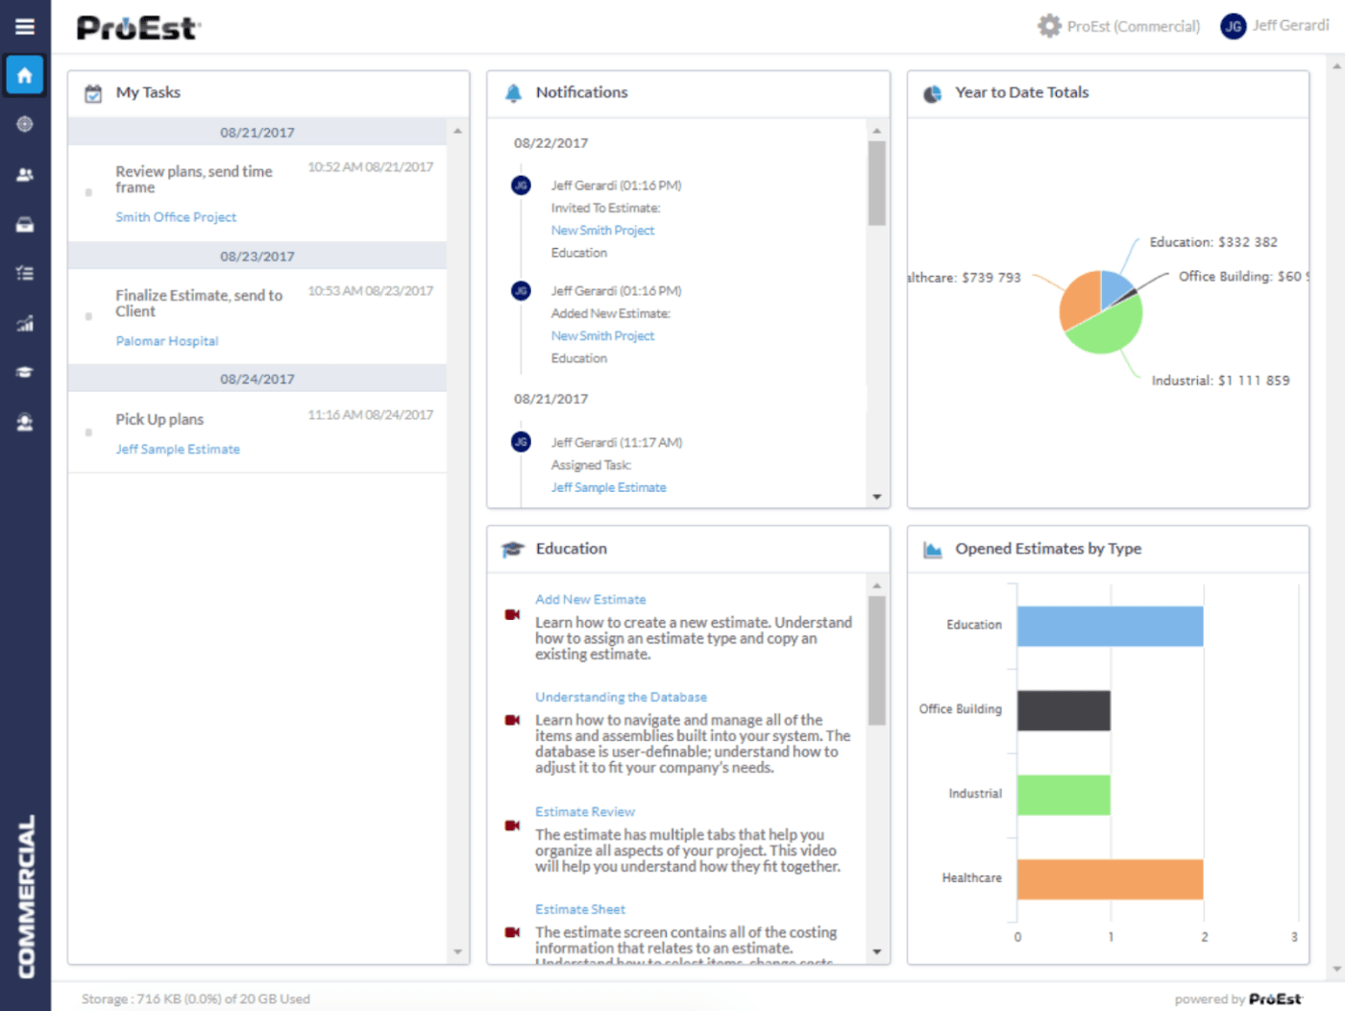
ProEst Estimating Software
Notes:
History lane

Slide 23
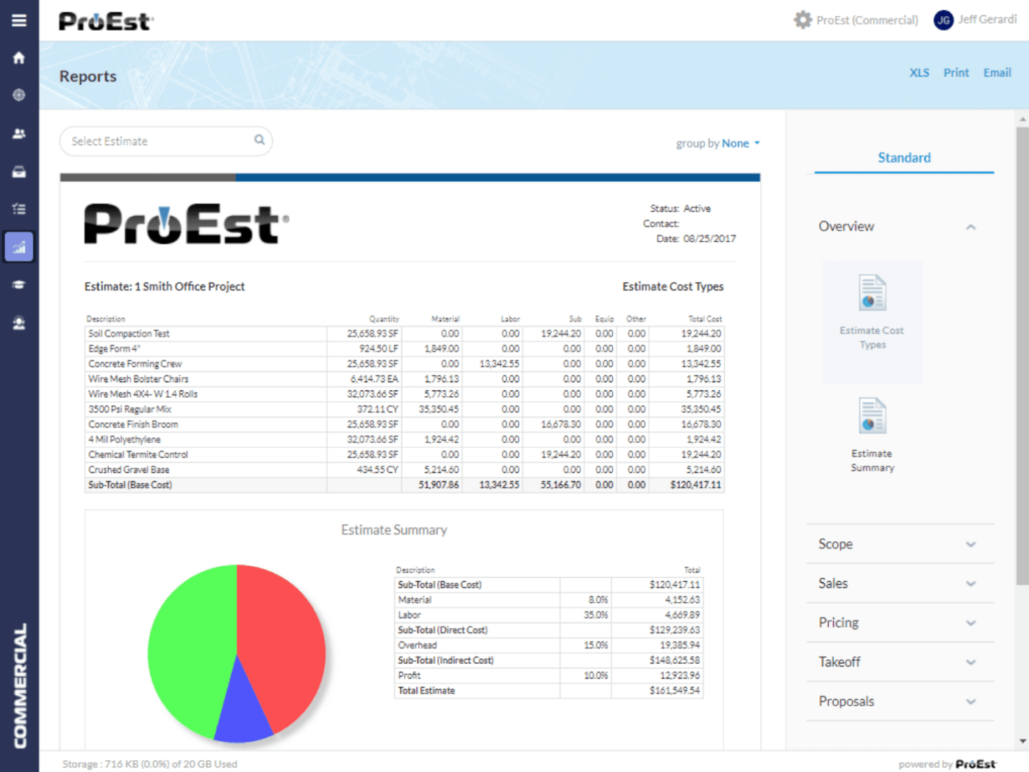
ProEst Estimating Software
Notes:
History lane

Slide 24
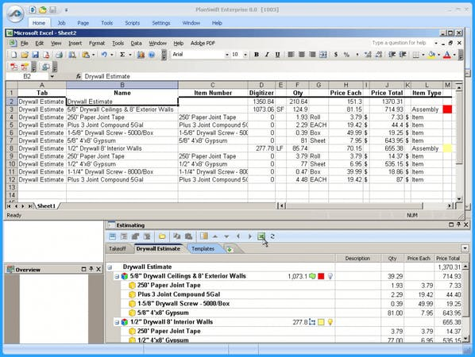
PlanSwift Software
Notes:
History lane

Slide 25
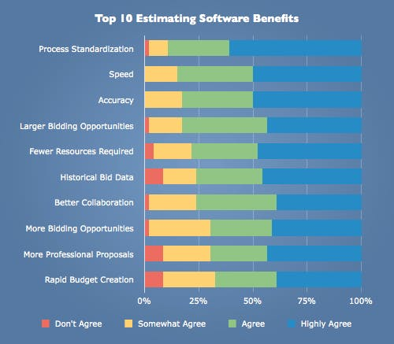
The Benefits

Slide 26
Digital Estimating
The Barriers
Lack or low level of knowledge
Resistant to change
Wrong perception about new innovations
Cost implications
Lack of technical know how
Availability of valid data
Data security
Others

Slide 27
The Challenge for us
Recommendations
RSMeans Data Online Software
  A cloud-based access to a comprehensive database of construction costs in North America.
  The application details costs for materials, equipment, labour and productivity at the unit, assembly and square foot level.
  Costs are grouped by project type, allowing users to select the dataset that best fits their needs
  It offers quick cost lookup, Excel export and reference.
Can we have same in Nigeria?

Slide 28

Recommendations
Training and workshop at various levels
Additional study, learning and practice
Software purchase and usage
Implementation at various levels
Keeping track with international practices

Slide 29


Thank you for Listening!

