Slide 1

TECHNICAL ISSUES & RISK MANAGEMENT IN ESTIMATING FOR CONSTRUCTION PROJECTS
QS Dr Aminu M. Bashir
PhD (QS), MSc (PM), BSc (Q/S), FNIQS, MAPM, ACIArb, RQS
2021 NIQS INDUCTION WORKSHOP,
LAGOS.
3rd August, 2021
Presented by

Slide 2

PRESENTATION OUTLINE
Nature of Construction Projects
Concept of Estimating: Definition & Purpose
Role of Estimating in the Project Life Cycle
Types of Estimates & their Functions
Technical Issues in the Preparation of Estimates
Conceptual Estimates, Preliminary Estimates, Detailed Estimates & Bid Estimates
Risks and Construction Projects
Risks at various Estimating Stages
The Risk Management Process
Conclusion

Slide 3
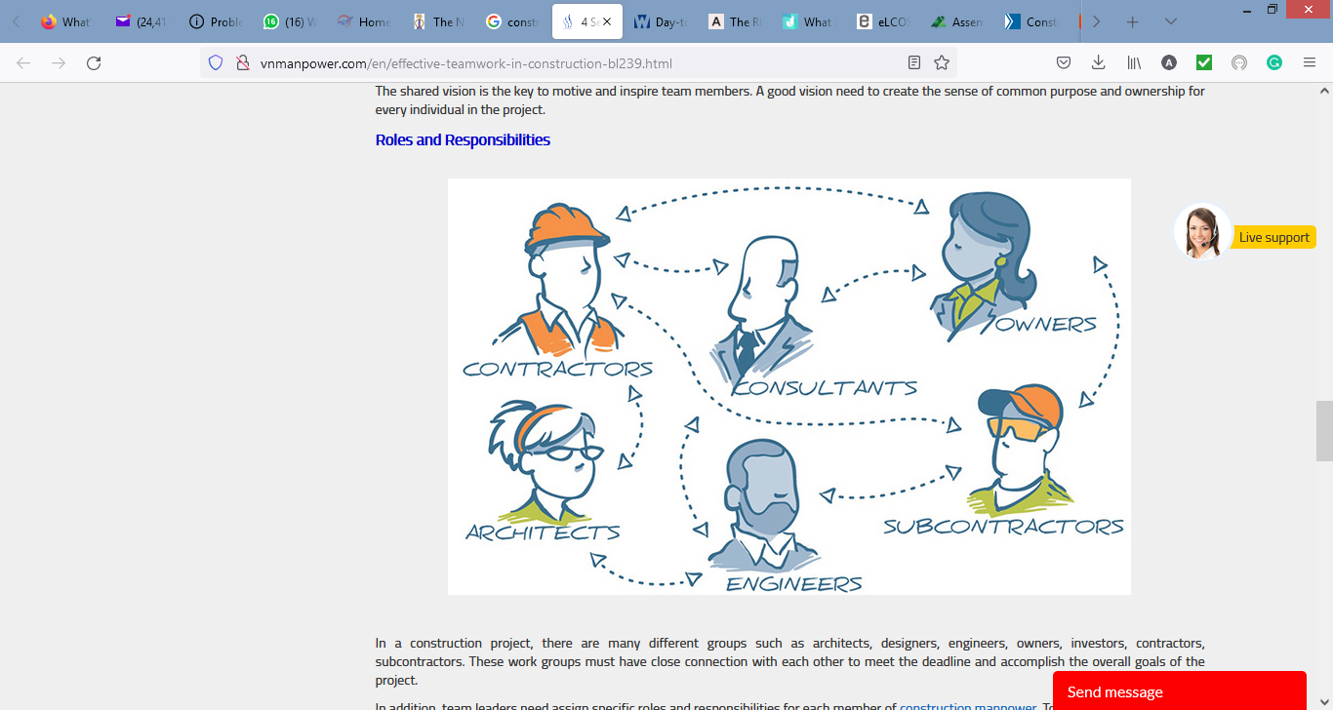
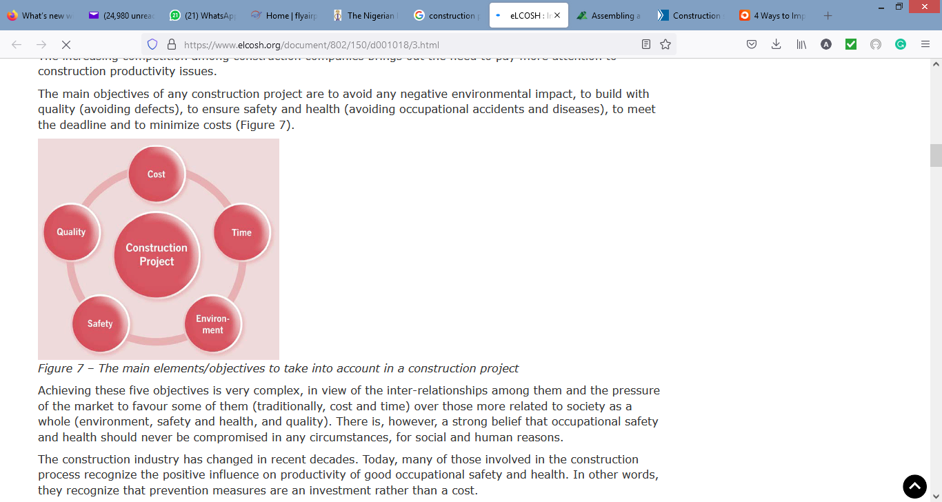
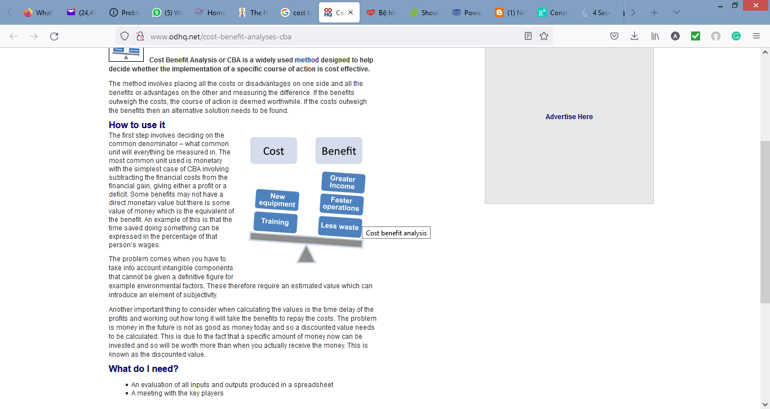
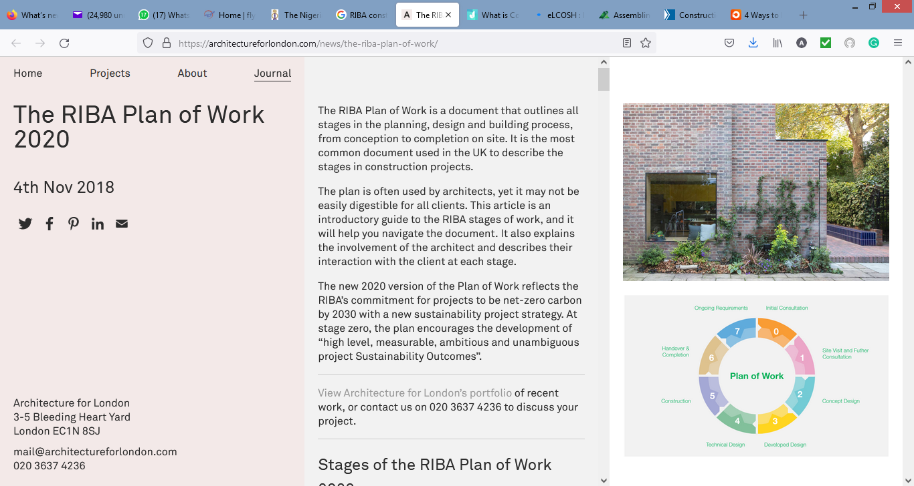
NATURE OF CONSTRUCTION PROJECTS

Slide 4
CONCEPT OF ESTIMATING
Definition of Estimating
  An assessment of the probable cost of a future activity (Pratt, 2019)
  The process of predicting the cost of building a physical structure (Brook, 2004)
Purpose of Estimating
  To prepare budgets for future expenditures
  To establish probable cost of project for financial feasibility
  To enable the contractor secure profitable work by the competitive bidding process
  To maximize the accuracy of the estimating process by including procedures for checking and verifying the precision of the work
  To maximize the productivity of the estimating department in terms of generating the highest volume of estimating product with the resources available

Slide 5
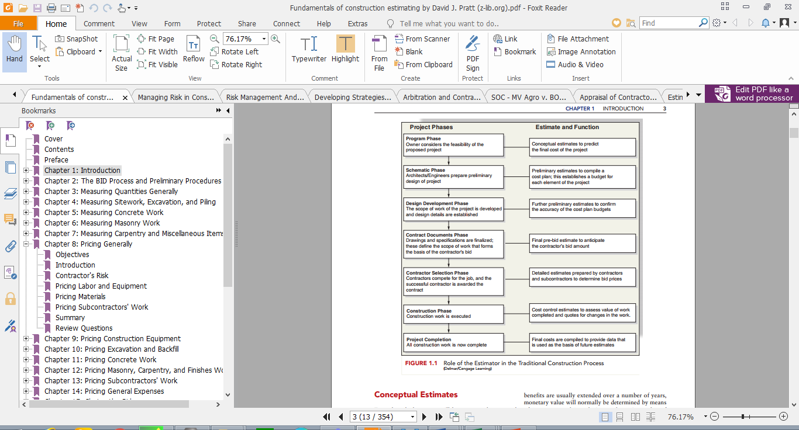

ROLE OF ESTIMATING IN THE PROJECT LIFE CYCLE

Slide 6
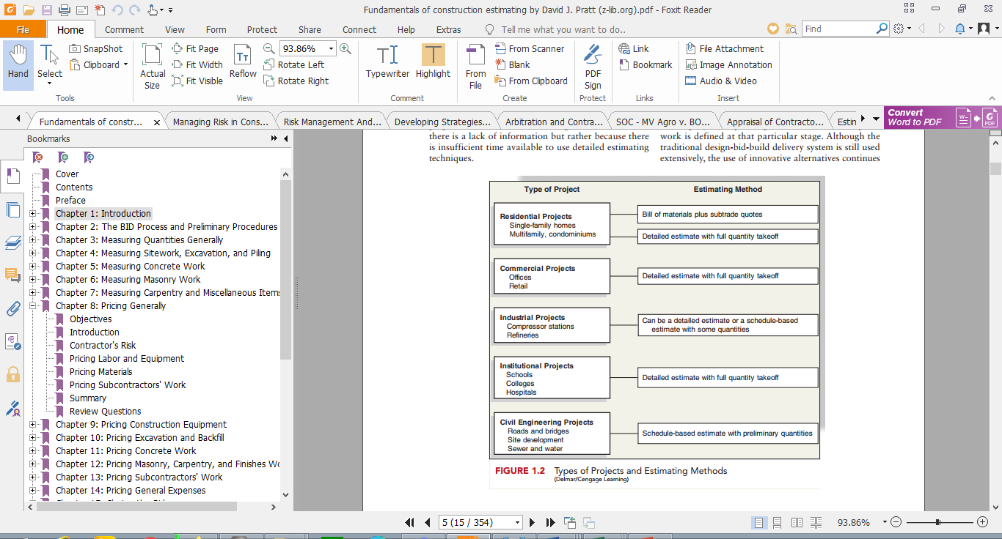

TYPES OF ESTIMATES AND THEIR FUNCTIONS

Slide 7

TECHNICAL ISSUES IN THE PREPARATION OF ESTIMATES
Conceptual Estimates (Inception/Programme Phase)
  Detailed cost-benefit analysis of the proposed scheme
  Appropriate capture of the cost constituents i.e. land, finance, construction, legal & professional fees, admin/agency, maintenance, operating and marketing costs, etc.
  Accuracy of estimate determines continuity and basis of design/consultancy fees
Preliminary Estimates (Scheme Design)
  schematic designs depicting the general scope, shape and layout of the project
  Elemental & comparative cost planning of alternative proposals
  Value analysis of components, cost checks and reconciliations
  Periodic affirmation of the cost limit/budget for the project.
  Expectation of financial rewards in terms of more revenue and cost benefits

Slide 8
TECHNICAL ISSUES IN THE PREPARATION OF ESTIMATES (Contd.)
Detailed Estimates (Detailed Design Phase)
  Most accurate forecast of construction cost
  Require detailed designs and specifications
  6 steps process of take-offs, billing, pricing, subcontractors quotes, overhead expenses, mark up
The Bid Estimates (Tender Stage)
  Sourcing information on projects out for bid (Newspapers, Tender Journals, “Solicitation Notices”, Websites)
  Open and Closed Bidding Processes
  Marketing strategies: developing an information gathering system & establishing a network of business contacts, promoting organisational competencies.
  Bidding during recession & boom.

Slide 9
TECHNICAL ISSUES IN THE PREPARATION OF ESTIMATES (Contd.)
The Bid Estimates (Tender Stage)
  Factors to consider in the Bid Decision:
    Type of project,
    Size and estimate of the project
    Location of the project
    Quality of drawings & specifications
    Reputation of designers & owners
    Specialized work
    Anticipated construction problems
    Safety considerations
    Need for the work and bonding capacity
  Obtaining Bid Documents: either electronically or hard copies.
  Need to check for completeness of documents as soon as they are received.

Slide 10
TECHNICAL ISSUES IN THE PREPARATION OF ESTIMATES (Contd.)
The Bid Estimates (Tender Stage)
  Review of Bid Documents: starts with instructions to bidders,
  then specifications and drawings for anything unusual such as specialised scaffolding.
  General contractors’ items and clauses dealing with payments, variations equally need to be checked.
  Other Considerations/Issues:
  The Query List
  Team Approach
  Site Visit
  Bid security
  Bid conditions might be necessary or considered depending on complexity and project circumstances.

Slide 11
TECHNICAL ISSUES IN THE PREPARATION OF ESTIMATES (Contd.)
The Bid Estimates (Tender Stage)
  The Pre-Bid Review Meeting:
  To ensure no obvious omissions from the bid,
  To consider the competitiveness of the bid price and
  To consider an appropriate fee for the project.
  The Contractor’s Risks: emanates from the following,
  Nature of the contract: lump sum or cost plus contracts.
  Cost plus transfers risks to the client while lump sum places risks on the contractor.
  Other risk items in lump sum that could lead to extra costs are – inaccurate quantity take-offs, lower productivity than anticipated, failure of subcontractors/suppliers to meet obligations.

Slide 12
TECHNICAL ISSUES IN THE PREPARATION OF ESTIMATES (Contd.)
The Bid Estimates (Tender Stage)
  The Contractor’s Risks (Contd.):
  Pricing labour and Equipment: hourly wage rate of labour/equipment and the anticipated productivity could fall short of expectation and cause losses on a project.
  Factors such as weather conditions, site storage space, access to and around the site, type and quality of tools and equipment, motivation and morale of workers, quality of job labour, etc. greatly affect reliability of estimates.

Slide 13

RISKS ISSUES IN THE PREPARATION OF ESTIMATES
  Inception/Programme phase: First fundamental risk –
  Unclear, unagreed and uncommunicated project objectives.
  Risks associated with cost-benefit analysis for the decision to proceed with the project at this stage are:
    Economic (inflation, currency fluctuation, shortages in material/labour/plant availability)
    Political (changes in laws or Governments, approval delays, etc.)
    Environmental (unforeseen site conditions, inclement weather).

Slide 14

RISKS ISSUES IN THE PREPARATION OF ESTIMATES
  Preliminary Estimates phase: In addition to the above,
  Design risk (defective design, changes/deficiency or late issue of design),
  Project level risk (improper quality control and project management, appropriateness of cost planning and value management techniques).

Slide 15

RISKS ISSUES IN THE PREPARATION OF ESTIMATES
  Detailed Estimates Phase: some of the above mentioned risks categories will still be prevalent at this stage for the Client and Design Team members to deal with.
  These include economic, design, political and project level risks.

Slide 16

RISKS ISSUES IN THE PREPARATION OF ESTIMATES
  The Bid Estimates Phase: Risks items at this stage encompass design, economic, political, environmental, social, project and contractual.
  Several risk factors under the above broad headings MUST be identified, analysed and an appropriate risk response strategy put in place (contained in the Bid Estimate) should they eventuate during the implementation phase of the project.

Slide 17
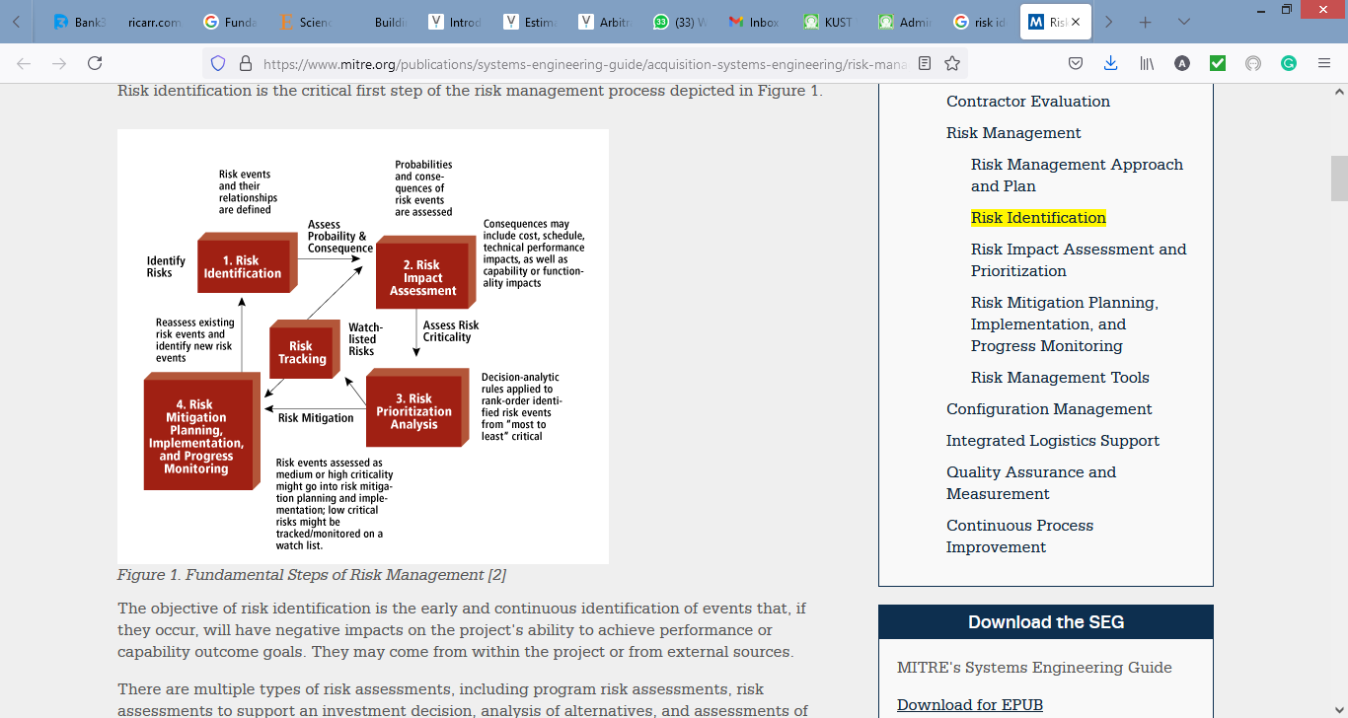
RISK MANAGEMENT STRATEGY IN THE PREPARATION OF ESTIMATES

Slide 18
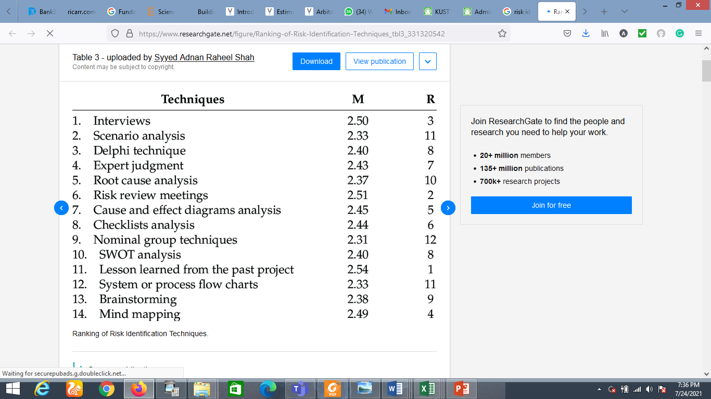
RISK MANAGEMENT STRATEGY IN THE PREPARATION OF ESTIMATES
Risk identification techniques are as follows,

Slide 19
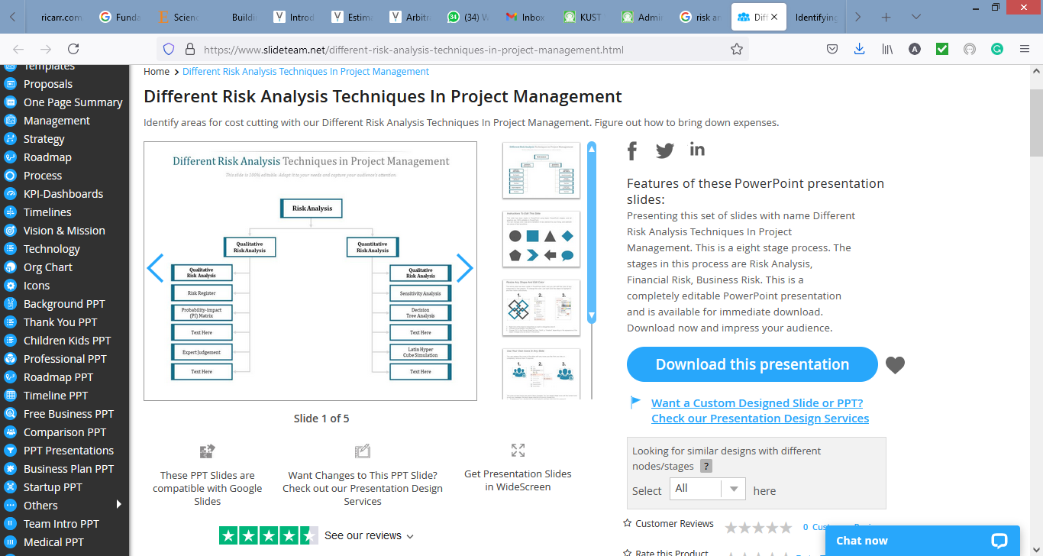
RISK MANAGEMENT STRATEGY IN THE PREPARATION OF ESTIMATES

Slide 20
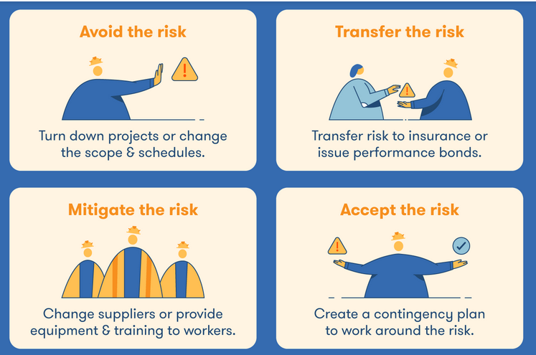

RISK MANAGEMENT STRATEGY IN THE PREPARATION OF ESTIMATES
Response techniques for identified risks are,

Slide 21
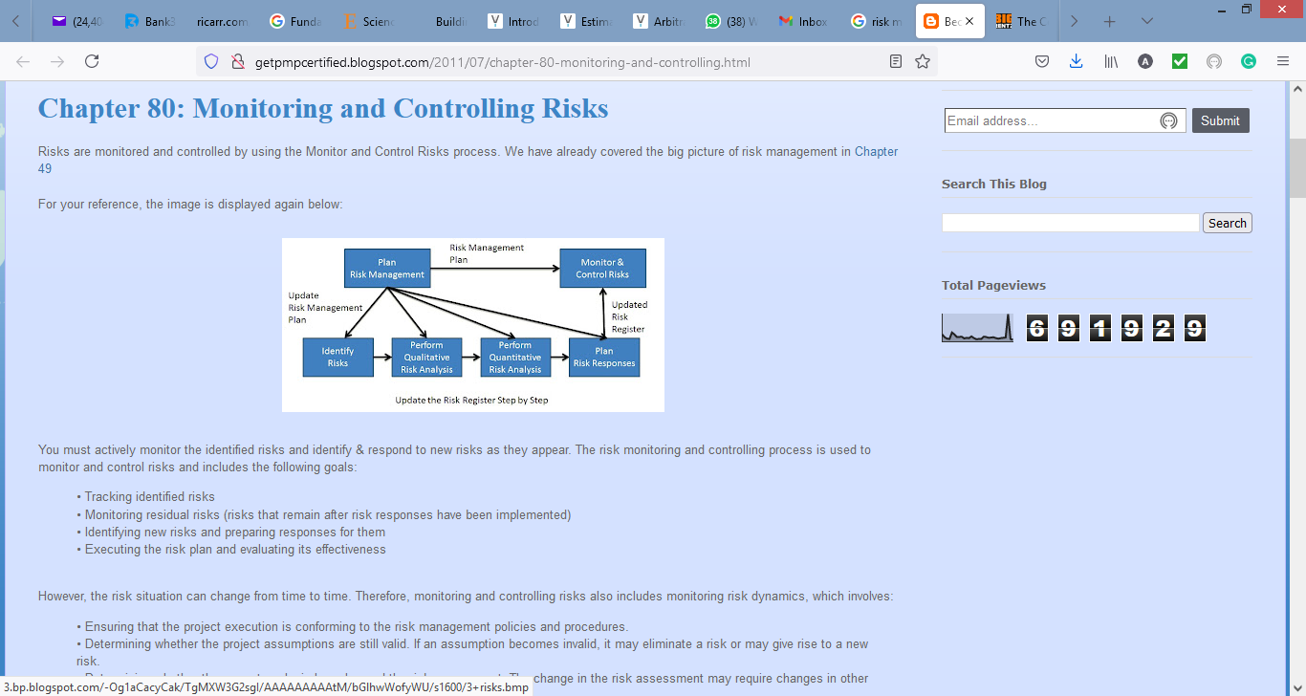

RISK MANAGEMENT STRATEGY IN THE PREPARATION OF ESTIMATES
Risk monitoring and control is the ultimate strategy in the RM process,

Slide 22

CONCLUSION
The reliability of estimates and overall project success for CLIENTS lies in the TECHNICAL ISSUES considered in the preparation of conceptual, preliminary and detailed ESTIMATES at the various phases of the project life cycle
The ability of Contractors’ to secure projects, earn profit and grow greatly depends on the quality and accuracy of their BID ETIMATES
The inevitability of RISKS in any construction project makes its management not only desirable but imperative and necessary on all TECHNICAL ISSUES identified across the multiple stages of the ESTIMATING PROCESS
Be mindful of the TECHNICAL ISSUES and MANAGE the RISKS.

Slide 23


THANK YOU FOR LISTENING.

