Slide 1

THE NIGERIAN INSTITUTE OF QUANTITY SURVEYORS
2-DAY NATIONAL SEMINAL (Train the Trainers) ON IMPORTANCE
OF RESOURCES SCHEDULE FOR INCLUSIVE DEVELOPMENT OF THE CONSTRUCTION INDUSTRY
HELD AT
No. 24, NIQS CRESCENT, OFF MICHAEL AMA NNACI CADASTRAL ZONE B6,
MABUSHI DISTRICT, ABUJA
ON
MONDAY 29TH & TUESDAY 30TH MARCH, 2021
PAPER
RESOURCE SCHEDULE - A TOOL FOR EFFECTIVE MANAGEMENT OF CIVIL ENGINEERING PROJECTS
Presented by:
QS Aderemi Muraina FNIQS, MRICS, RQS
Principal Partner, Amaquants Associates
Abuja
March, 2021

Slide 2
OUTLINE OF PRESENTATION
Abstract
Introduction
Benefits of Resource Scheduling
Steps of Project Resource Scheduling
Resource Scheduling of a Typical Civil Engineering Project (Highway)
* Project Description
*Scope of Works
*Plant and Enquipment Classifications
*Plant and Equipment Requirement and Avalability
*Equipment Allocation to Work Groups
*Standard Productivity of Machinery
*Equipment Hiring Rates (Third Party Contract)
*Labour - Output Constants of Highway
*Material Schedule Constants
*Project Schedule of Work groups
*Cost Estimation Method.
*Conclusion
*References

Slide 3
ABSTRACT
Virtually all projects have limited capacity or resources. Therefore, the success of a project is
tied to how well the resources are managed and how well the project is scheduled.
Unless matching resources are planned and procured, no activity can be be executed according to
prefixed time schedule.
In early years CPM/PERT and Gantt charts methods were used for project management.
However now a days Project Management softwares have been adopted. MS Project and
Primavera Project Planners are the most popular software packages used for construction
projects.
Project Management techniques can be used to resolve resource conflicts and also useful in
minimising the project duration within limited availability of resources to make the project
profitable.
keywords: Project Managment, Resource Scheduling, Resource levelling, Project Management
Softwwares.

Slide 4
INTRODUCTION
Project is a onetime activity with defined objectives which has to be finished in a certain period of time using limited number of resources. The project management comprises the computation of the early and the late start schedule, slack times of the activities and the allocation of the available resources over time to the execution of the activities.
Resource scheduling is the futuristic planning of activities that is limited by the available resources. Resource scheduling includes resource allocation to various activities and resource leveling. Resource leveling is a technique which is used to analyze unbalanced use of resources (usually people or equipment) over time, and resolves over-allocations or conflicts among different resources.

Slide 5
BENEFITS OF RESOURCE SCHEDULING
  A key part of project management is properly managing resources to complete tasks
  efficiently, on schedule and budget . However, scheduling resources - which include
  people, materials, equipment, or facilities - is often a complex task.
  it involves allocating and scheduling resources based on resource capacity, availablility,
  effort, as well as project scope. Organizations run into trouble by either over-allocating resources or under-allocating them, which can impact profitability, client satisfaction, employee trust, or relationships with third-party vendors.
  Effective resource scheduling helps solve problems associated with resource availability and
  work capacity in various ways. Here are the key benefits of implementing resource scheduling in Construction Projects Operations.

Slide 6
1. BETTER ORGANIZATION
Projects often include various teams, departments, locations, vendors, and resource types.
Resource scheduling helps you organize all aspects to effectively plan and complete the project.
DEFINE THE PROJECT
The first step is to define the scope of the project. List all the tasks needed to complete the project,
and every job involved with completing each task.
DETERMINE THE TIME
Next, you need to estimate the time duration and effort for each task of the project. This may
include the number of hours, days, or weeks a task will take, the amount of manpower needed for
each task, or the percentage of usage required.
IDENTIFY CONSTRAINTS
Each task will have constraints, so it's important to plan for them. Examine each task for any specific
restrictions. It could be a deadline, specific skills required, time of day work needs to be done,
weather restraints, or other dependencies.

Slide 7
  2. SMART TASK DISTRIBUTION
Once you know all the tasks and jobs involved with the project, you have to distribute those tasks
among your various resources. But distributing tasks evenly isn't always the best solution. You need
to distribute tasks smartly, which resource scheduling tools can help you do.
RESOURCE ALLOCATION
The first step in smart task distribution is identifying the resources needed to complete every task of the
project. This includes looking at your consumable and reusable resources and determining the quantity
required or the total effort needed for the tasks.
DETERMINE AVAILABILITY
Next, check the availability of the resources required. This includes looking at the equipment needed for
each task and whether that equipment is being used or will be needed for other projects.

Slide 8
As for workers, you'll need to track their availability as well. A scheduling platform makes this task more
efficient because it enables you to determine when more workers is needed, respond to time-off requests
accurately, and find replacements quickly without disrupting output or delaying tasks.
MATCH CAPABILITY WITH TASKS
You not only match resources with tasks based on availability, but also capability. Consider the strengths
and weaknesses of workers. While one worker may be available for a task, another person may have the
skill to do the task faster, so you may need to schedule the task around his/her availability to meet deadlines.
A good way to manage this is having a resource capability database, which records the specific skills and
abilities of each worker. It will help you schedule your human resources faster and easier.

Slide 9
When you're under time constraints, such as when a project has a definite deadline, resource delays
smoothing some work and removes flexibility, but it is usually more efficient and cost-effective.
Resource leveling is used when you have restraints on resource availability. In this method, start and
finish dates are adjusted based on resource constraints.
In most situations, you'll use a combination of smoothing and leveling to complete the project.

Slide 10
4. REAL-TIME DATA AND ANALYSIS
    Monitoring resource consumption in a project is critical to timely delivery and cost efficiency. Using technology to monitor your project in real-time provides key data and analysis.
    TRACK PROJECTS
    Since resources and employees assigned to a project may be in different locations or on different teams, it's important to have a centralized system that provides full visibility into how resources are being used.
    Software solutions provide these insights to help you see how the project is progressing in real-time with daily reports.
    BE READY TO RE-ALLOCATE
    No matter how well you initially allocated your resources, projects change along the way. With proper real-time analysis, you can see if you have over-allocated or under-allocated your resources.
    Realizing these issues immediately allows you to make necessary adjustments without sacrificing delays in the project or increasing labor cost by paying overtime because workers are taking on more tasks than necessary.
    ANTICIPATE DELAYS
    Sometimes delays are necessary for various reasons. Data analysis can help you predict them in advance and adjust deadlines well ahead of time instead of at the last minute. Last-minute deadline adjustments can leave you scrambling to re-allocate resources and can cause even longer project.

Slide 11
5. PLAN IN ADVANCE
Resource scheduling helps you plan ahead for future projects by anticipating future capacity
and demand. Here are some ways it helps you prepare.
MONITOR DEMAND
Proper scheduling allows you to evaluate which resources are in high demand. You can
schedule your projects well ahead of time and delay future tasks based on constraints you
anticipate.
UNDERSTAND TRENDS
Resource scheduling also involves evaluating trends. You take into account seasonal highs and
lows and adjust your scheduling to anticipate bottlenecks and low activity periods.

Slide 12
6. IMPROVE EMPLOYEE TRUST
Resource planning also improves employee trust. When you have an accurate system, it
doesn't put any undue burdens or demands on employees. They trust the schedule because it
gives them proper insight into busy times so they can plan days off well in advance. This
improves the work environment and employee accountability.
Resource scheduling is essential to project management. Without proper resource scheduling,
projects don't meet deadlines, go over budget, and put added strain on employees and resources.
The process can be complex, but a resource scheduling helps to identify resource availability and capacity,
properly allocate resources, make better estimates, and analyze data for better decision-making.

Slide 13
Steps of Project Resource Scheduling
Plan Schedule Management
Define the Project Activities
Determine dependencies
Sequence activities
Estimate Resources
Estimate Durations
Develop the Project Schedule
Monitor and Control

Slide 14
RESOURCE SCHEDULING OF A CIVIL ENGINEERING PROJECT (HIGHWAY & ITS STRUCTURES)

Slide 15
BRIEF OF DESCRIPTION
The Road should be constructed as follows: 7.30m width carriageway and 2.75m width surface dressed shoulders on either side. (Existing & New Roads)
The Pavement specification for the carriageway states; 150mm laterite subbase, 150mm crushed rock base course, Prime coat MC1 and blinding, 60mm thick asphalt binder course, 40mm thick asphalt wearing course.
For the shoulder 150mm laterite subbase, 150-200mm laterite base course, Prime coat MC1 and blinding and single layer surface dressing using S125 and 18mm sized chipping.
For the Bridge:
The length is 100m, 8.0m width carriage with 1.20m walkways on the sides. It has seven (7) spans of 15.0m length each.

Slide 16
Scope of Works
HIGHWAY (ROAD)
Extract of the main items of work with their quantities (Existing & New Roads)
Item | Unit | Quantity
Bush clearing | Ha | 130
Scarification | m2 | 200,000
Removal of unsuitable material | m3 | 100,000
Sand filling | m3 | 90,000
Diameter 900mm pipe culvert | m | 1,600
Box culverts and pipe culverts end walls | m3 | 2,500
Median separator | m | 30,000
Trapezodal drain | m | 20,000
U-channel | m | 10,000
Kerbstone | m | 5,000
Chutes | m | 2,000

Slide 17
Item | Unit | Quantity
Cut of spoil | m3 | 30,000
Borrow to fill | m3 | 400,000
Cut to fill | m3 | 150,000
Laterite subbase | m3 | 65,000
Laterite shoulder base | m3 | 50,000
Crushed stone base course | m3 | 60,000
60mm Asphalt binder course | m2 | 350,000
40mm Asphalt wearing course | m2 | 450,000
Patching of potholes | m3 | 15,000
Asphalt regulating course | tons | 5,300
Prime and blind | m2 | 700,000
Shoulder surface dressing | m2 | 330,000
Stone pitching | m2 | 10,000

Slide 18
Item | Unit | Quantity
Sand-cement stabilisation and for bridge works: | m3 | 15,000
For the Bridge Works Sub soil investigation | LS | 1
350mm square precast driven piles | m3 | 3,000
Concrete grade 12 as blinding to pile caps | m3 | 80
Concrete grade 30 to pile caps | m3 | 500
Concrete grade 30 to bridge abutments | m3 | 300
Formwork to pile cap and foundations | m2 | 300
Formwork to abutment and Piers | m2 | 700
High tension reinforcement | tons | 130
Weep holes at abutments | nos | 50
Concrete to deckslab, transition slab and walkway | m3 | 400
Precast concrete beams, filigram slabs and parapet walls | m2 | 280
Formwork to superstructure | m2 | 2,100
H.T reinforcement to super structure | tons | 160
Bearing on cross beams | nos | 56
Expansion joints | m | 77

Slide 19
RESOURCES - Plant and Equipment
Construction equipments can be broadly classified as under:
1. Earthwork equipments:
Earth cutting and moving equipments: Bulldozers, Scrapers, Front-end loaders, Motor graders.
Excavation and lifting equipment: Backhoes, Power shovels, Draglines, Clamshells.
Loading equipment: Loaders, shovels, Excavators.
Transportation Equipment: Tippers, Dump trucks, Scrapers, Conveyors.
Compacting Equipment: Tamping foot rollers, smooth wheel rollers, Pneumatic rollers, Vibratory rollers, plate compactors.
2. Concreting Plant and Equipment:
Production Equipment : Batching plants, concrete mixers.
Transportation equipment : Truck mixers, Concrete dumpers.
Placing equipment : Concrete pumps, Conveyors, Hoists, Grouting equipment.
Concrete Vibrating equipment: Needle vibrators, Plate compactors.
3. Material Hoisting Equipments:
Hoists: Fixed, Mobile, Fork lifts.

Slide 20
Mobile cranes: Crawler mounted, self propelled rubber tyred, truck mounted.
Tower cranes: Stationary, Travelling type.
4. Special Purpose heavy construction plant and Equipment:
Aggregate production equipment: Crushing plants, Rock blasting equipment, Screening plants.
Concrete paving equipment: Concrete paver finishers.
Pile driving equipment: Pile driving hammers.
Asphalt mix production and Placement equipment: Asphalt plants, Asphalt pavers.
Tunneling equipment: Drill Jumbos, Muck hauling equipment, Rock bolters, Tunnel boring machines.
5. Support & Utility services Equipment:
Pumping and Dewatering equipment.
Pipe laying equipment.
Generators.
Welding equipment.

Slide 21
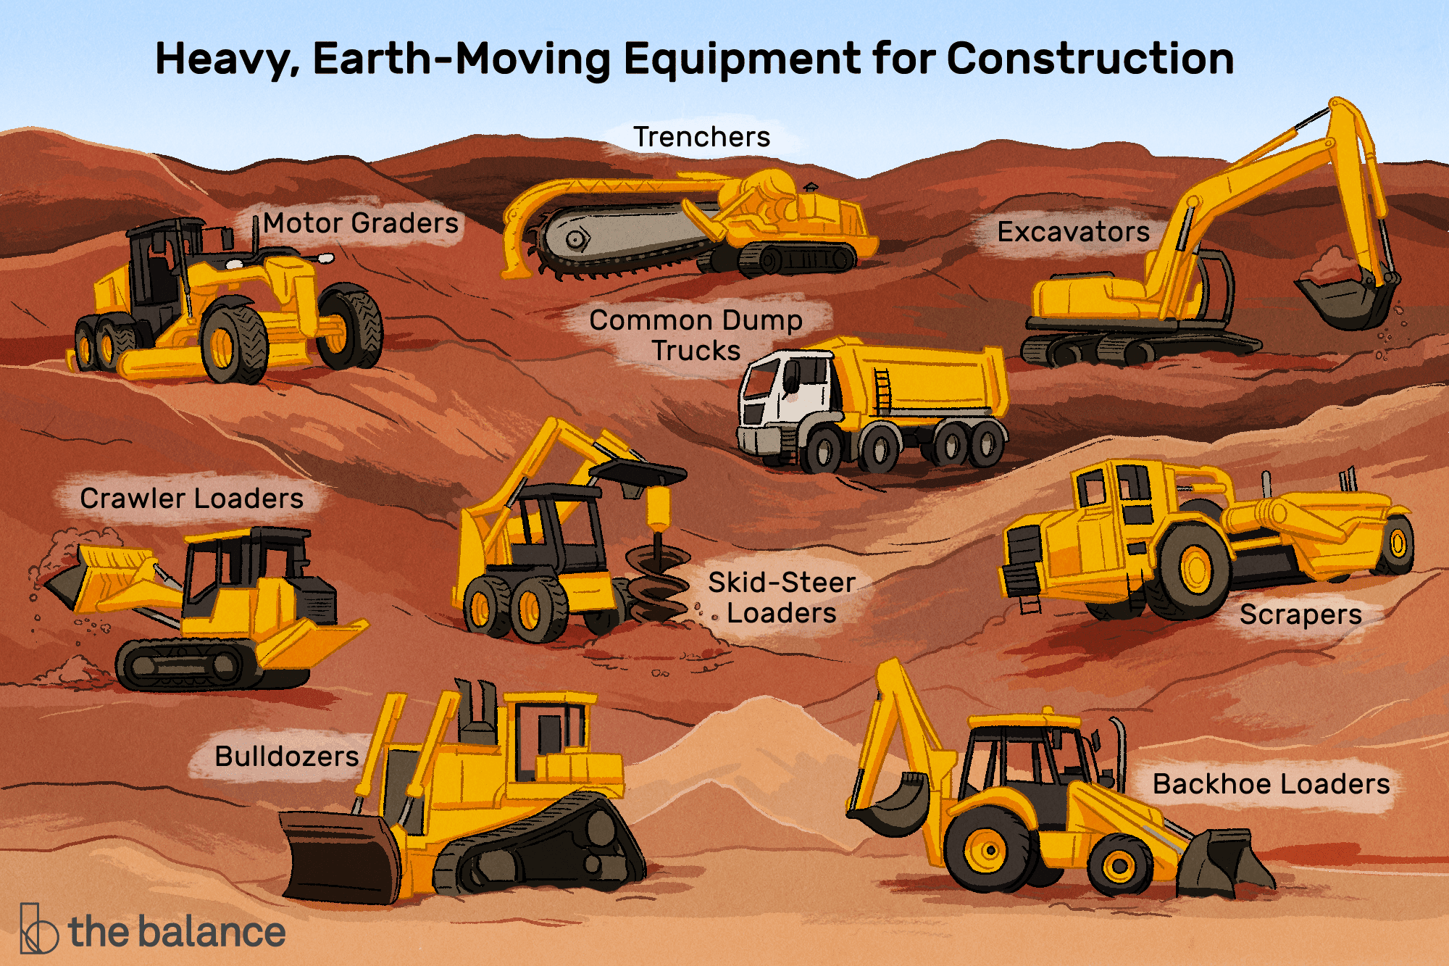

Slide 22
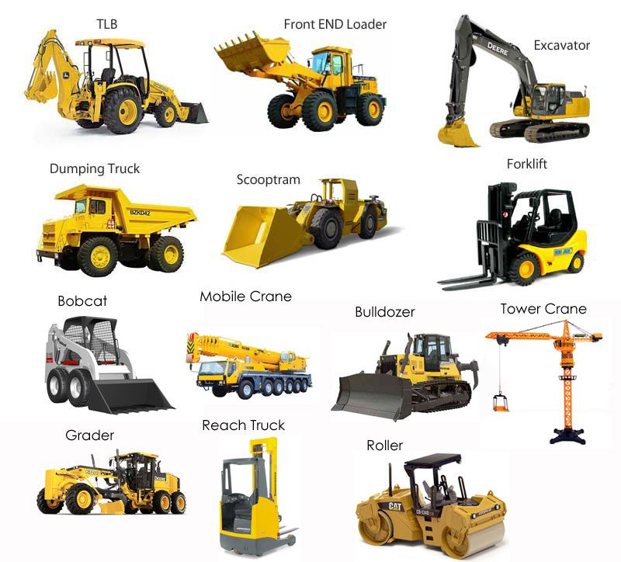

Slide 23
Plant and Equipment
Table below, shows the plant and equipment required and the position of the company
as regards availability.
Plant and equipment requirement
S/N | Description | Quantity | Available | Add Reqt
1. | Crusher plant | 1 | 1
2 | Asphalt production plant | 1 | 1
3 | Concrete batching pant | 1 | 1
4 | Pile driver | 1 | 1
5 | Bulldozer - D8 | 1 | 1
6 | Buldozer - D6 | 4 | 3 | 1
7 | Wheel loader - 980 | 1 | 1
8 | Wheel loader - 966 | 5 | 3 | 2
9 | Track excavator | 4 | 2 | 2
10 | Wheel excavator | 2 | 1 | 1

Slide 24
S/N | Description | Quantity | Available | Add Reqt
11. | Backhoe loader | 2 | 1
12 | Scraper | 1 | 2
13 | Soil compactor | 2 | 1 | 1
14 | Sheepfoot roller | 2 | 2 | 2
15 | Motor grader | 4 | 3 | 2
16 | Vibro roller | 5 | 2 | 2
17 | Steel roller | 4 | 2
18 | Pnematric roller | 2 | 2 | 2
19 | Paver | 2 | 2 | 2
20 | Small compactor | 2 | 2 | 1
21 | Plate vabrator | 2 | 2
22 | Front dumper | 2 | 2
23 | Prime tanker | 2 | 2
24 | Water tanker | 6 | 2 | 4
25 | Tipping trailer - 40 tons | 15 | 10 | 5
26 | Tipper - 25 tons | 25 | 15 | 10
27 | Mixer lorry | 3 | 2 | 1
28 | 25 ton crane | 2 | 1 | 1
29 | Tower crane | 2 | 1 | 1
30 | Pick up | 30 | 20 | 10

Slide 25
: Planned purpose of Equipment - Equipment Allocation to Work Groups
Group No. | Description | Equipment | Scope of Work | Equipment Role
1 | Earthmoving | Dozer D81 | Site clearance only | The dozer to clear site and push materials aside
2 | Concrete | Track excavator - TX2 Wheel excavator - WX2 Front dumper - FD2 Lorry mixer - LR2 | Culverts | The excavators to carry out the excavation for concrete works. (Track for difficult terrain and wheel for other terrain). The Front dumper to help convey concrete to dump location. Lorry mixer to transport ready mixer concrete to site
3a | Earthmoving | Dozer - D3 Soil compactor - SC3 Motor grader - MG3 Vibro roller - VR3 Water tanker - WT3 | Scarificaton | Dozer to rip the existing asphalt surface at change of sections. Soil compactor to “grind” the ripped asphalt material and pulverize. Motor grader to grade the pulverized road Vibro roller to compact the graded road. Water Tanker to wet the surface.

Slide 26
Group No. | Description | Equipment | Scope of Work | Equipment Role
3b | Earthmoving | Dozer - D3 x 2 Track excavator - TX3 Scaper - SCR3b Vibro roller - VR3 Wheel loader - WL3x2 Sheepfoot roller - SF3 Motor grader - MG3 + MGb Water tanker - WT3 Tippers - 8 nos | *Removal of *Unsuitable *Sand Filling *Cut of Spoil *Cut of fill *Borrow to fill *Sub base *Shoulder Base | Removal of unsuitable and cut to spoil: Track excavator to load the tippers direct. Spoil distance at approximate 2km Sand Filling: dozer to spread, tippers to haul, rollers to compact. Cut to fill: dozer to push scraper, scraper to load and haul, spread and rollers to compact. Other fill: dozer and wheel loader at the borrow pit, to excavate and load, tippers to haul, grader to spead, rollers to compact.
4 | Eathmoving | Dozer - D4 x 2 Track excavator - TX4 Wheel loader - WL4x2 Soil compactor - SC4 Vibro roller - VR4 Sheepfoot roller - SF4 Motor grader - MG4 Water taker - WT4 Tippers - 8 nos | *Removal of *Usuitable *Sand Filling *Cut to fill *Borrow to fill | Removal of unsuitable and cut to spoil. Track excavator to load the tippers direct. Spoil distance at approximate 2km. Sand filling: dozer to spread, tippers to haul, rollers to compact. Cut to fill: dozer cut, wheel loader to load, tippers to haul, Grader to spread and rollers to compact. Other fill: dozer and wheel loader at the borrow pit, to excavate and load, tippers to haul,grader to spread, rollers to compact. Water tanker to wet surface for all cases.

Slide 27
Group No. | Description | Equipment | Scope of Work | Equipment Role
5 | Stone base prime and blind, cement stab and Patch Pothholes | Paver - PV5 Pneumatic roller - PR5 Steel roller - SR5 Vibro roller - VB5 Tipping trailers - 10 nos Prime taker - PT5 Zeppeling with brush ZB5 Pulverzer - PV5 Grader - MG5 Water tanker. | *Crushed stone base course *Cement stabilisation *Patch potholes *Prime and blind | Crushed stone base course: Trailers to haul Paver to lay, roller to compact, prime tanker to spray MC1 Cement stabilisation: Cement to be spread manually and with Grader Pulverizer to mix cement and sand Grade to spread Rollers to compact Water tanker to cure Patch Potholes: Excavator to excavate asphalt after cutting with cutting machine. Asphalt placing, manual/with grader/paver then roller to compact.
6 | Earthmoving | Dozer - D6 Wheel excavator - WX6 Scraper - SR6 Wheel loader - WL6 Soil compactor - SC3 Sheepfoot roller - SF6 Motor grader - MG6 x 2 Water tanker - WT6 Tippers - 8 nos | *Cut to spoil *Cut to fill Borrow to fill | Cut to spoil: Track excavator to load the Tippers direct. Spoil distance at approximate 2km. Sand filling: Dozer to spread, Tippers t haul, rollers to compact. Cut to fill: Dozer to push scraper to load, haul, spread and rollers to compact. Other fill: Dozer and wheel loader at the borrow pit, to excavate and load, tippers to haul, grader to spread, rollers to compact. Water tanker to wet surface for all cases.

Slide 28
Group No. | Description | Equipment | Scope of Work | Equipment Role
7 | Concrete | Dozer - D4 x 2 Wheel excavator -WX7 Backhoe loader - BH7 Front dumper - FD7 Lorry mixer - LR7 | *U-channel *Trapezoidal drain *Kerbstone *Chutes Stonepitching | The excavator and backhoe loader to carry out the excavation for concrete works. The Front dumper to help convey concrete to dump location. Lorry mixer to transport ready mixed concrete to site
8 | Asphalt | Paver - PV8 Pnematic roller - PR8 Steel roller - SR8 Prime tanker - PT8 Zeppelin with brush - ZB8 Tipping trailers - TR8. | * Asphalt regulating Course * Asphalt binder course * Asphalt wearing course *Shoulder surface dressing | Asphalt works: Tripping trailers to haul Zeppeling with brush to sweep Prime tanker to spray Tack coat Paver to lay asphalt Roller to roll and compact. Surface dressing: Prime tanker to spray S125. Trailer to haul and spread chipping with split spreader.
9 | Bridge | Crane - CR9 Lorry mixer - LR9 Concrete pump - CP9 Pile driver - PD9 Dozer - D9 Wheel loader - WL9 Track excavator - TX9 Vibro roller - VR9 Rammax compactor - SF9 Tippers - T9 x 2 | For Bridge work | For clearing, piling, concrete works
27

Slide 29
Group No. | Description | Equipment | Scope of Work | Equipment Role
10 | Concrete | Slipform paver (GOMACO) G10 Lorry Mixer - LR10X2 | For median seperator (Crash barrier) | Laying of insitu concrete median seperator (concrete crash barrier) using the slipform paver (GOMACO) fed by the lorry mixer.

Slide 30
Standand Productivity of Machinery
Work item and unit | Bush clearance & topsoil | Site clearance | Scarify Asphalt | Scarify Ground | Filling | Excavation | Cut | Shape & grade | Asphalt | Concrete | Aggregate
Equipment | m2/hr | m2/hr | m2/hr | m2/hr | m3/hr | m3/hr | m3/hr | m2/hr | Tons/hr | m3/hr | Tons/hr
Bulldozer D8 | 800 | 1000 | 200 |  |  |  | 170
Bulldozer D6 |  |  |  |  | 160 |  | 150
Motor grader 14G |  | 600 |  | 500 |  |  |  | 400
Scraper 730E |  |  |  |  | 70 |  | 70
Excavator 345 |  |  |  |  |  | 60 | 80
Wheel loader 966G |  |  |  |  | 180
Asphalt plant -marini |  |  |  |  |  |  |  |  | 100
Soil compactor 825G |  |  | 200
Sheepfoot roller/Compactor |  |  |  |  | 60
Vibro roller B212D |  |  |  |  | 80
Concrete mixing plant - ELBA |  |  |  |  |  |  |  |  |  | 30
Crusher - Kawasaki jaw crusher |  |  |  |  |  |  |  |  |  |  | 100
Paver Titan 411 |  |  |  |  |  |  |  |  |  | 150

Slide 31
HIRING RATES
EQUIPMENT AND DIESEL RATES (THRID PARTY CONTRACT)
S/N | EQUIPMENTS | HIRE RATE | DIESEL CONSUMPTION | LOWBED | OPERATOR RATE | TOTAL AMOUNT
1 | 14 G GRADER | 80,000.00 | 39,000.00 | 60,000.00 | 8,000.00 | 187,000.00
2 | PAYLOADER 950 | 70,000.00 | 26,000.00 | 60,000.00 | 8,000.00 | 164,000.00
3 | EXCAVATOR 320 | 85,000.00 | 39,000.00 | 70,000.00 | 8,000.00 | 202,000.00
4 | EXCAVATOR 330 | 95,000.00 | 39,000.00 | 70,000.00 | 8,000.00 | 212,000.00
5 | DOZER D8 | 95,000.00 | 52,000.00 | 70,000.00 | 8,000.00 | 225,000.00
6 | SMOOTH ROLLER | 60,000.00 | 13,000.00 | 60,000.00 | 8,000.00 | 141,000.00
7 | SHEEP FOOT ROLLER | 80,000.00 | 13,000.00 | 60,000.00 | 8,000.00 | 161,000.00
8 | PNEUMATIC ROLLER | 80,000.00 | 13,000.00 | 60,000.00 | 8,000.00 | 161,000.00
9 | STANDARD PAVER | 125,000.00 | 26,000.00 | 60,000.00 | 8,000.00 | 219,000.00
10 | BACKHOE | 55,000.00 | 26,000.00 | 60,000.00 | 8,000.00 | 149,000.00
11 | WATER TANKER | LS | LS | LS | LS | 40,000.00
12 | TAR BOILER | LS | LS | LS | LS | 100,000.00

Slide 32
S/N | EQUIPMENTS | HIRE RATE | DIESEL CONSUMPTION | LOWBED | OPERATOR RATE | TOTAL AMOUNT
13 | TIPPER | LS | LS | LS | LS | 50,000.00
14 | PORTABLE HAND ROLLER | LS | LS | LS | LS | 25,000.00
15 | HIAB | LS | LS | LS | LS | 50,000.00
16 | CUTTING MACHINE | LS | LS | LS | LS | 30,000.00
17 | COMPRESSOR JACK HAMMER | LS | LS | LS | LS | 60,000.00
18 | HAND PLATE COMPACTOR | LS | LS | LS | LS | 10,000.00

Slide 33
Labour
This constitute team members or workers and contingent staff with different skill sets and the
form backbone of any project
Labour output
Manpower constant is the quantity of work that can be done by one person in one day (8 working
hours) considering of safety and quality measures
The quantity of work done by one person divided in total quantity of construction activity gives
number of workers required to finish that activity.

Slide 34
LABOUR
Some output constants of Civil Engineering works are given below:
S/N | Description | Unit | Labour in days (8 working hrs) (Operators + Helpers)
1 | Bush clearing | HA | 100Hr/HA
2 | Scarification | m2 | 0.07Hr/Sq.m
3 | Removal of unsuitable materials | m3 | 0.16Hr/Cub.m
4 | Cut to spoil | m3 | 0.18Hr/Cub.m
5 | Cut to fill | m3 | 0.23Hr/Cub.m
6 | Burrow to fill | m3 | 0.2Hr/Cub.m
7 | Sand filling | m3 | 0.38Hr/Cub.m
8 | Topsoil and Grassing | m2 | 0.07Hr/Sq.m
9 | Drainage Excavation and backfill for culverts and drains | m3 | 1.83HA/Cub.m
10 | Dia. 900mm concrete pipe culvert | Lin.m | 17.50Hr//Lin.m
11 | RC box culvert and pipe culvert end walls (concrete + Reinforcement + Formwork) | m3 | 8.83Hr/Cub.m
12 | Median separator | Lin.m | 2.40Hr/Lin.m

Slide 35
S/N | Description | Unit | Labour in days (8 working hrs) (Operators + Helpers)
13 | Trapezoidal drain | Lin.m | 2.90Hr/Lin.m
14 | Precast concrete U-Channel | Lin.m | 6.14Hr/Lin.m
15 | Kerb stones | Lin.m | 3.0Hr/Lin.m
16 | Chutes | Lin.m | 3.0Hr/Lin.m
17 | Drain cover slab | Lin.m | 6.48Hr/Lin.m
18 | Store pitching | Sq.m | 0.08Hr/Sq.m
19 | Laterite sub base | m3 | 0.24Hr/Cub.m
20 | Laterite Shoulder base | m2 | 0.24Hr/Cub.m
21 | Sand/Cement stabilization | m3 | 0.77Hr/Cub.m
22 | 150mm crushed stone base course | m3 | 1.50Hr/Cub.m
23 | Prime and Sand | m3 | 0.036Hr/Sq.m
24 | 600mm Asphaltic binder | m2 | 0.09Hr/Sq.m
25 | 40mm Asphaltic wearing course | m2 | 0.07Hr/Sq.m
26 | Patching of Portholes | m2 | 4.17Hr/Sq.m

Slide 36
S/N | Description | Unit | Labour in days (8 working hrs) (Operators + Helpers)
27 | Surface dressing of shoulders | m2 | 0.02Hr/Sq.m
28 | Asphalt regulating course (wearing) | m2 | 0.47Hr/Sq.m
29 | KM Posts | Nr | 32Hr/Nr
30 | Bridge 350mm Sq Precast concrete piles | Lin.m | 24.40Hr/Lin.m
31 | Concrete blinding to pile caps | m3 | 3.0Hr/Cub.m
32 | Concrete grade 30 to pile caps and foundations | m3 | 1.2Hr/Cub.m
33 | Concrete grade 30 to abutment and piers | m3 | 11.72Hr/Cub.m
34 | Formwork to pile cap and foundations | m2 | 2.8Hr/Sq.m
35 | Formwork to abutment and piers | m2 | 9.31Hr/Sq.m
36 | Reinforcement to pile caps and foundation | ton | 213Hr/ton
37 | Weep holes | No | 2.0Hr/No
38 | UPVC drainage pipes | Lin.m | 1.67Hr/Lin.m
39 | Service ducts | Lin.m | 1.0Hr/Lin.m
40 | Precast concrete beams and filigram slabs | Cub.m | 22Hr/Cub.m

Slide 37
S/N | Description | Unit | Labour in days (8 working hrs) (Operators + Helpers)
41 | Insitu concrete to Deck slab, walkways and Transition slab | Cub.m | 1.45Hr/Cub.m
42 | Formwork to superstructure | Sq.m | 9.3Hr/Sq.m
43 | Reinforcement to superstructure | ton | 218Hr/ton
44 | Bearing | Nr | 129Hr/Nr
45 | Therma Expansion joint | Lin.m | 24Hr/Lin.m

Slide 38
MATERIALS SCHEDULE

Slide 39
MATERIAL SCHDULE
S/N | Description | Unit | Qty | Material Breakdown
1 | Bush Clearing | Ha | 130 | NIL
2 | Scarification | m2 | 20,000 | NIL
3 | Removal of Unsable Material | m3 | 100,000.00 | NIL
4 | Sand filling | m3 | 1m3 | 1.15 m3
5 | Concrete Grade 20 (1.2.4 mix) | m3 | 1m3 | - 6.3 Bags of Cement - 1.5 tons of Granite
6 | Concrete M20 (1: 1/2: 3 mix) | m3 | 1m3 | 8.2 bags, 0.86 m3 granite, 0.43m3 Sand
7 | Concrete M15 (1:2:4 mx) | m3 | 1m3 | 6.4 bags, 0.89m3 granite 0.45m3 Sand
8 | Concrete M10 (1:3:6 mix) | m3 | 1m3 | 4.5 bags, 0.95m3 granite, 0.48m3 Sand
9 | Concrete M5 (1:4:8 mix) | m3 | 1m3 | 2.7 bags, 0.76m3 granite, 0.38m3
10 | Formwork (one use) slab/beams/columns | m2 | 1m2 | Plywood/Plank - 1m2 2” x 3” x 12 - 2-4 planks Nail - 0.51bs
11 | Reinforcement | ton | 1 ton | 1.05 tons of Reinforcement 10kg of Binding wire
12 | Laterite Subbase/Shoulder base | m3 | 1 m3 | 1.15m3 of laterite
13 | Crush stone base course | m3 | 1 m3 | 1.05m3 of crushed stone base course

Slide 40
S/N | Description | Unit | Qty | Material Breakdown
13 | 40mm Asphalt wearing course | m2 | 1 ton | 0.08 - 0.96ton/m2
14 | Prime and Sand (MC1) (180 Litres/drum) 0.9L/m2 (Spraying rate) | m2 | 1m2 | 0.95/m2 MC1 0.007 ton of fine aggregate
15 | Surface dressing of shoulder (S 125 at 1.2L/m2) | m2 | 1m2 | 0.28 tons of granite 1.3 Litres/m2 of S125

Slide 41
Summary of work groups and schedule
Work group | Type | Start month | Location | End month | Remarks
01 | Earthmoving (Site clearance) | 03 | Existing road and new road | 04
02 | Concrete | 03 | Existing road and new road | 30
03 | Earthmoving (Scarification) | 04 | Existing road | 05
3b | Earthmoving (Cut to spoil/fill etc) | 04 | New road | 08 | The disbanded
04 | Earthmoving | 05 | Existing road and new road | 20 | Reduced strength between months 9 - 15
05 | Earthmoving (Cut to spoil/fill etc) | 06 | New road | 28 | Expanded group 03
06 | Stone base | 07 | Existing road and new road | 24
07 | Asphalt | 12 | Existing road and new road | 29
08 | Concrete | 16 | Existing road and new road | 30
09 | Bridge | 04 | New road | 20 | Reduced strength between 9 - 15

Slide 42
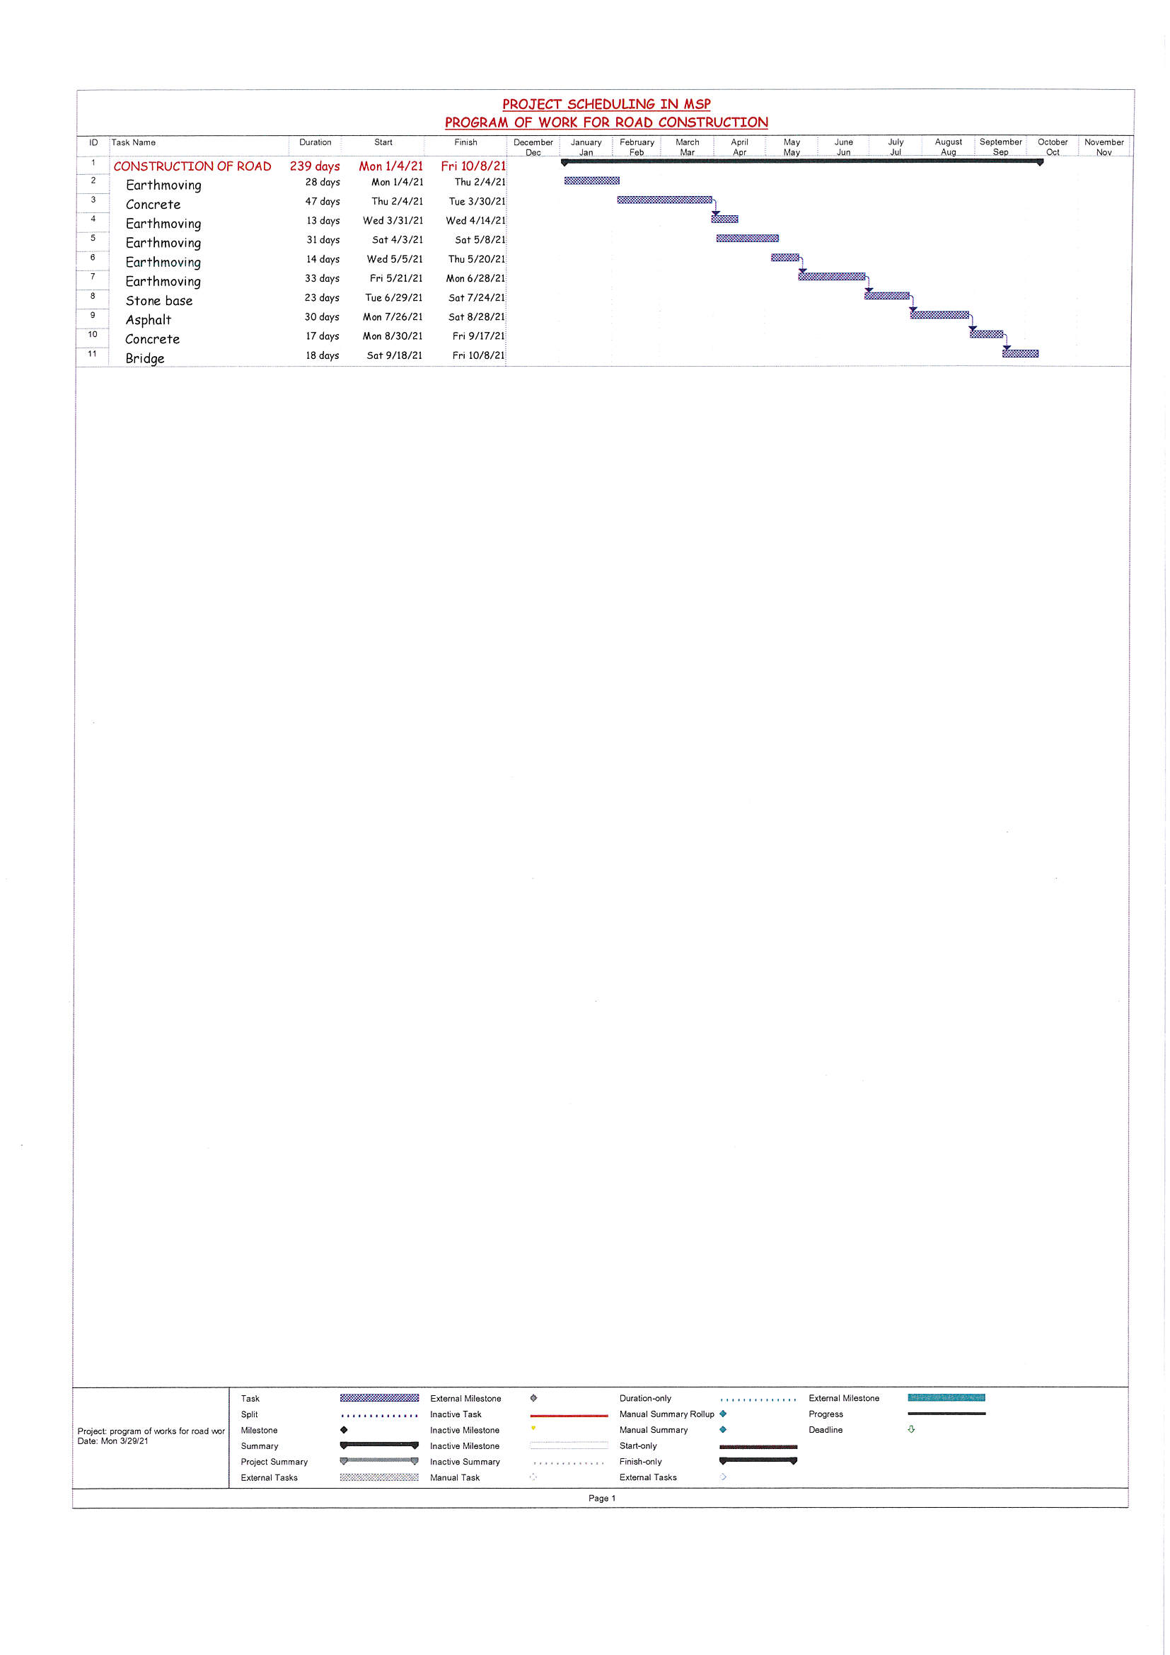

Slide 43
COST ESTIMATION
Unit Cost Estimating Method
Project Estimate
A. Direct Cost (Quantity dependent Costs)
i. Labour
ii. Equipment/Plant
iii. Fuel & Lubricants Net Cost
iv. Materials
v. Subcontractor
B. Indirect Cost (time dependent costs)
1. Mobilization and demobilization
i. Transport to site of plant and Equipment
ii. Camp erection (living quarters etc)
iii. Site/Yard Installation
iv. Demolization

Slide 44
2. Running Cost
i. Rental Costs (Properties and Utilities)
ii. Camp Staff Cost (Running of Camp)
iii. Office Administration Staff and Security
iv. Drivers
v. Support Technical Staff
vi. Small Tools and Equipment
vii. Laboratory Consumables
viii. Office Expenses
3. Supervision Cost
i. Expatriate Personnel Requirement
ii. Local Senoir Staff
iii. Travel Cost for International Trips
iv. Travel Cost for Local Trips

Slide 45
4. Overhead and Profit
i. Insurance (All risk)
ii. Maintenance of Project for Contract Duration
iii. Financial Charges
iv Attendant to expenses incurred by the Client/Engineer (Client allow 2.5% as attendant cost. Extra Cost to be added to the Estimate)
v. Head Office Expenses
vi. Social Responsibility/Development Contribution
vii. Witholding Tax
viii. Profit/Risk.

Slide 46
CONCLUSION
The nature of the construction industry is unique in characterized by complex deloyment
pattern of resources resulting in risk and uncertainty inherent in every phase of the project life
cycle. In fact a state of the resource management is essential for a construction project to
succeed in fulfilling its project objectives. Allocation of resources for activities in necessary
in construction domain to complete the project within the scheduled time. Resource levelling
is needed in construction projects to avoid the difficulties associated with the large variations
in resource usage.

Slide 47
REFERENCES
ICM Contractor Inc - Benefits of Resource Scheduling
Mattews, Mark D - Resource Scheduling Incorporating Capacity into Schedule Construction
Resource Management - The Complete Guide to Resource Scheduling in Project Management.
Rhuta Joshi, Prof. V.Z
Patif - Resource Scheduling of Construction Project Care Study
Technological Institute of
the Philipines - Standard Productivity of Machinery
U.V. Ogogu - Estimating and Cost Control for Road Projects
Visual Planning - What is Resource Scheduling?
Visual Planning - Scheduling Software

