Slide 1

TASK SCHEDULING & COST:VALUE DETERMINANTS OF CONSTRUCTION PROJECT
NIQS 2021 TRAIN–THE- TRAINERS WORKSHOP
DR. JOSHUA OLORUNKIYA
PHD, MRICS,MNIQS, MCIOB,MNIOB, MCInstCES, Reg Qs, Reg Bldr.

Slide 2
KEY FACTS
If you were driving to a place you have never seen, you need to use a MAP or GPS as a guide to arrive safely and on time.
Project Management follows same methodology and purpose. To achieve each project goals, you need to plan them in advance.
Good project Management is NO LONGER AN OPTION in today’s corporate world. It is a critical tool to help your company stay on target and accomplish its goals.
Simply stated, Project Management is the process of achieving set goals within the constraint of TIME, BUDGET and STAFFING REQUIREMENTS.
The process of Project Management is guided by three (3) key principles PLANNING, CONTROLLING & MANAGING.

Slide 3
Planning Vs. Scheduling
Planning primarily involves selecting the appropriate policies, project methodologies, and procedures required to deliver the project on time.
Scheduling, on the other hand, converts the plans, scope, and cost into an operational timeline.

Slide 4
Why Task Scheduling?
Project scheduling, when done well, makes the entire project run more smoothly.
Committing to the project scheduling process at the beginning of your project will give you a clear picture of the requirements set before us.
It also gives us the chance to catch issues early and alert clients if a timeline isn’t feasible. Besides being good for us as project managers, project scheduling is good for the team.
Everyone knows what to expect and when. Everyone is being held accountable for the same due dates.
Other managers can allocate resources efficiently for the project, and they’ll be able to anticipate when resources will be available for other projects.

Slide 5
Eight Basic Steps of Tasks Scheduling
Plan Schedule Management
Define the Project Activities
Determine the Dependencies
Sequence Activities
Estimate Resources
Estimate Durations
Develop Project Schedule
Monitor & Control

Slide 6

Why Project Monitoring/Control?

Slide 7
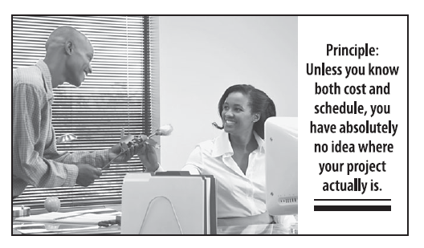
Fundamental Facts

Slide 8
Key Performance Indicators
Knowing cost allows you to figure out what is going on.
If the work is on schedule and fewer hours were required than estimated, then people are working more efficiently than expected.
If work is on schedule but more hours have been expended than planned, then this is a sign of trouble.
If the work is behind schedule and total hours more than planned, it means people are not doing what they are supposed to do.

Slide 9
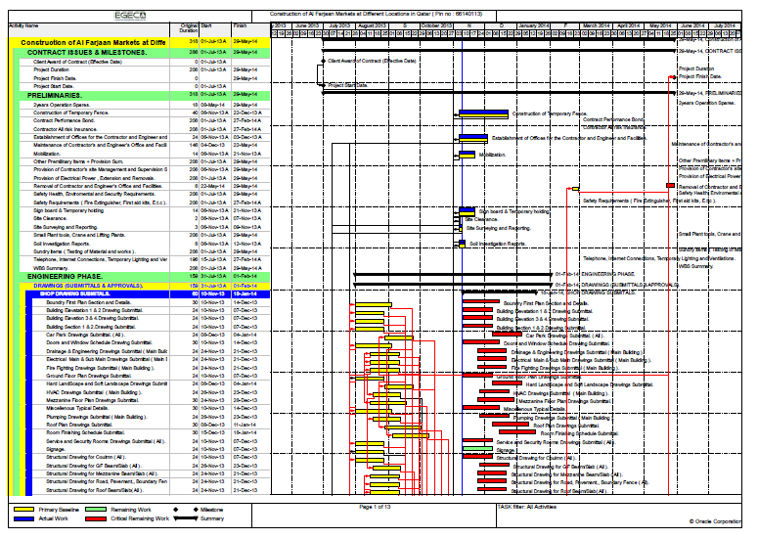

Slide 10
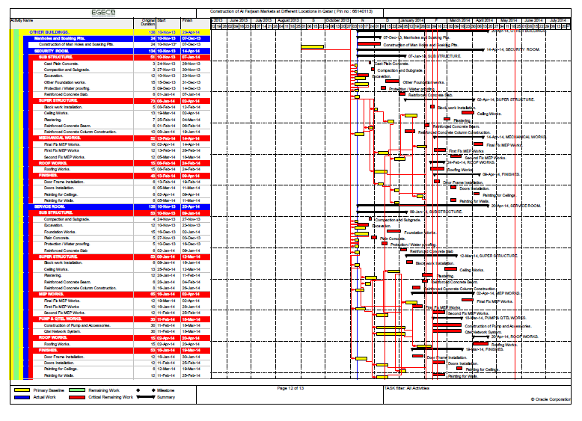

Slide 11
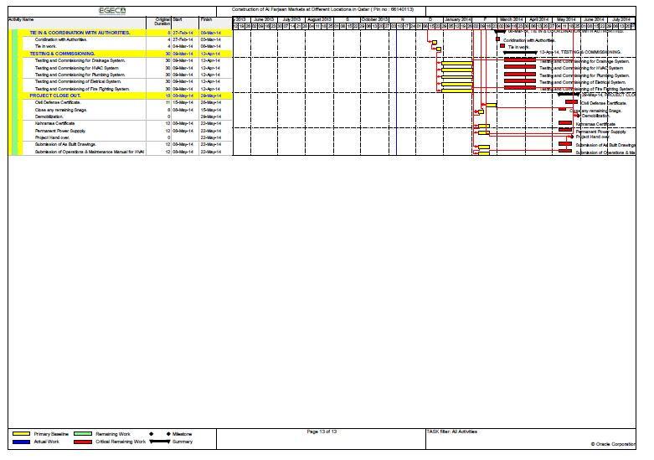
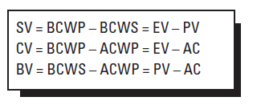
EARNED VALUE ANALYSIS FOMULARS

Slide 12
Primavera P6 –An Overview
Primavera P6 Professional Project Management is an integrated project portfolio management solution that enables project-driven businesses to achieve a competitive edge.
Primavera P6, the recognized standard for high-performance project management software, is designed to handle large-scale, highly sophisticated and multifaceted and multiple projects simultaneously. It can be used to organize projects up to 100,000 activities, and it provides unlimited resources and an unlimited number of target plans.
Primavera P6 is amazing software for anyone involved in planning, management and reporting of a project. Primavera P6 has benefited every industry from aerospace to manufacturing, electronics to IT, Telecom to Civil, and many more.

Slide 13
Some benefits of Primavera P6:
It optimizes management of all resources.
It gives clear visibility of what’s going on in the project.
It allows quick and easy forecasting of WBS’s, activities or projects.
Conducts what-if analysis and analyze alternative project plans
It facilitates Earned Value analysis with ease
It allows for on-the-spot tracking of work progress and view past period performance for reporting purposes.
The integrated risk management feature enables you to identify, categorize, and prioritize potential risks associated with specific work breakdown structure (WBS) elements and resources
It enables the creation of risk control plan, assign a probability of occurrence and an organizational breakdown structure (OBS) element to each risk
Allows for maintaining project’s document library

Slide 14
Structuring Project Using Primavera 6
Establishing Project Codes & Working with User-Defined Fields
Setting up EPS
Structuring Projects
Creating Calendars
Setting up OBS
Defining Resources & Roles
Defining Budget
Creating & Reviewing WBS

Slide 15
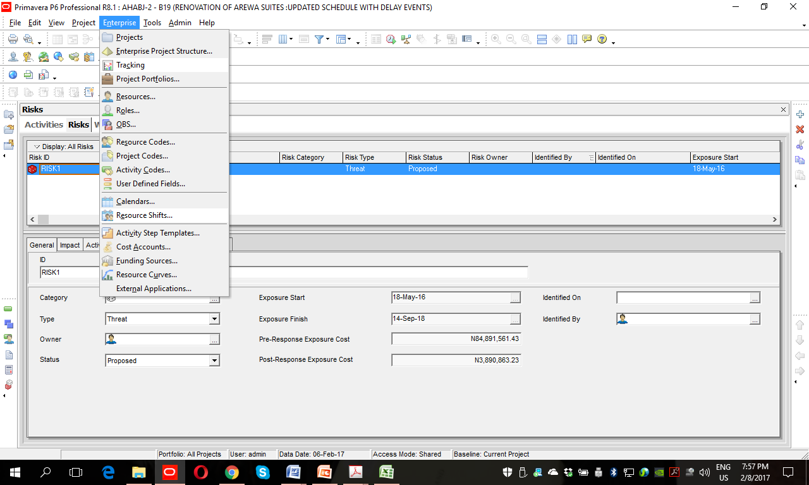
OVERVIEW OF THE ENTERPRISE MENU

Slide 16
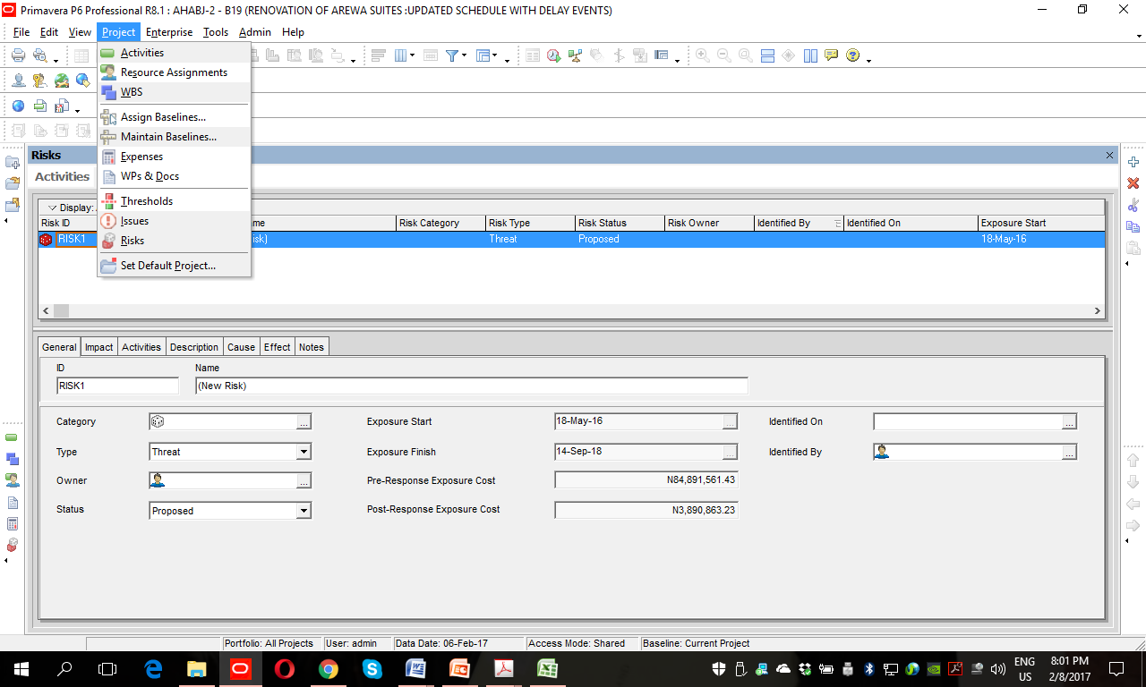
Overview of the Project Window Menu

Slide 17
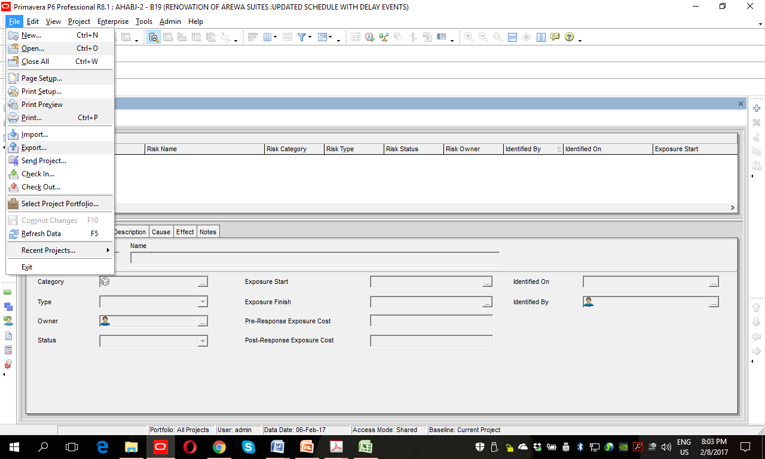

Slide 18
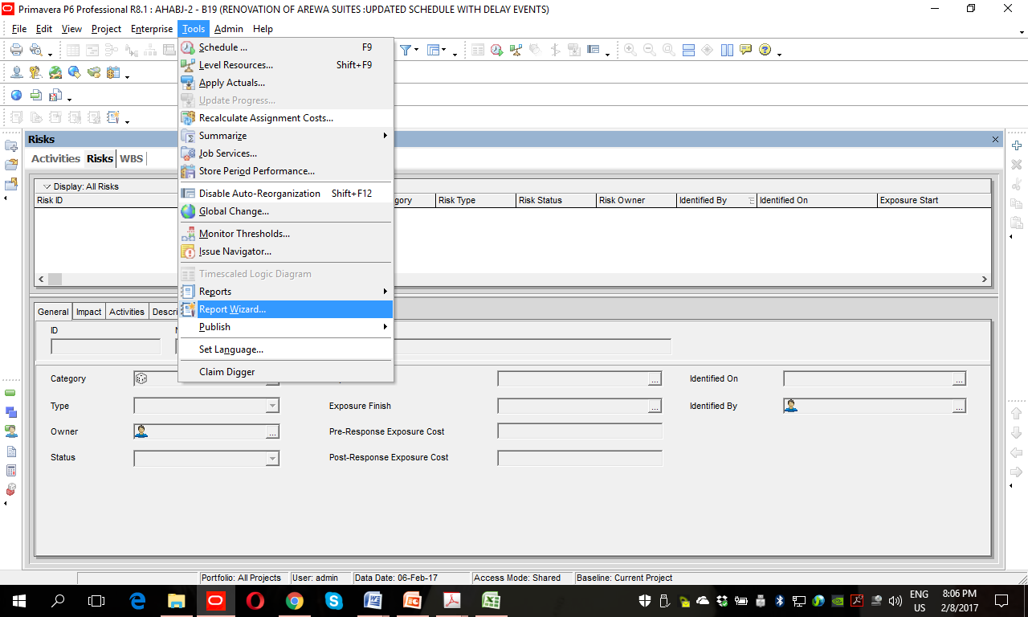
Overview of the Tools Menu

Slide 19
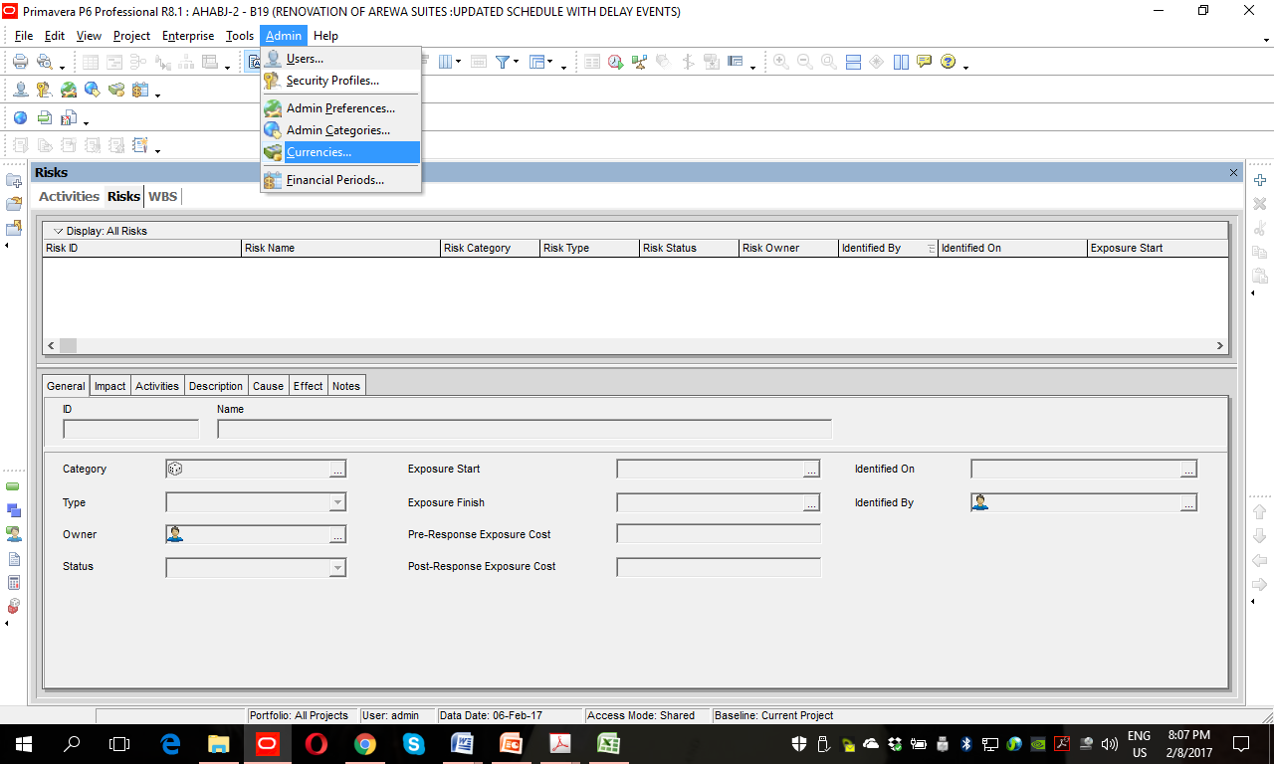

Slide 20
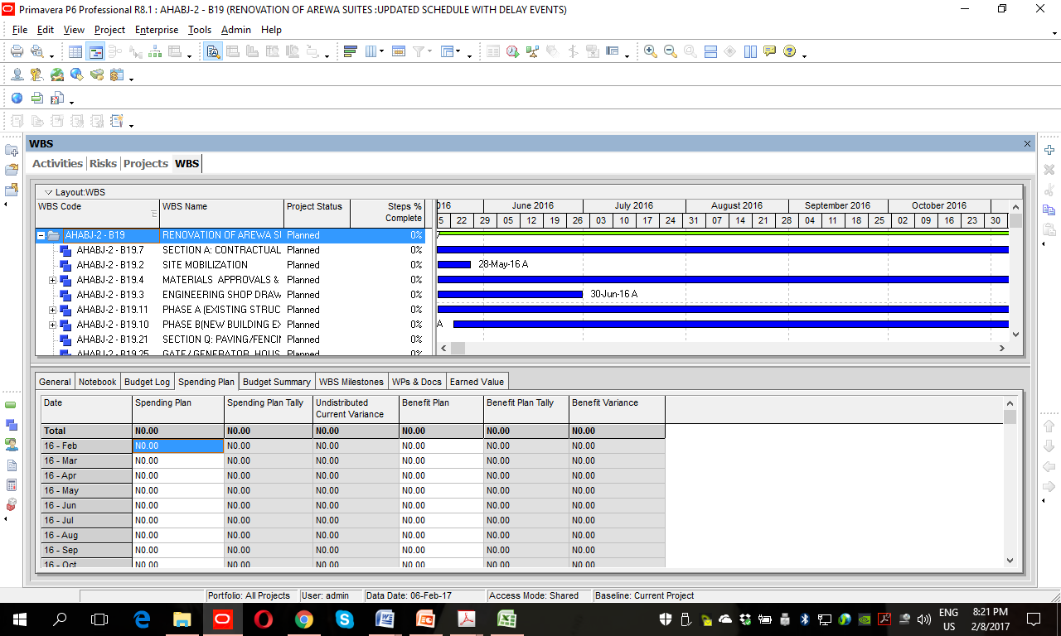
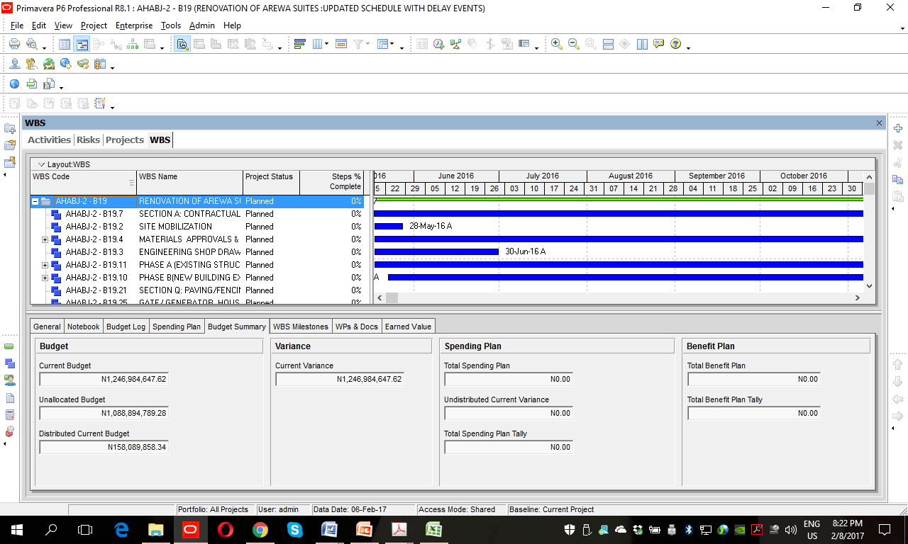
Creating Work Breakdown Structure

Slide 21
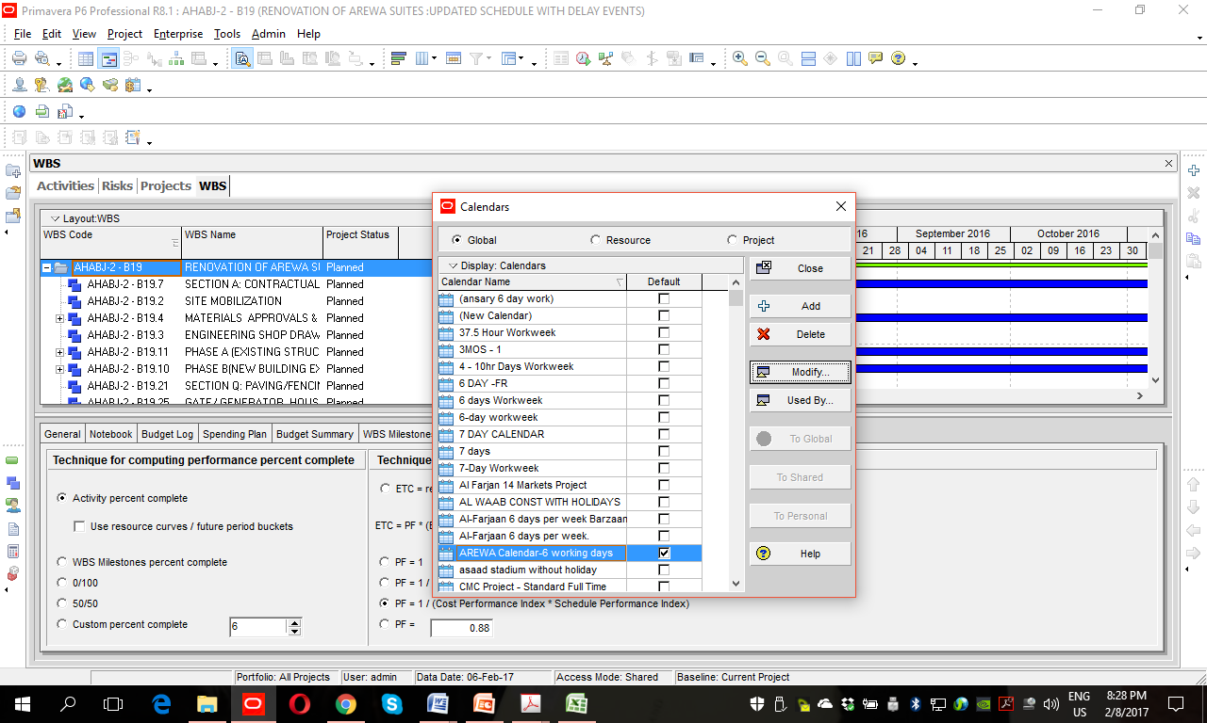
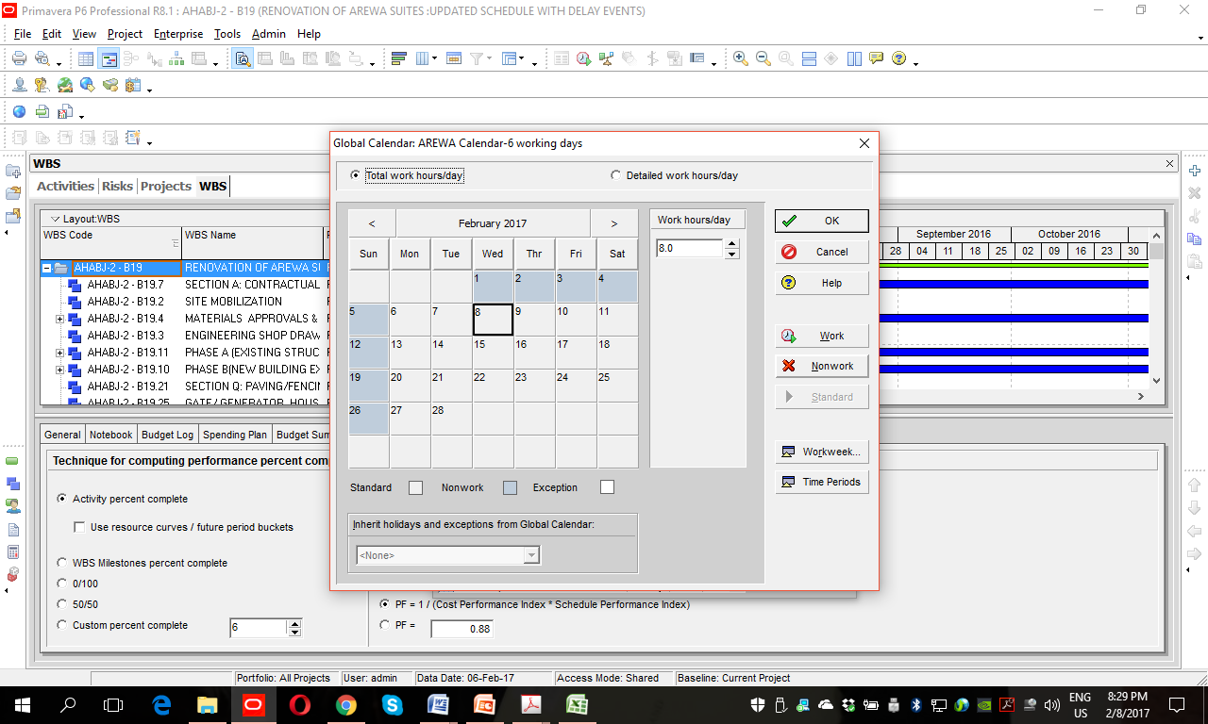
Creating Calendars

Slide 22
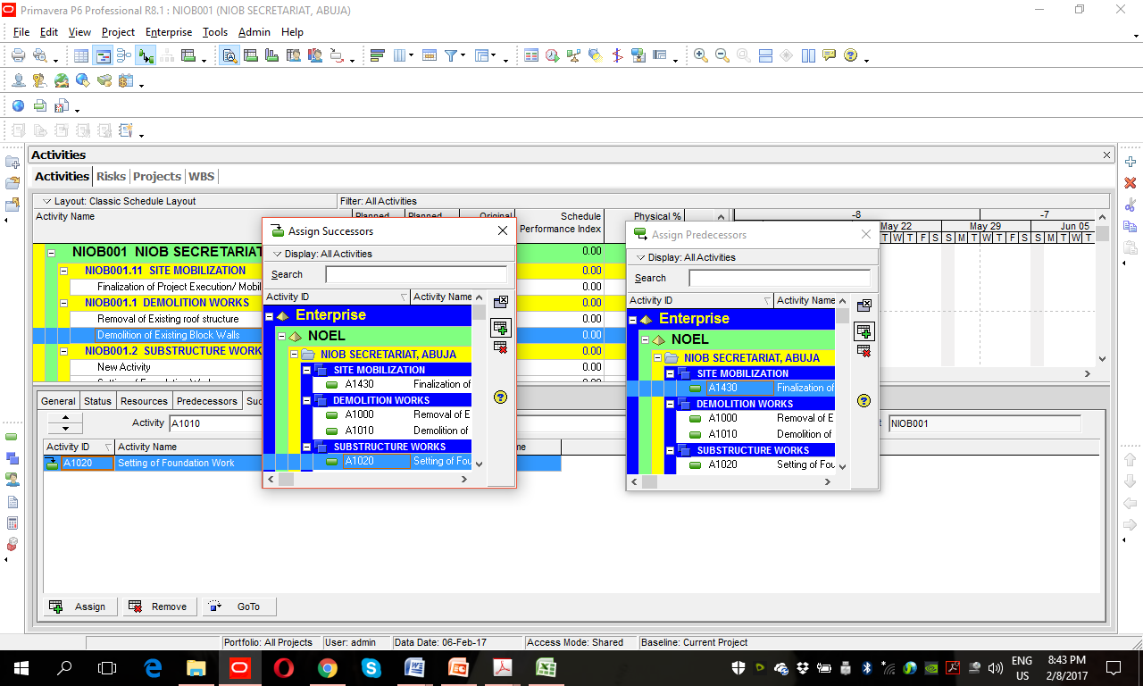
Establishing Activities Relationships

Slide 23
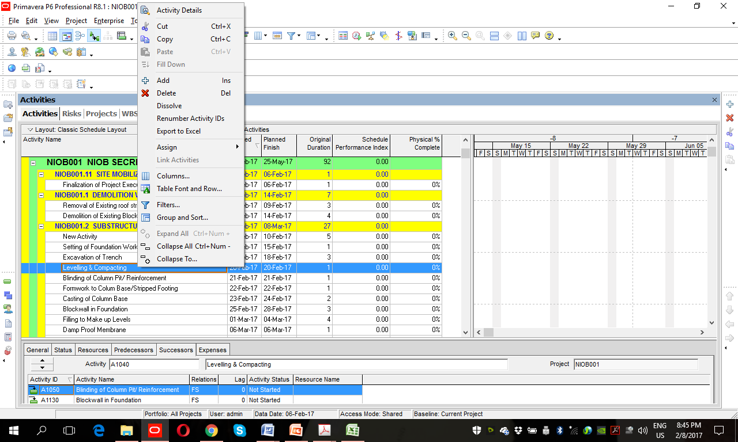
Dissolving or Deleting Activity

Slide 24
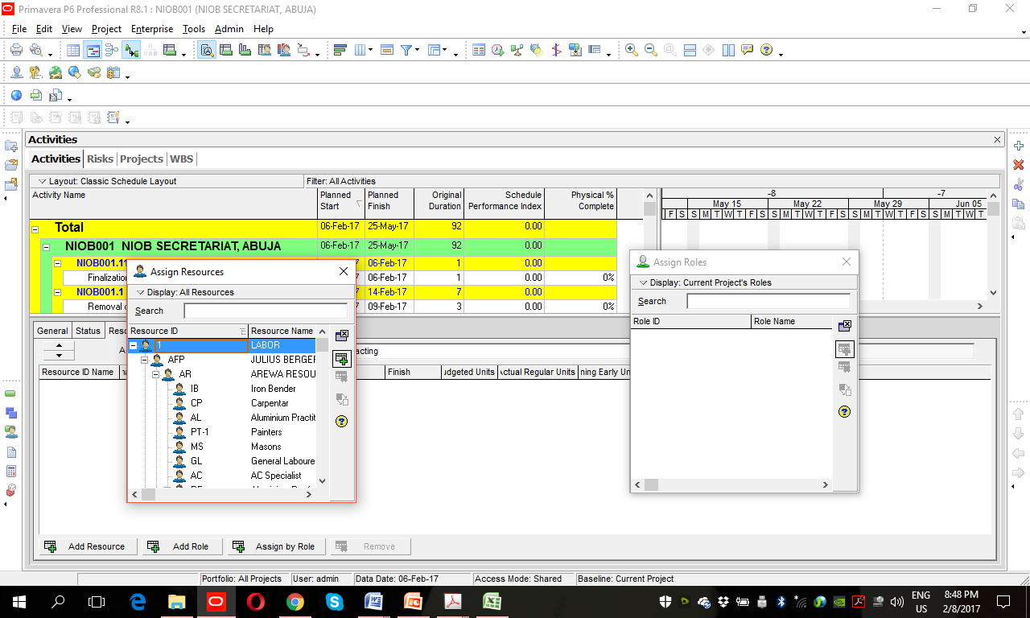
Assigning Resources & Role

Slide 25
For Enquiries on the Software Installation/Online Tutorials
Email: esthojconsults@gmail.com
Call/Sms/WhatsApp: 09051602999; 08140989555
Visit: WWW.ESTHOJ.COM

