Slide 1
IMPORTANCE OF RESOURCE SCHEDULE FOR INCLUSIVE DEVELOPMENT OF THE CONSTRUCTION INDUSTRY
Developing Schedule/Constants of Plant in Building and Civil Engineering Construction
BY
DR. RICHARD .A. KOLAWOLE

Slide 2
BACKGROUND
According to Okoye, Ngwu and Ugochukwu (2015) it is trying to draw reliable development projects or make exact quotes with no accessible constants. While Wood (1976) reasons that work or plant constants for setting up the expense of work in the Bills of Quantities need not be speculated, envisioned or thought.

Slide 3
Background Cont’d
It thus becomes indispensable for the construction professional not only to have a complete understanding of the necessary skills, but also to determine the ideal composition of each skill in order to accomplish a task at shorter duration and decreased expense and this can only be possible through the use technological standards for labour and plant generally given as constants (Okereke, 2002).

Slide 4
Background Cont’d
However, taking into account the distinctions of each building site as far as climatic conditions, social and social fluctuations in the degree of innovative and the nature of accessible machines and materials, it is suggested that each construction organization should establish its own standards (Okoye, Ngwu & Ugochukwu, 2015).

Slide 5
BENEFIT OF PLANT CONSTANTS
increase in individual and collective productivity of labour;
Objective tendering;
Rational use of available resources;
Adaptation of more progressive management techniques.

Slide 6
SOURCES OF SCHEDULES /CONSTANTS
Plant literature compilation
In-house data

Slide 7
KEY WORDS
Construction Plant Schedules/Constants – are a guide of productivity and may be expressed as a quantity of hours per unit (or minutes or days per unit) or unit per hour (or unit per minute or day).
Rating Factor -This is expressed as a percentage of the efficiency of representative operator, which indicates how efficient an operator is in comparison to some of his average fellow workers.
Construction Plants – refers to heavy machinery and equipment used during construction work i.e Excavators, Cranes, Dumper, Hoist etc

Slide 8
DEVELOPING IN - HOUSE SCHEDULE /CONSTANTS
Work Study
Is a generic term for those techniques particularly for method study and work measurement Work study techniques are: time study, motion study, fatigue study and method study. Since this paper is not interested in investing factors that affect the efficiency and economy of a situation being reviewed in order to effect improvement, but to establish standard time required to complete work I will be focusing on time study

Slide 9
Cont’d
Time Study – is a structured process of directly observing and measuring plant/labour output using a timing device (stop watch) to establish the time required for completion of the work. The main objective is to determine by direct observation of plant output in a specific task and hence establish the standard time.

Slide 10
Cont’d
In time study of Construction Plant, it may not be possible to study machine time solely because plant operation includes manual, mental and machine times
  Manual time involves three operations, i.e. handling of tools, machines and materials.
  Mental time denotes time taken by the worker for thinking over some operation
  Machine time refers to time taken by the plant in doing its share of work

Slide 11
TIME STUDY PROCEDURE AN OVERVIEW
Observe the process –your study begins by simply observing
Decide on the fixed beginning and ending point
Define action endpoint (EP) and terminal point (TP).
Endpoint of one action is beginning of next
Break the process into steps and determine their beginning and end point

Slide 12
Cont’d
Record your data
Number of observations will depend on
Accuracy desired
Confidence desired
Data variability
Note
Outliners are to be neglected

Slide 13
Sample: Time Study Record Sheet
Element | 1 | 2 | 3 | 4 | 5 | Average Observed Time
A
B
C
D
E

Slide 14
Analyse your data
Now that you have recorded all the times, it’s time to analyse them and do a little math to arrive at a determination of the average time for each step.
Adjust the observed time by rating factor to obtain normal time for each element
Add the suitable allowances to compensate for fatigue, personal needs, contingencies etc. to give standard time for each element.
Compute allowed time for the entire job by adding elemental standard times considering frequency of occurrence of each element.

Slide 15
Cont’d
Make a detailed job description describing the method for which the standard time is established.
Test and review standards wherever necessary.

Slide 16
ILLUSTRATION
Developing output of a Concrete mixer of 200 litres capacity per day
Assuming that the average observed time for batching material into a Concrete Mixer is 2.30mins with a rating of 120% .allowance of 10% is allowed for the operation. The observed time for adding water and mixing in the drum is 1min and observed time for discharge is 1/2min. what is the Mixer output?
Solution
Observed Time = 2.30mins
Rating = 120%
Allowance = 10%

Slide 17
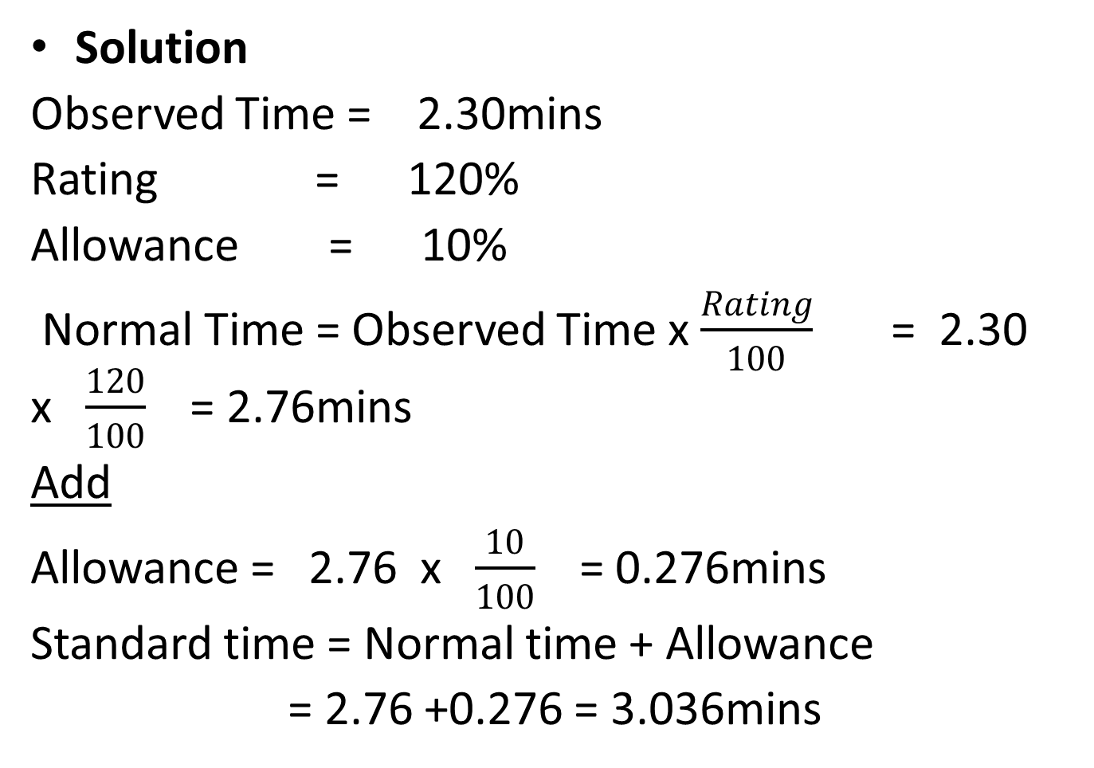
cont’d
Solution
Observed Time = 2.30mins
Rating = 120%
Allowance = 10%
Normal Time = Observed Time x $\frac{Rating}{100}$ = 2.30 x$\frac{120}{100}$ = 2.76mins
Add
Allowance = 2.76 x$\frac{10}{100}$ = 0.276mins
Standard time = Normal time + Allowance
= 2.76 +0.276 = 3.036mins

Slide 18
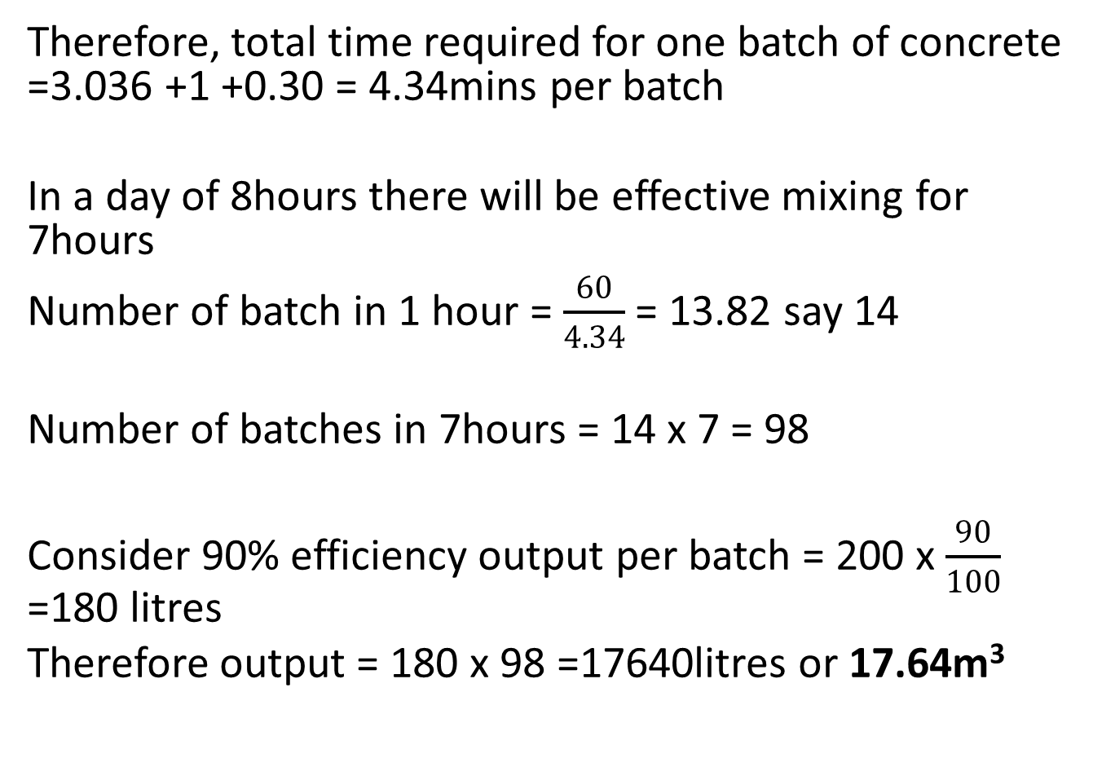
Cont’d
Therefore, total time required for one batch of concrete =3.036 +1 +0.30 = 4.34mins per batch
In a day of 8hours there will be effective mixing for 7hours
Number of batch in 1 hour = $\frac{60}{4.34}$ = 13.82 say 14
Number of batches in 7hours = 14 x 7 = 98
Consider 90% efficiency output per batch = 200 x $\frac{90}{100}$ =180 litres
Therefore output = 180 x 98 =17640litres or 17.64m³

Slide 19
THANK YOU
FOR
LISTENING

